Slide 1
A study of opportunities for AI to assist humans with their design activities
Design as a process in the large combines activities ranging from those that build on intuition to those that are highly mechanical. Automation has traditionally taken an important role in alleviation some of the more menial operations. Artificial Intelligence holds great promise in also assisting the user with their more creative operations or even taking over some of those entirely. Instead of focusing on an exclusively computational design process, this presentation takes the perspective of human activities in design in an attempt to highlight symbiotic opportunity for combined human/artificial intelligence. A Create, Organize, Refine, Evaluate (CORE) framework is utilized to identify a range of design activities and to provide inspiration for symbiotic support by presenting concrete illustrations of the various activities.

Slide 2
A study of opportunities for AI to assist humans with their design activities
Pieter J. Mosterman
Advanced Research & Technology Office
MathWorks

Slide 3
Motivation—Human centered perspective
Computational methods where possible
Not a panacea
Assist
Enhance user experience
Create efficiencies
Reduce learning need
Enable humans to easily
Correct automation failure
Cover the ‘20%’ that cannot be automated

Slide 4
Agenda
Introduction of a running example
Pick and place machine
Illustrations of design activities in the CORE framework
Create
Organize
Refine
Evaluate
Discussion of opportunities for computational support
Automation
AI performed
AI assisted

Slide 5
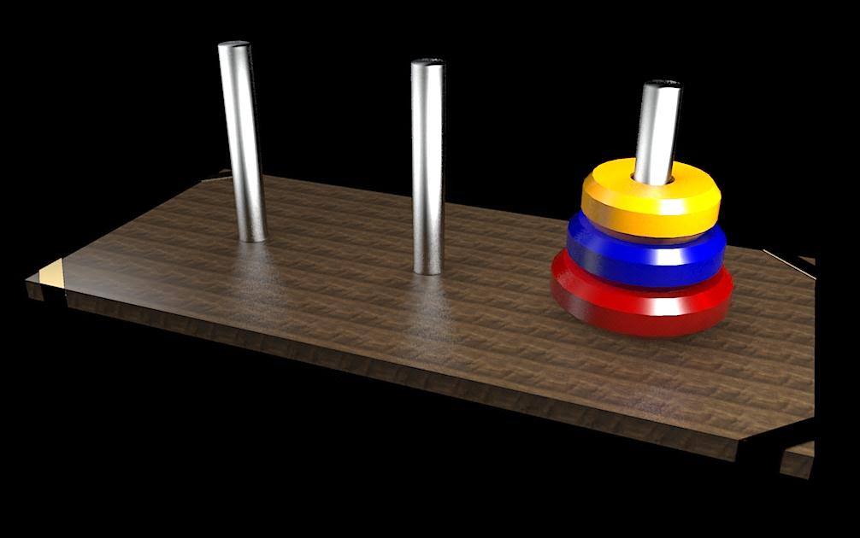
Towers of Hanoi

Slide 6
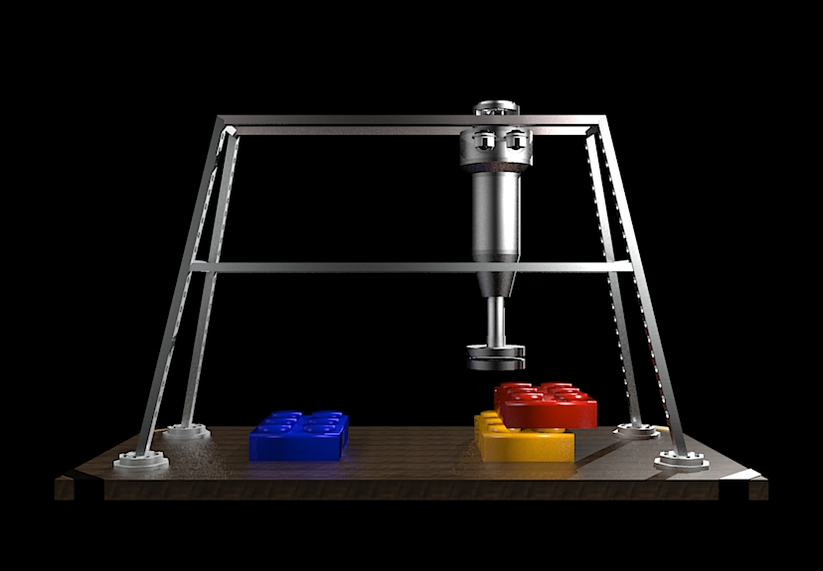

Slide 7
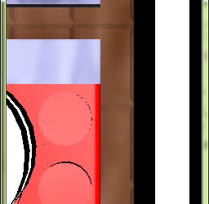
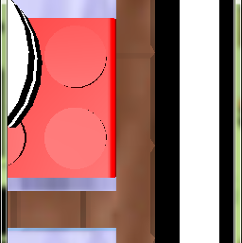

Slide 8
slider motor
slider
rails
gravity
nozzle motor
air pump
nozzle
block R
block B
block G

Slide 9
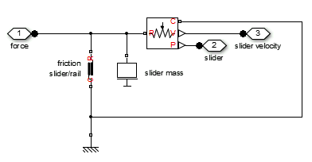
R
I

Slide 10
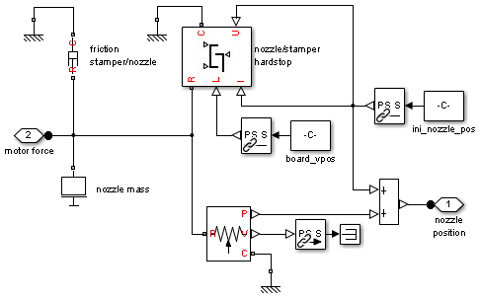
R
R,C
I

Slide 11
air pump
R,C
R,C
R,C

Slide 13
Agenda
Introduction of a running example
Pick and place machine
Illustrations of design activities in the CORE framework
Create
Organize
Refine
Evaluate
Discussion of opportunities for computational support
Automation
AI performed
AI assisted

Slide 14
Design activities
CREATE
ORGANIZE
REFINE
EVALUATE
C
O
R
E

Slide 15
Construct
Understand what you want to to do
Get inspiration as to what might solve your problem
Create semantic elements and computational representations
Quickly try out solution approaches
Cut across structural boundaries
Access any variable anywhere
Investigate technology options as principled solutions
Find solutions, parameter values
Use standardized (well developed) methods
Inspire
Extract
CREATE
Solve
C
Experiment

Slide 16
Construct
Making connections quickly
CREATE
C

Slide 17
Construct
Inserting blocks and laying them out quickly
CREATE
C

Slide 18
Construct
Inspire
CREATE
C

Slide 19
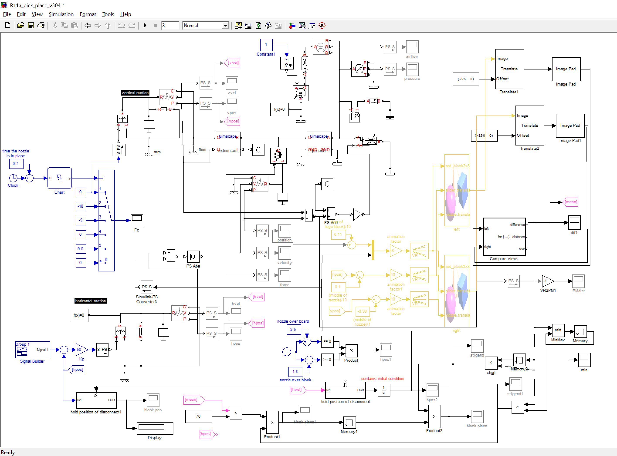
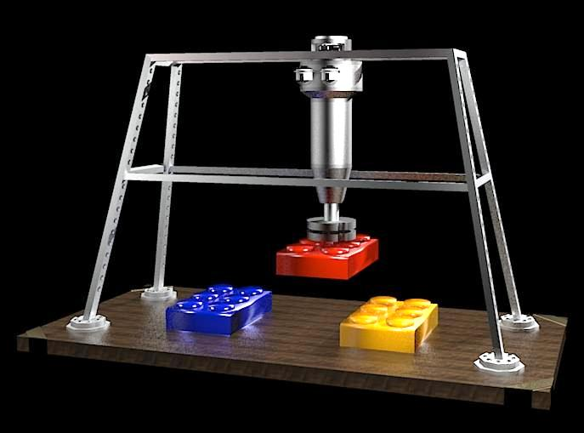
Construct
Conceiving a system
7x
Inspire
CREATE
C

Slide 20
Construct
Inspire
Extract
CREATE
C

Slide 21
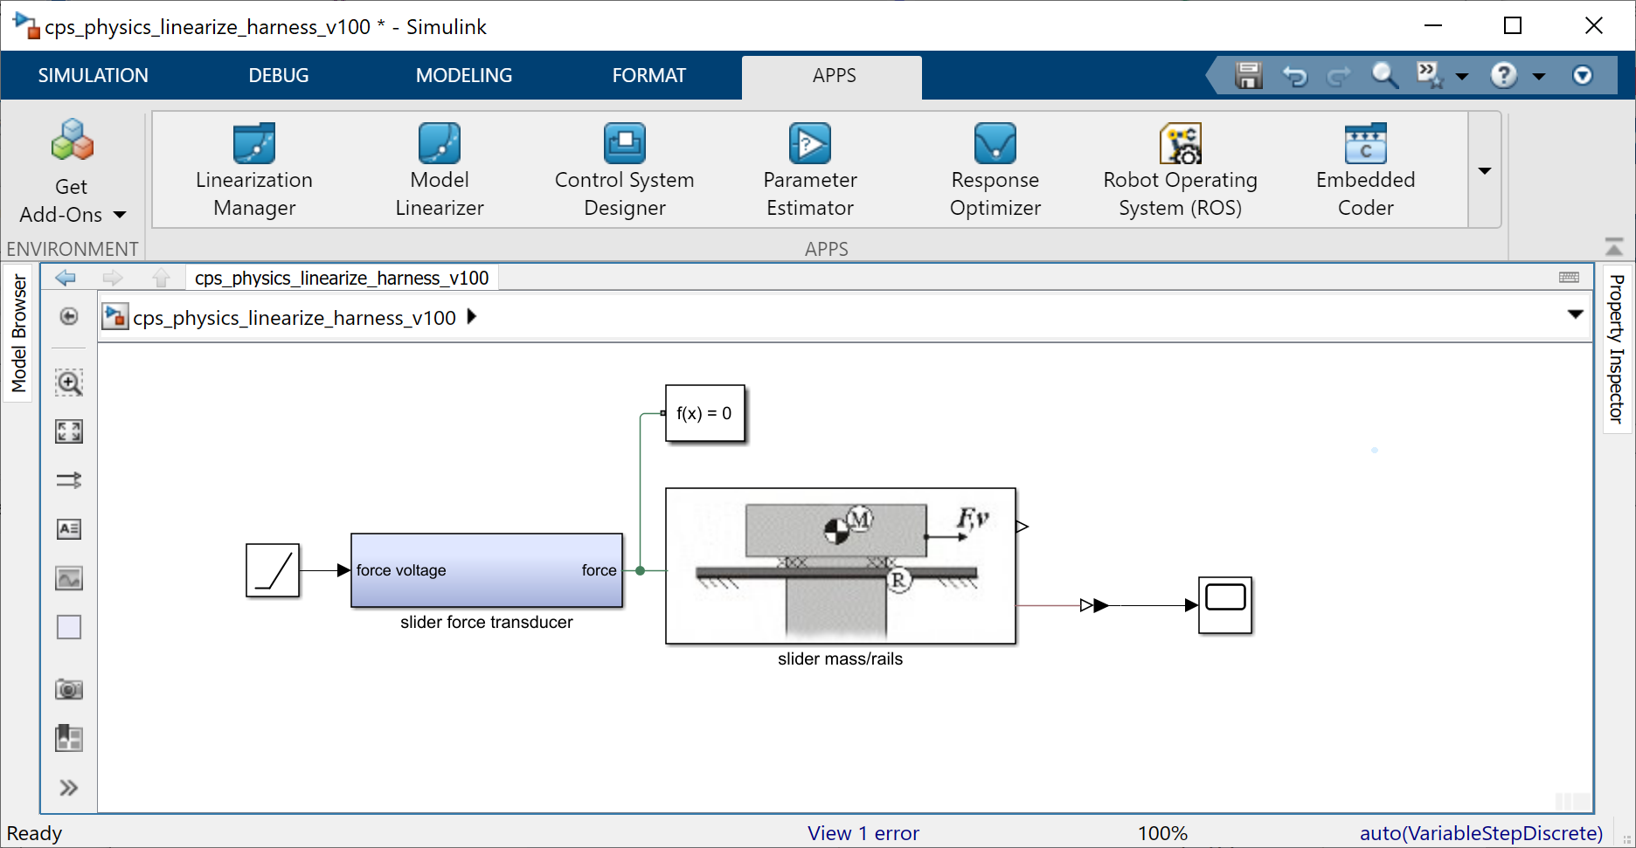
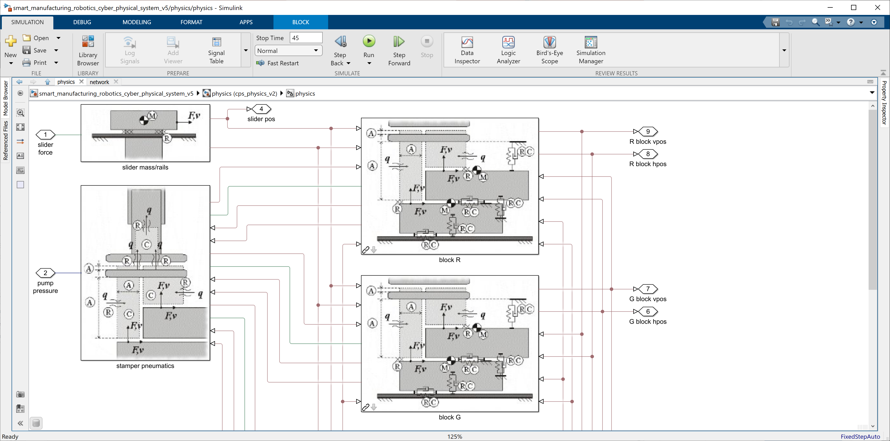
Construct
Linearizing around operating points
Inspire
Extract
CREATE
C

Slide 22
Construct
Inspire
Extract
CREATE
Solve
C

Slide 23
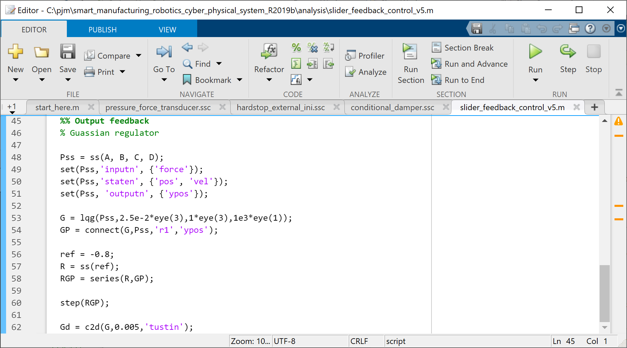
Construct
Synthesizing a Gaussian regulator
Inspire
Extract
CREATE
Solve
C

Slide 24
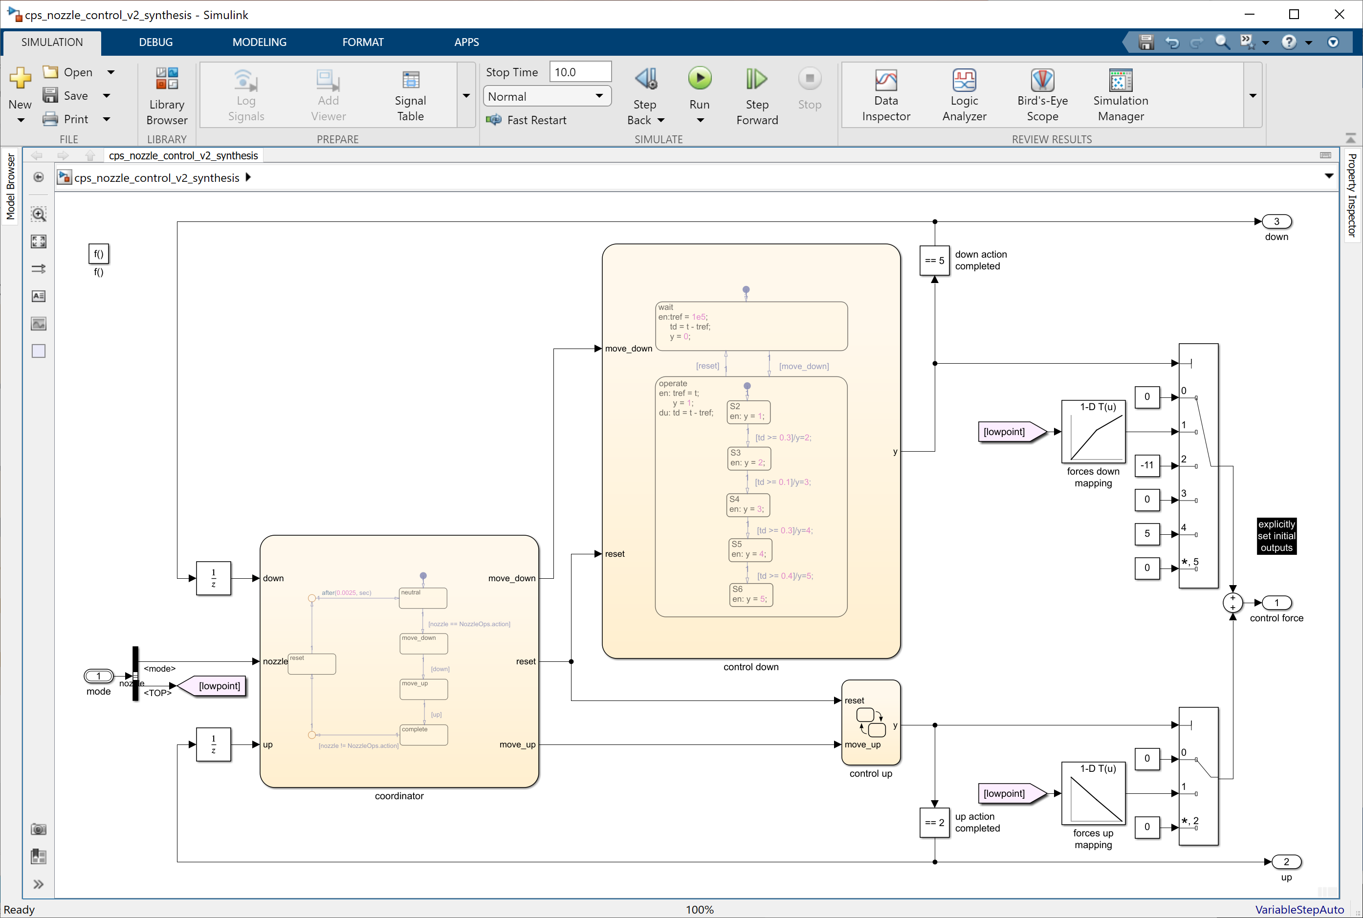
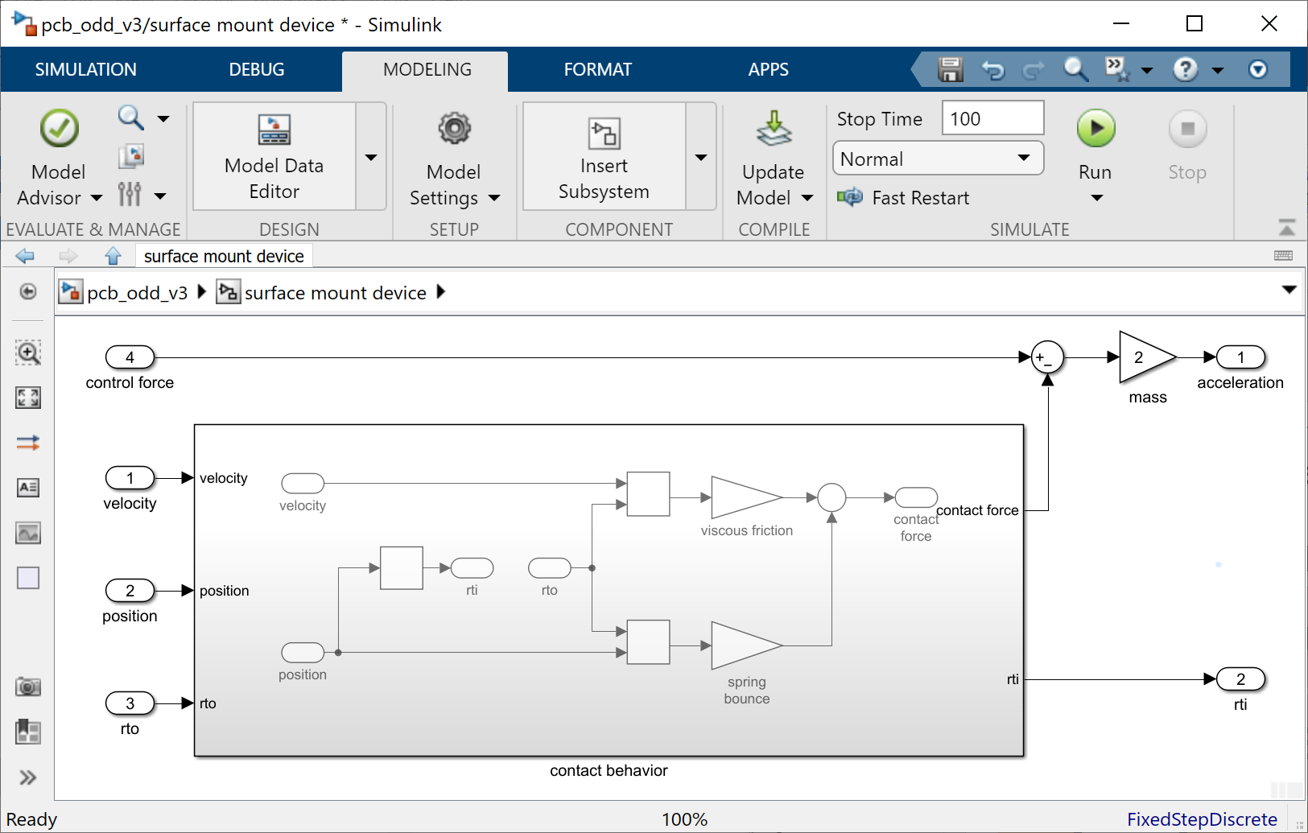
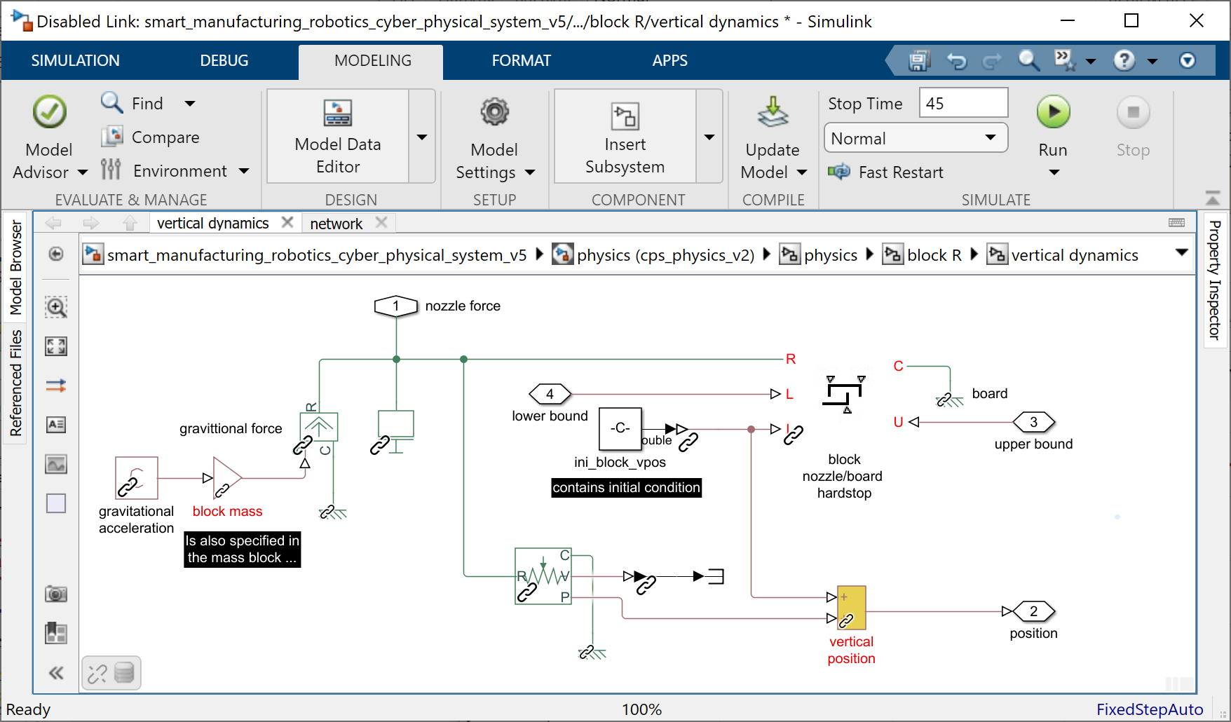
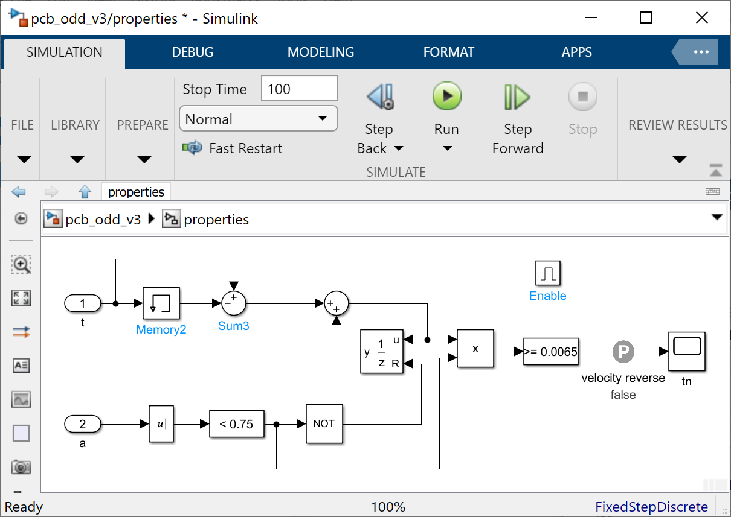
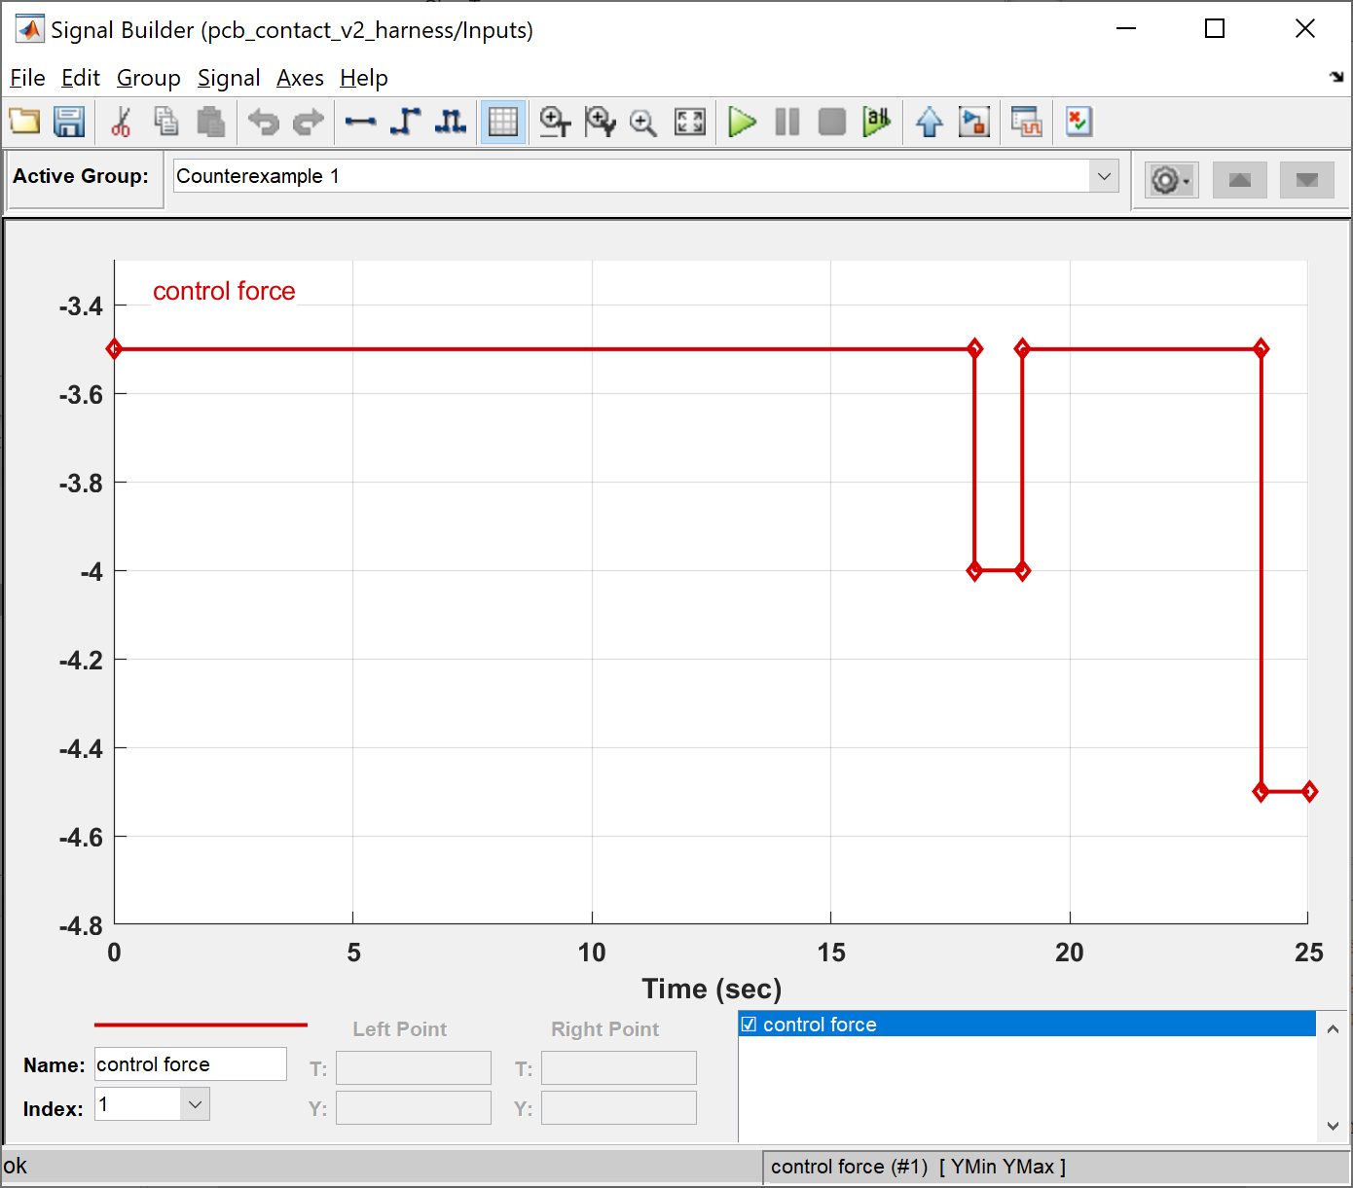
Construct
Synthesizing feedforward control
Inspire
Extract
CREATE
Solve
C
Contact behavior
Placement property
Nozzle vertical dynamics
Control input signal

Slide 25
Construct
Inspire
Extract
CREATE
Solve
C
Experiment

Slide 26
Construct
Identifying interacting features
Inspire
Extract
air pump
CREATE
Solve
R,C
C
Experiment
R,C
R,C

Slide 27
Construct
Identifying interacting features
Inspire
Extract
CREATE
Solve
C
Experiment

Slide 28
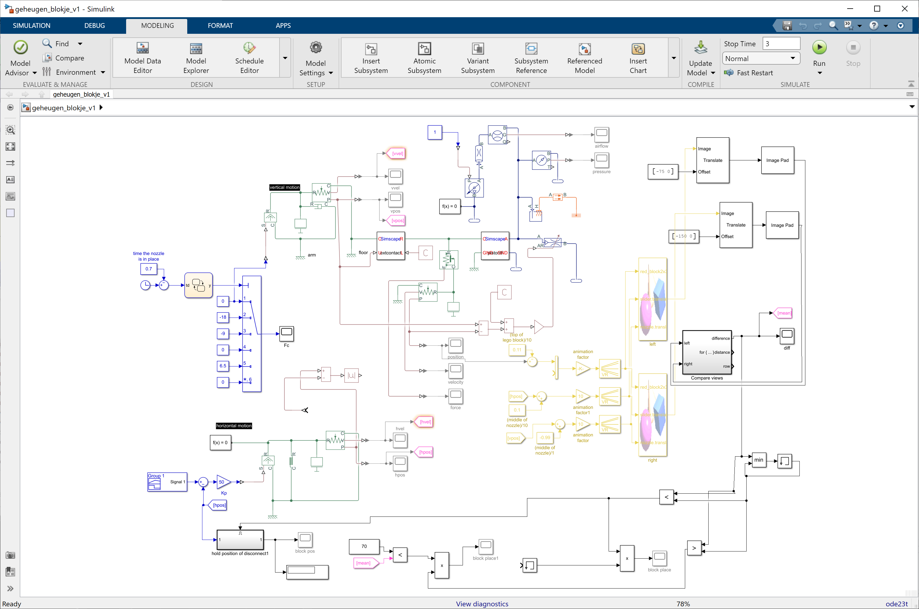
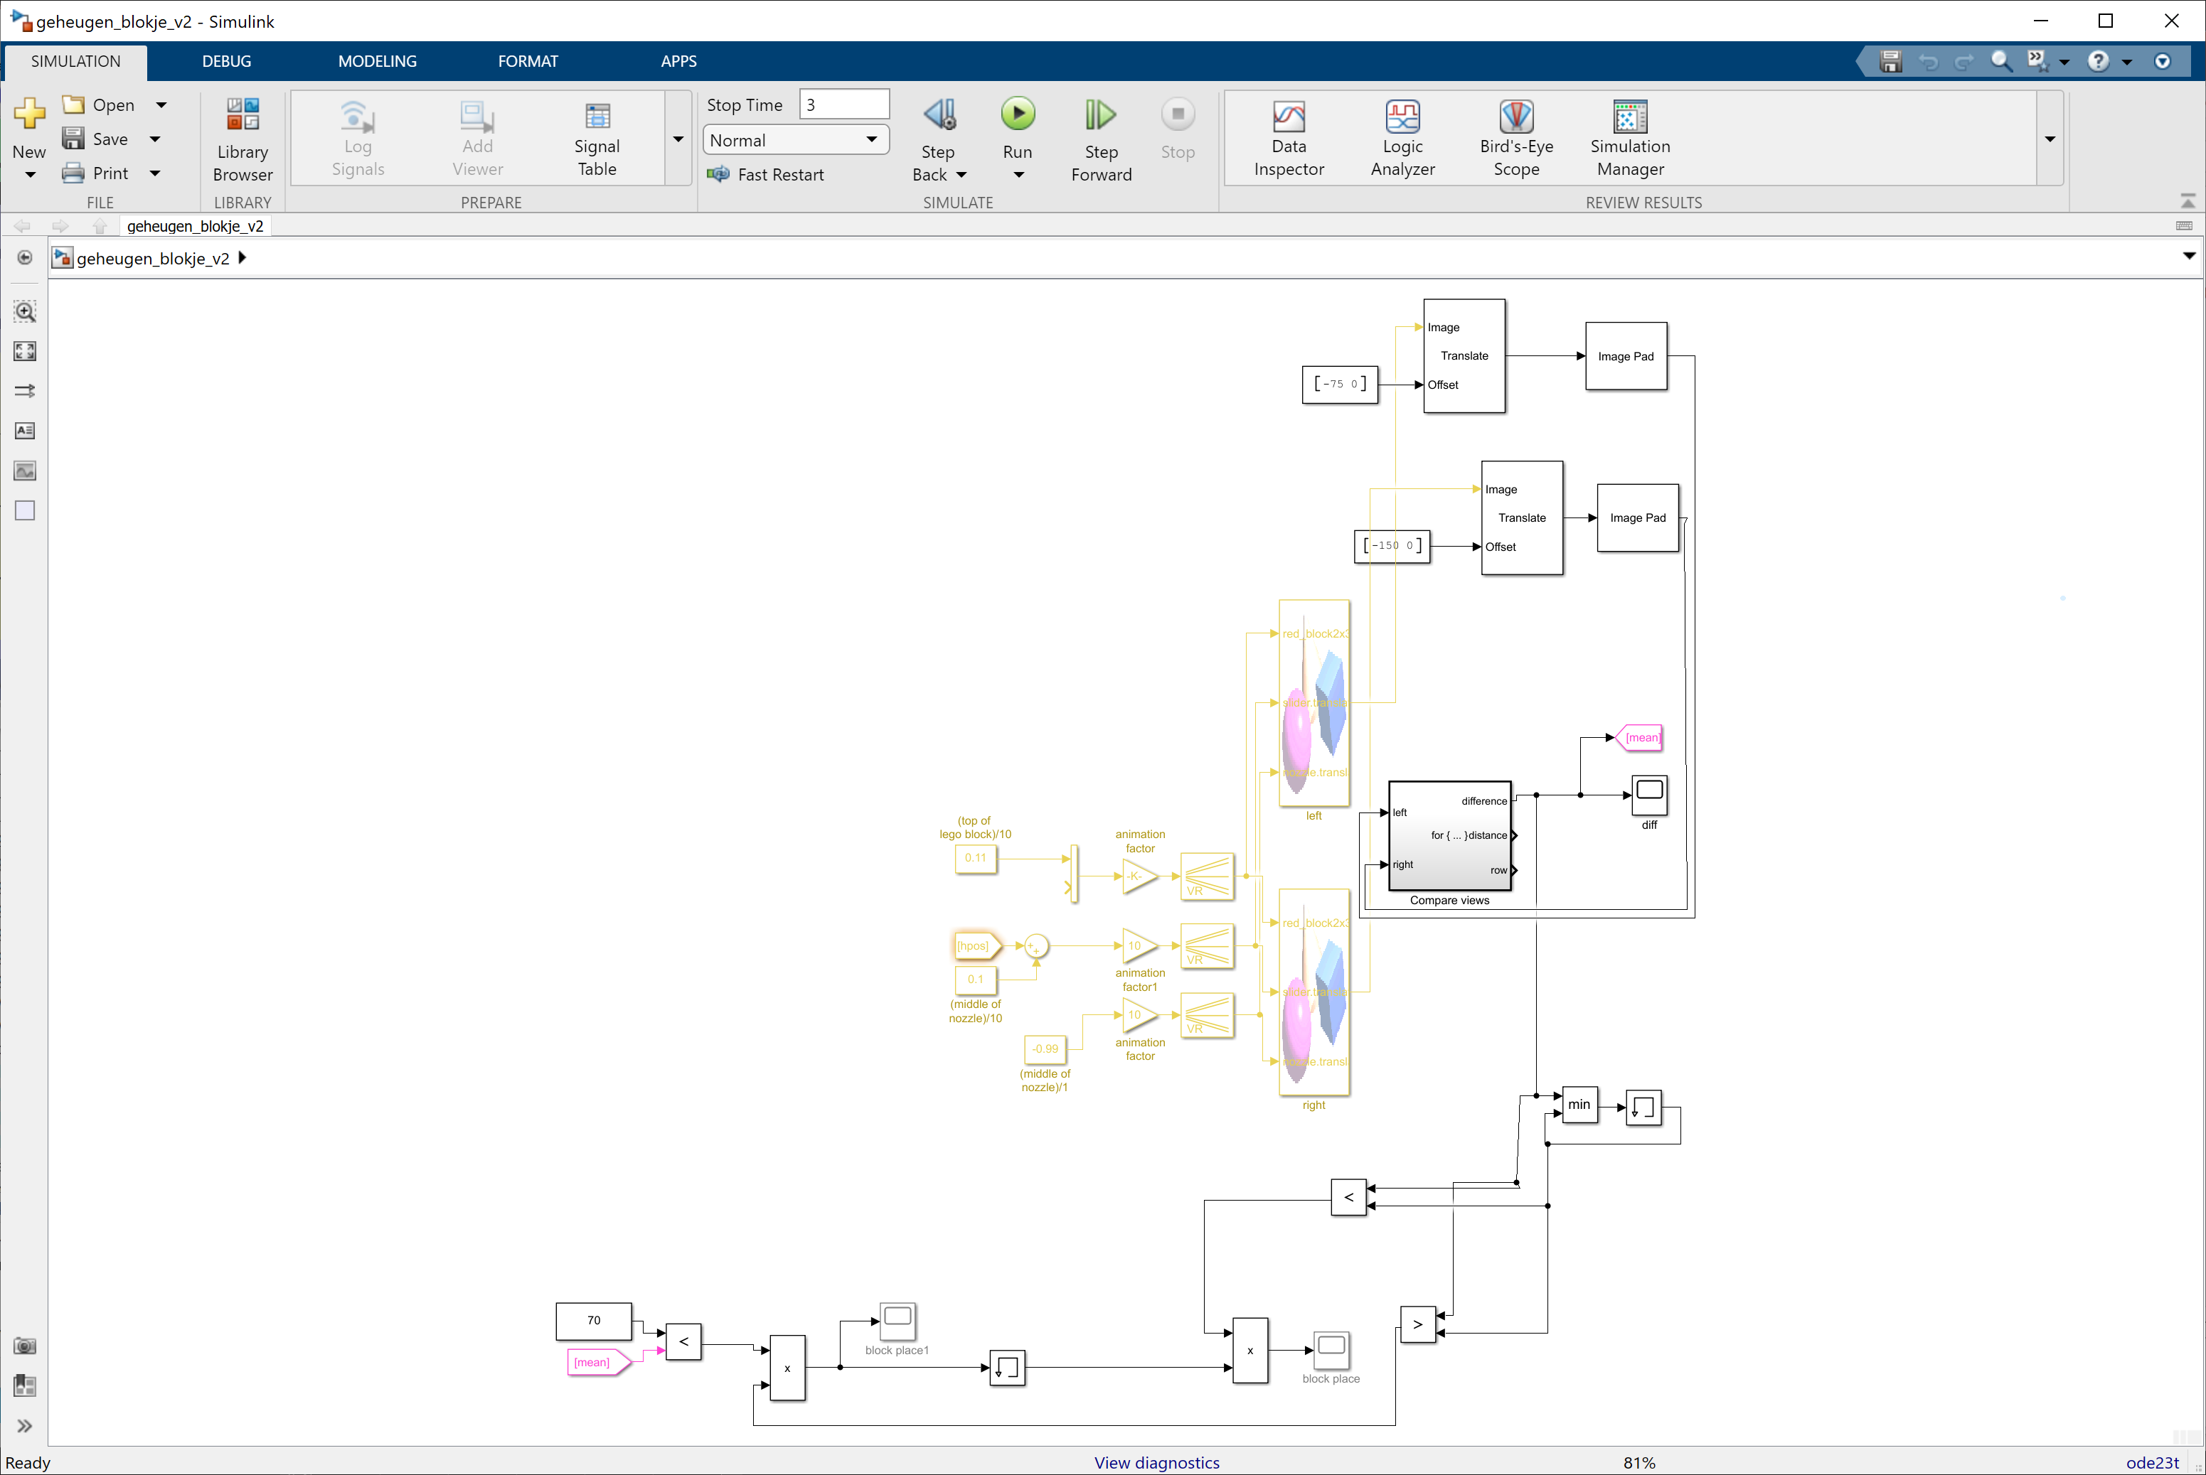
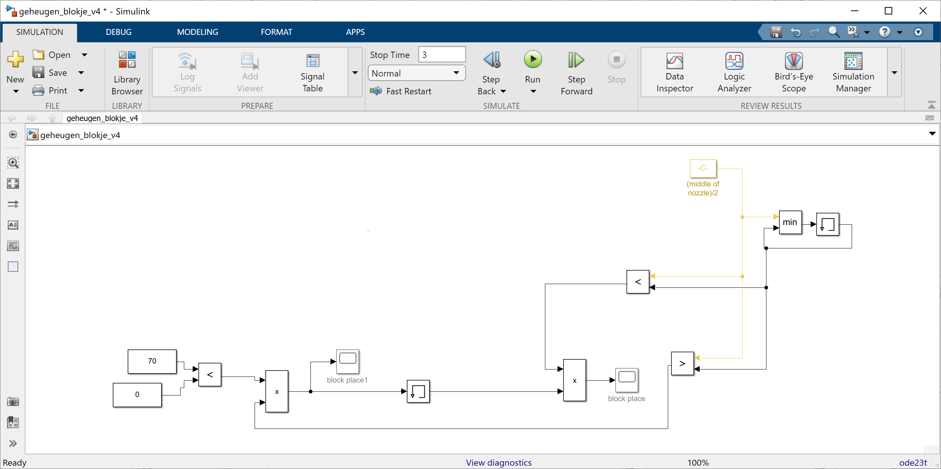
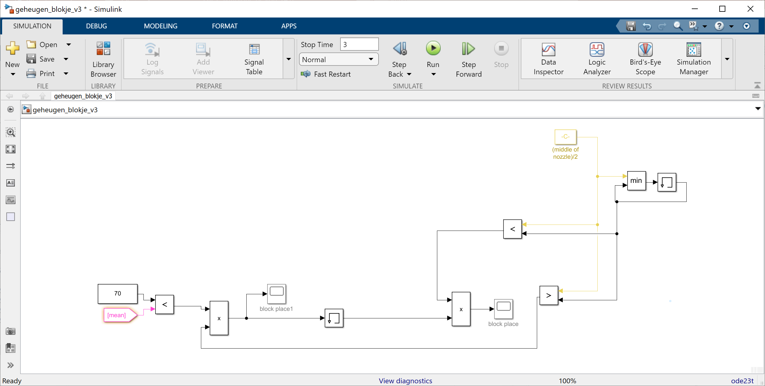
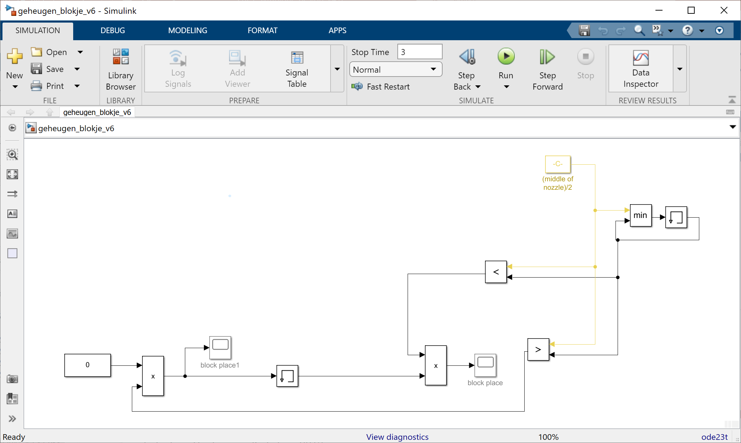
Construct
Debugging
Inspire
Extract
CREATE
Solve
C
Experiment

Slide 29
Design activities
CREATE
ORGANIZE
REFINE
EVALUATE
C
O
R
E

Slide 30
Structure
Ensure modeling hygiene
Create structure to scale up
Build larger designs
Work with other people (larger teams, other teams)
Apply uniform style
Understandable
Maintainable
Organize the design by grouping domains
Physics vs. software
Time based vs. event based
…
Check
Formalize
ORGANIZE
Trace
O
Navigate
Refactor

Slide 31
Structure
Structuring content
ORGANIZE
O

Slide 32
Structure
Check
ORGANIZE
O

Slide 33
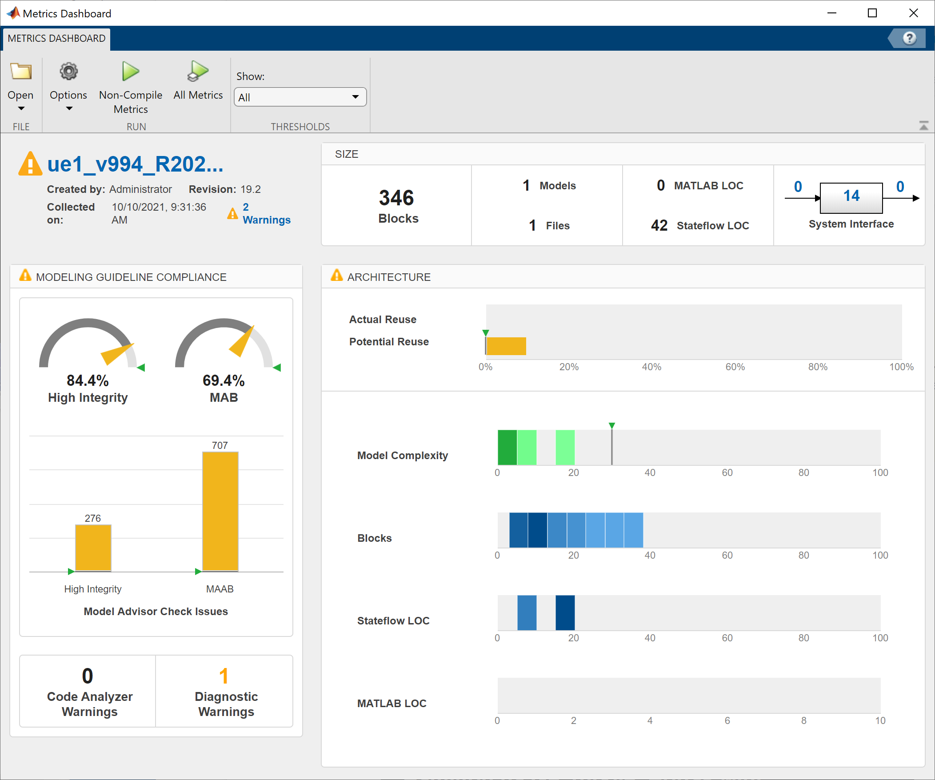
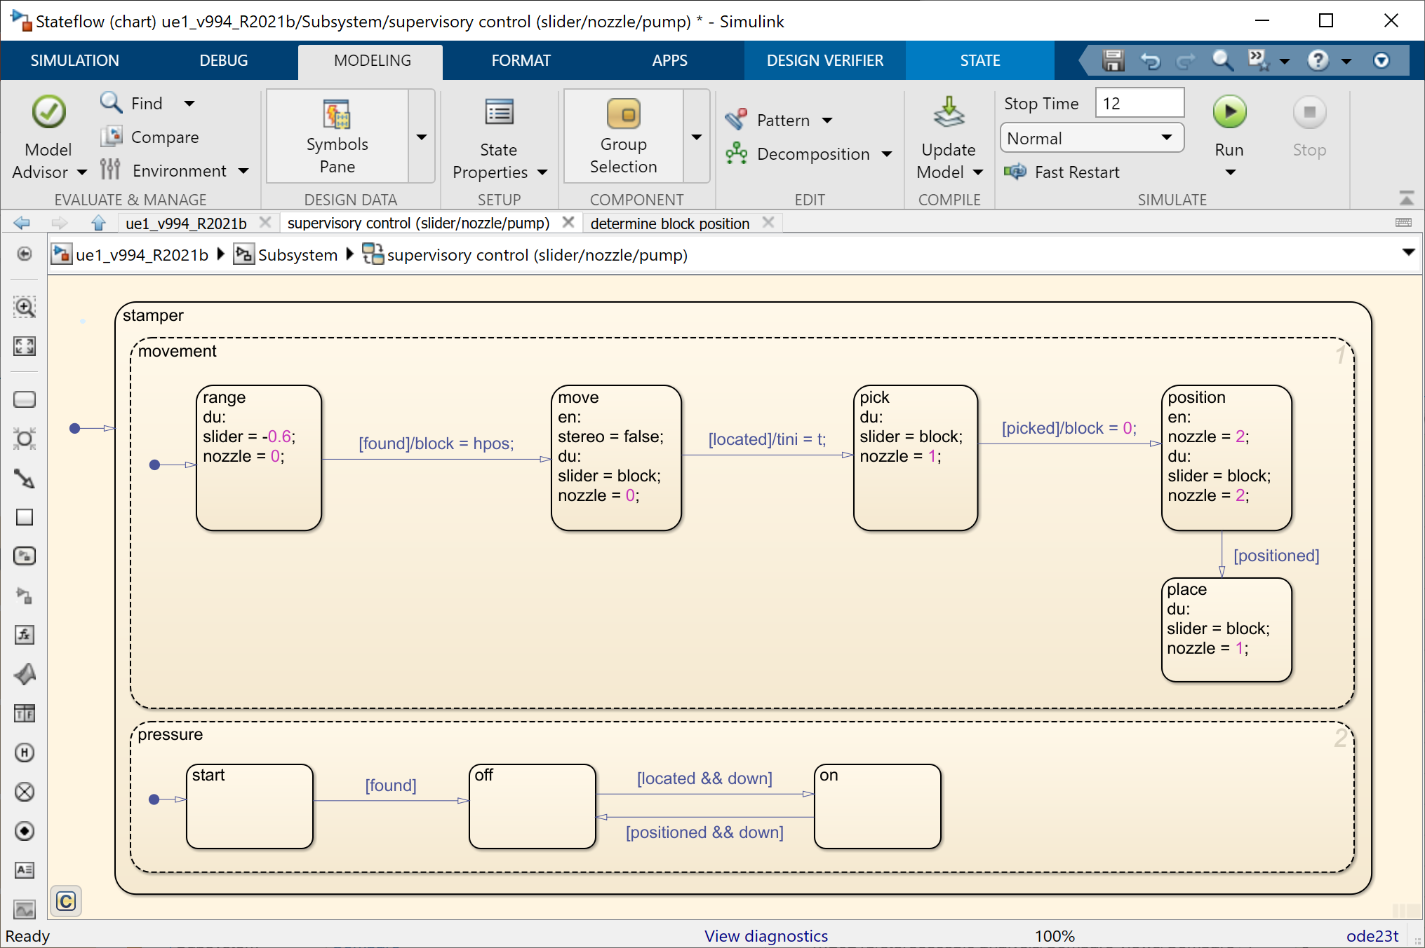
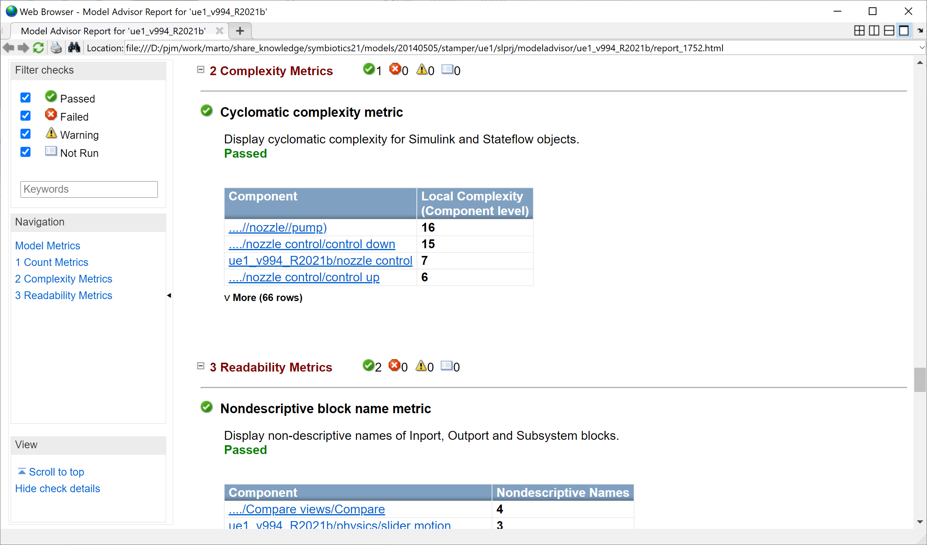
Structure
Determining structural complexity
Check
ORGANIZE
O

Slide 34
Structure
Check
Formalize
ORGANIZE
O

Slide 35
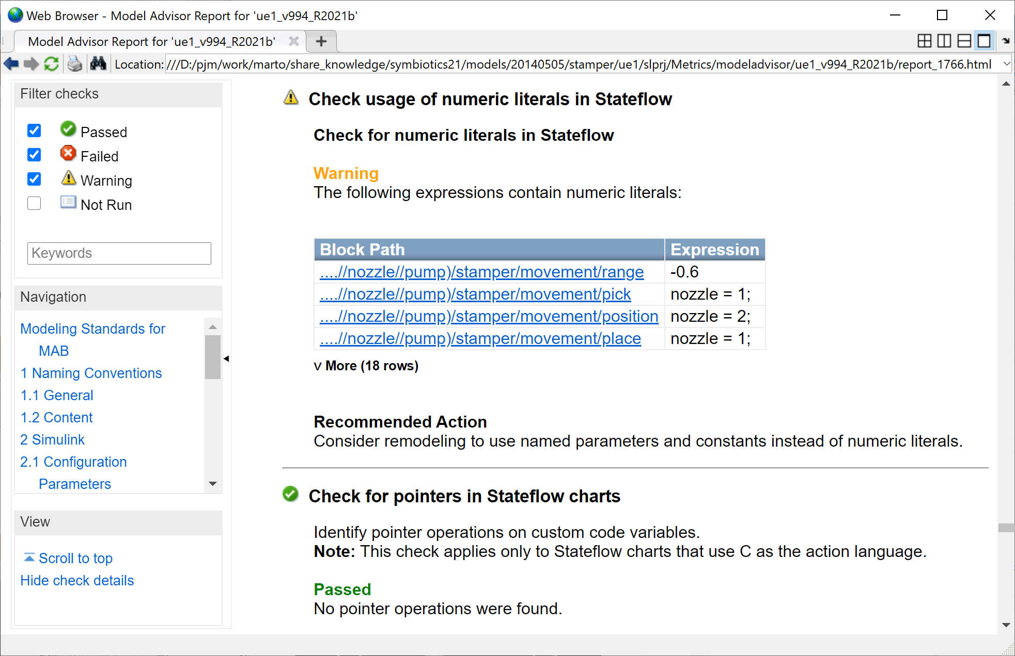
Structure
Following formal style guides
Check
Formalize
ORGANIZE
O

Slide 36
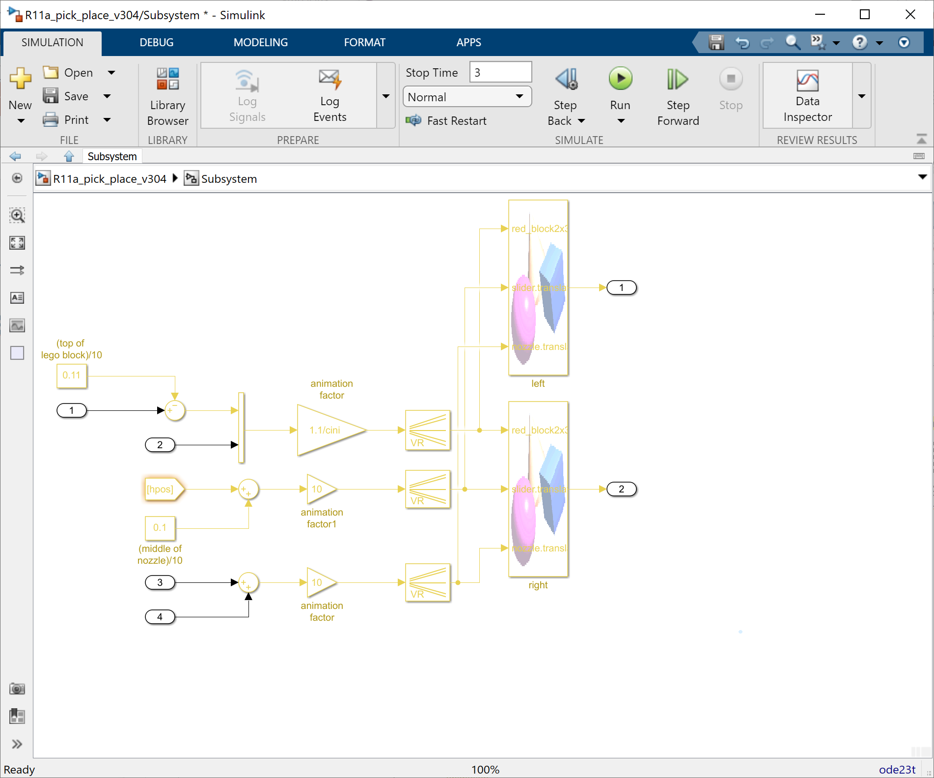
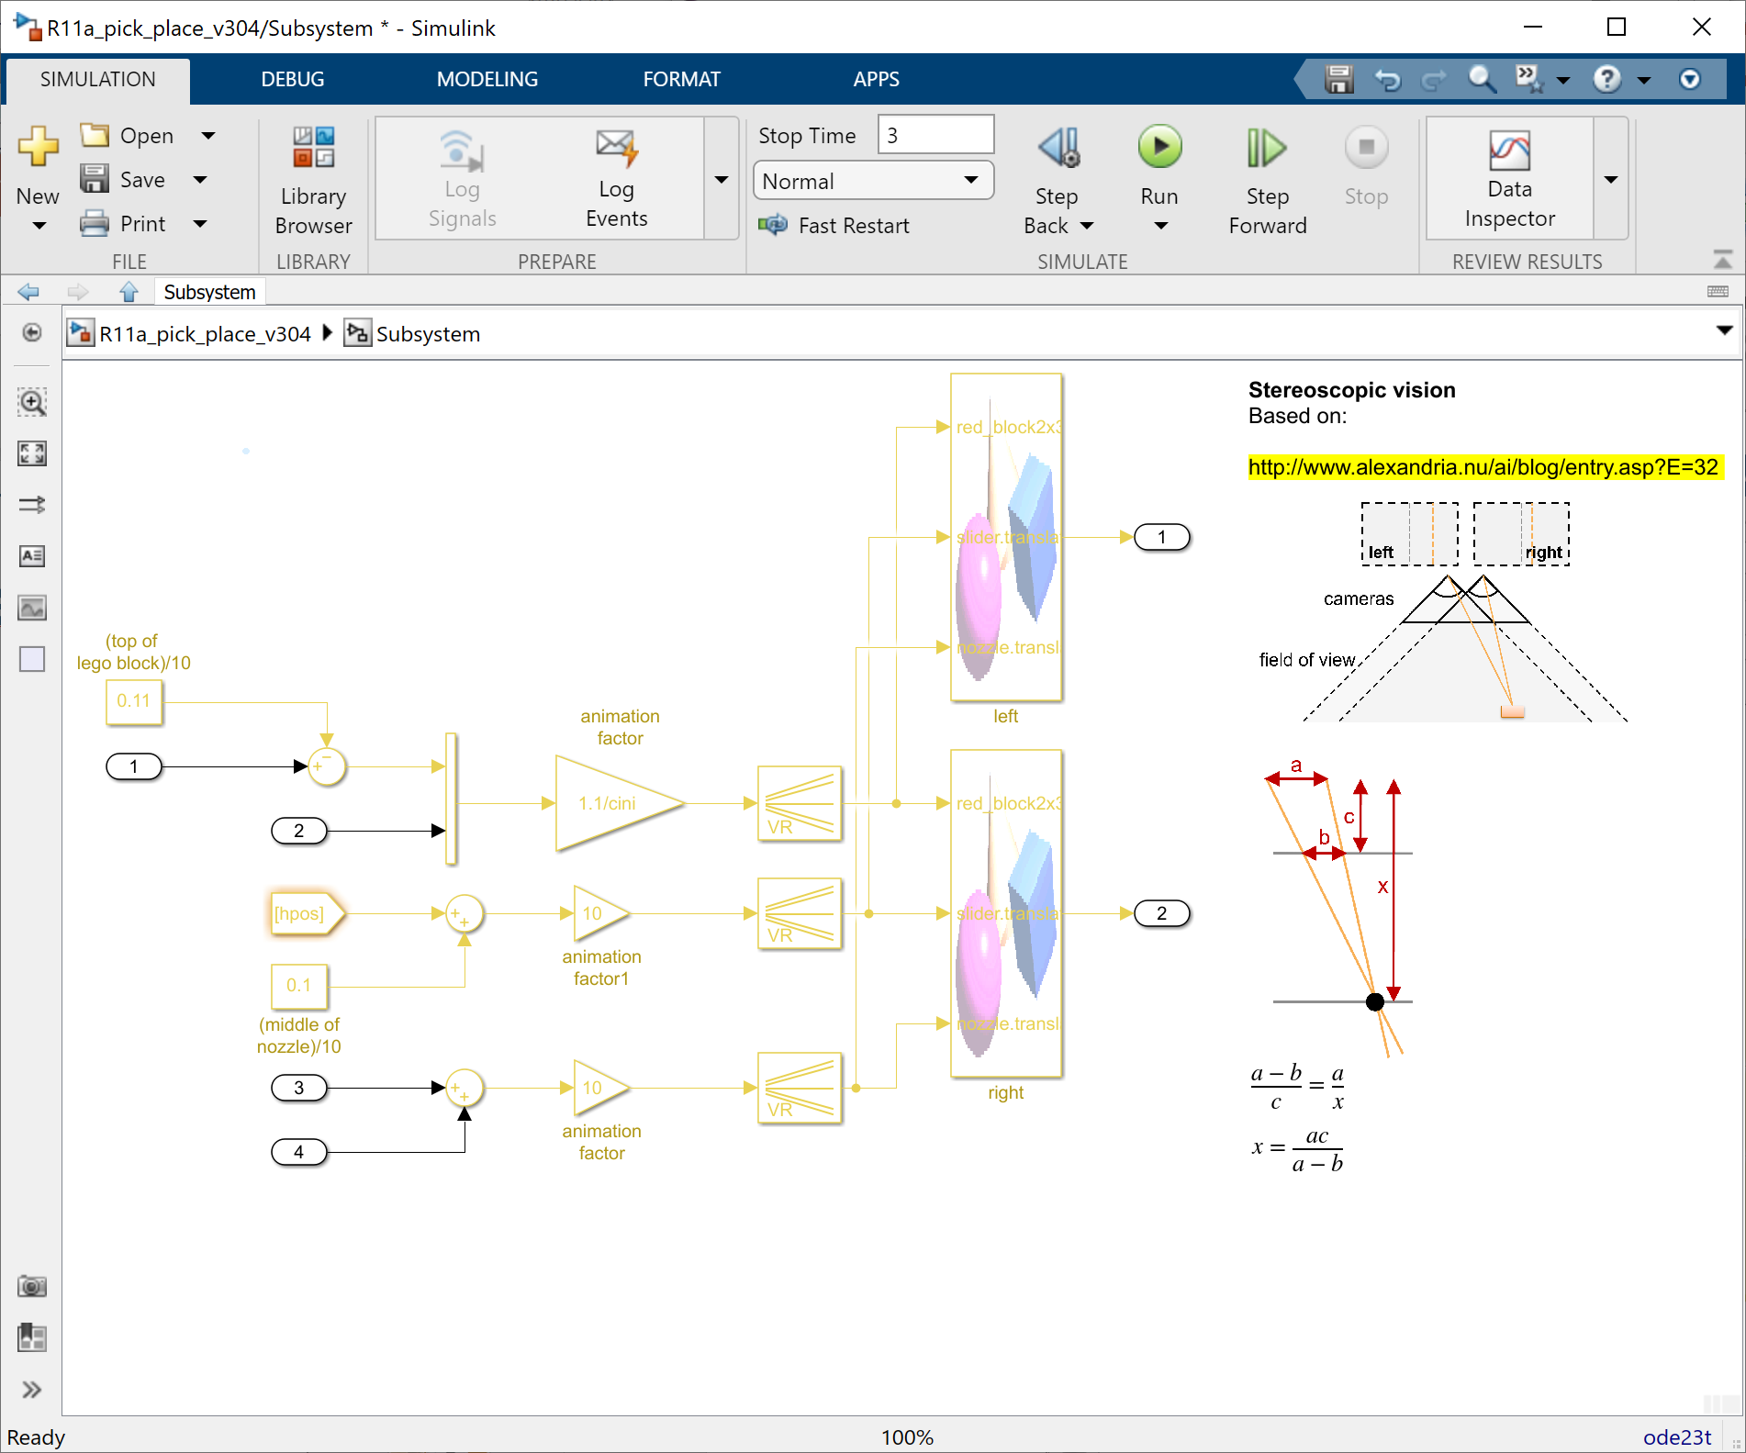
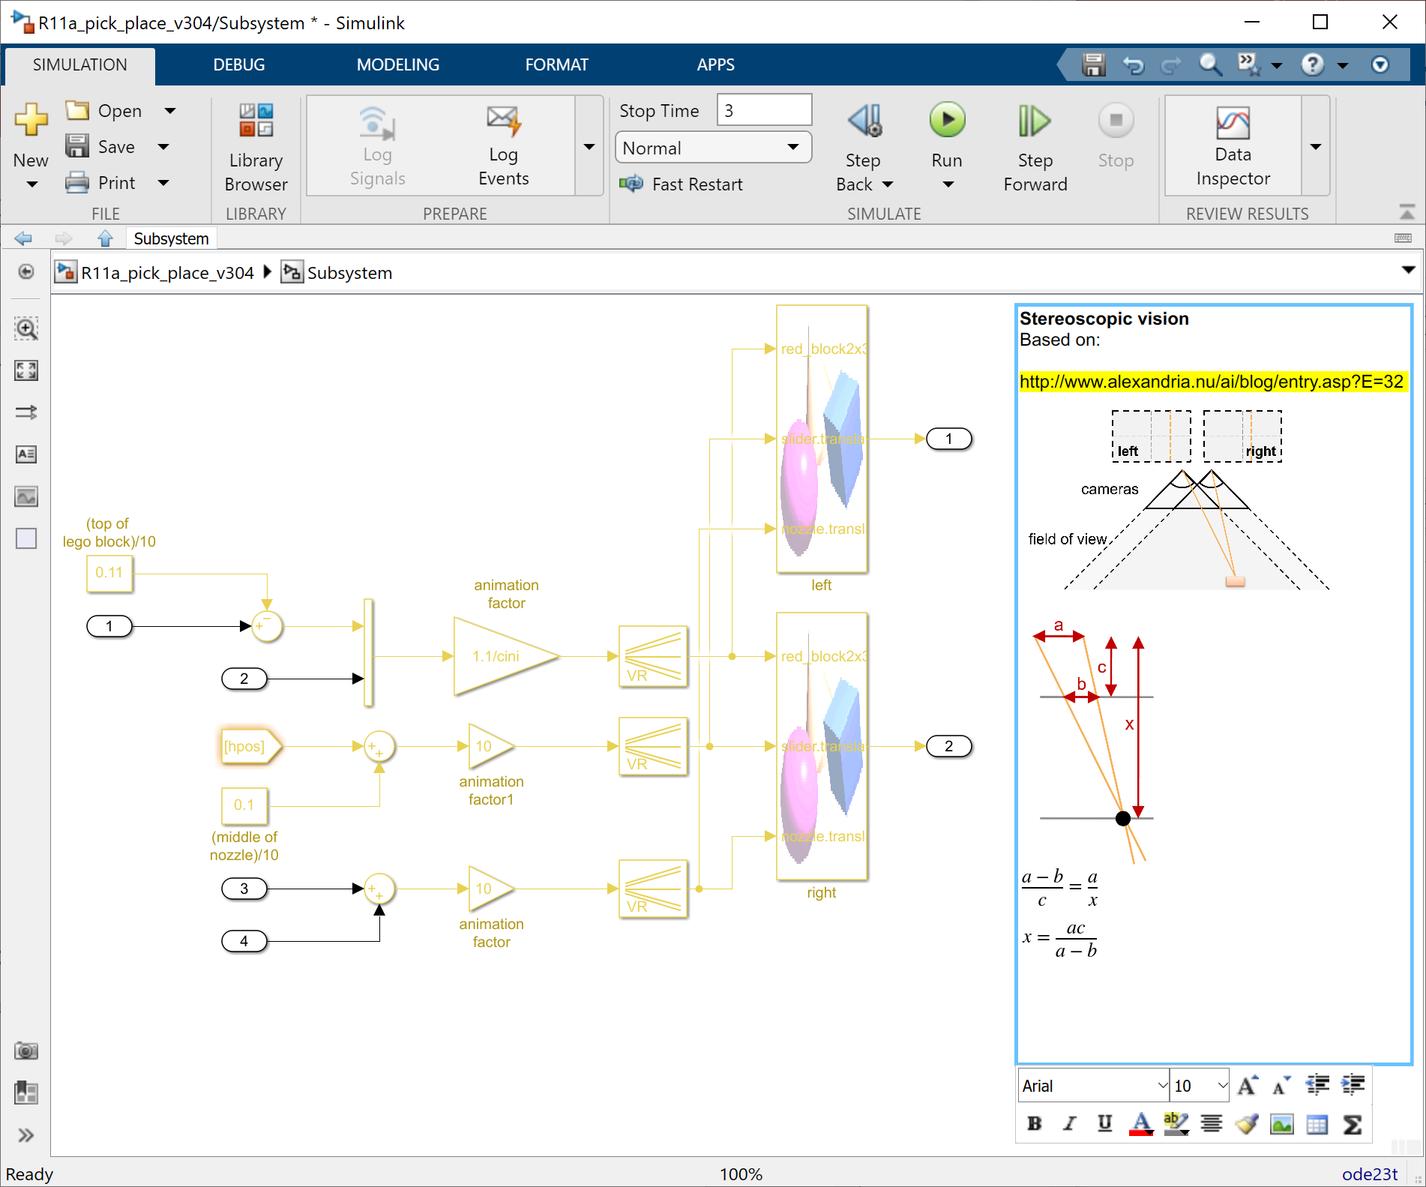
Structure
Documenting the content
Check
Formalize
ORGANIZE
O

Slide 37
Structure
Check
Formalize
ORGANIZE
Trace
O

Slide 38
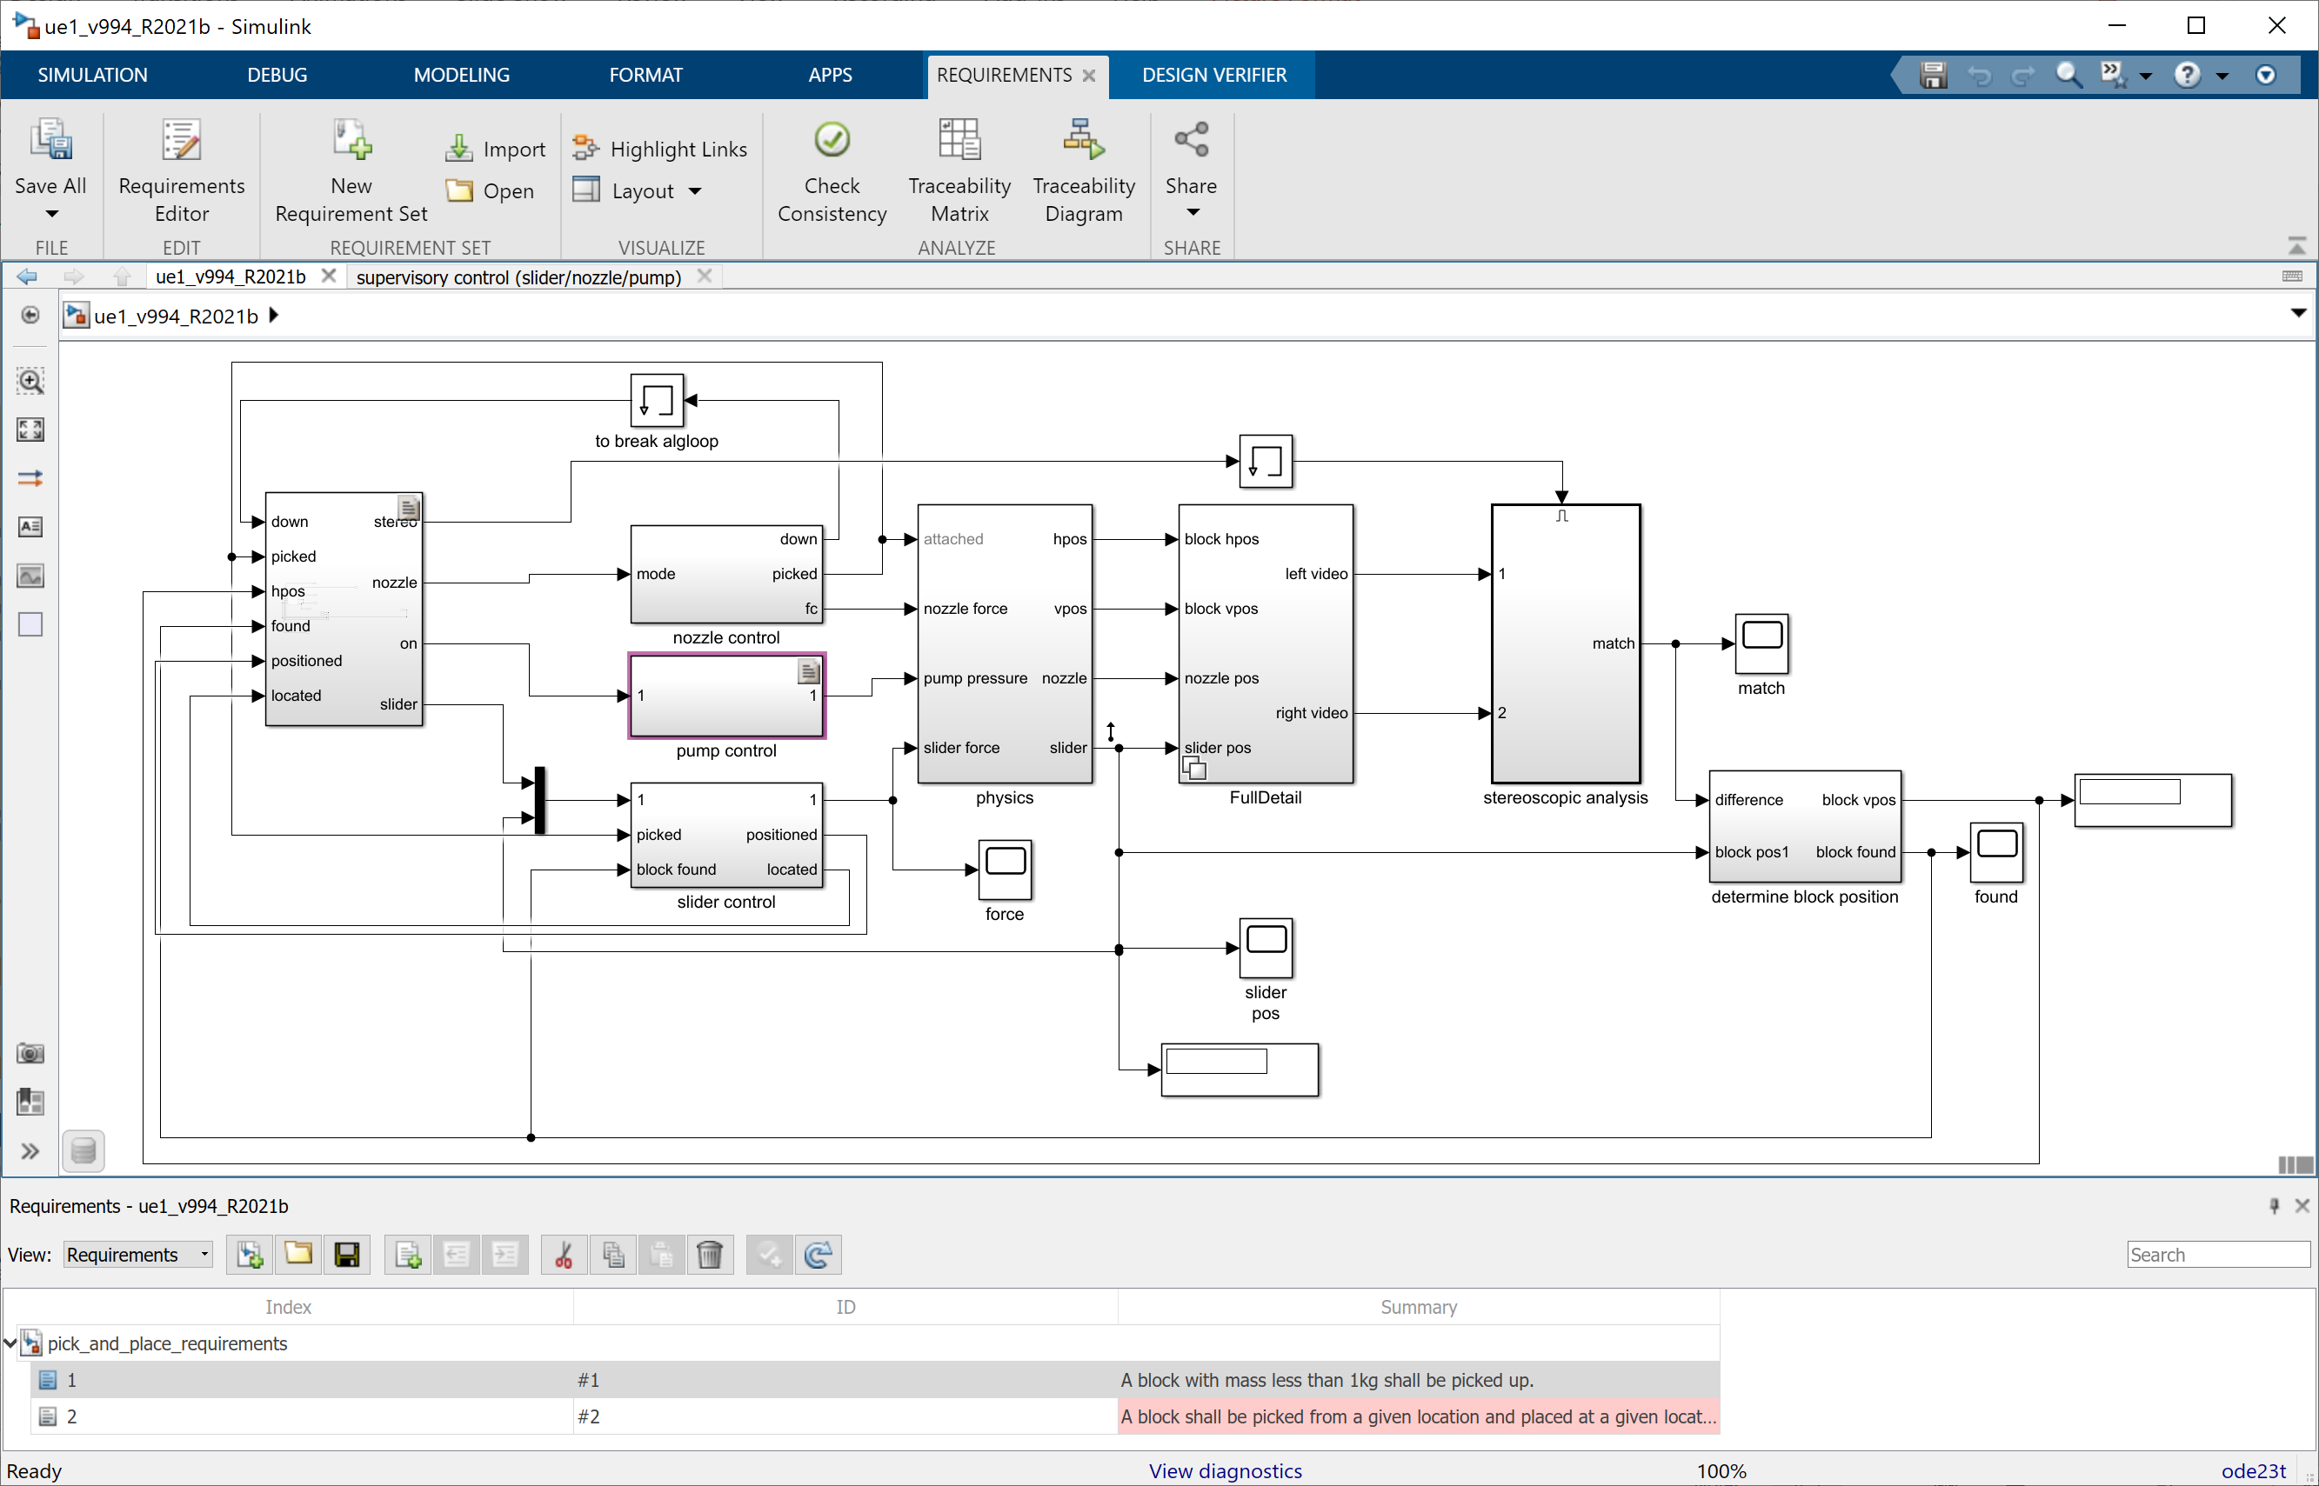
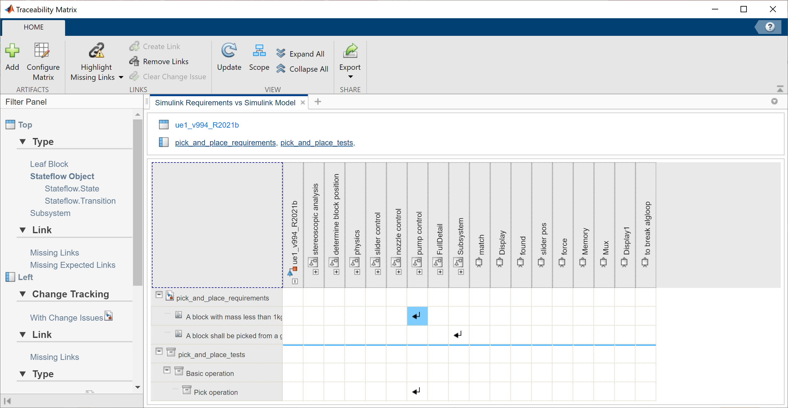
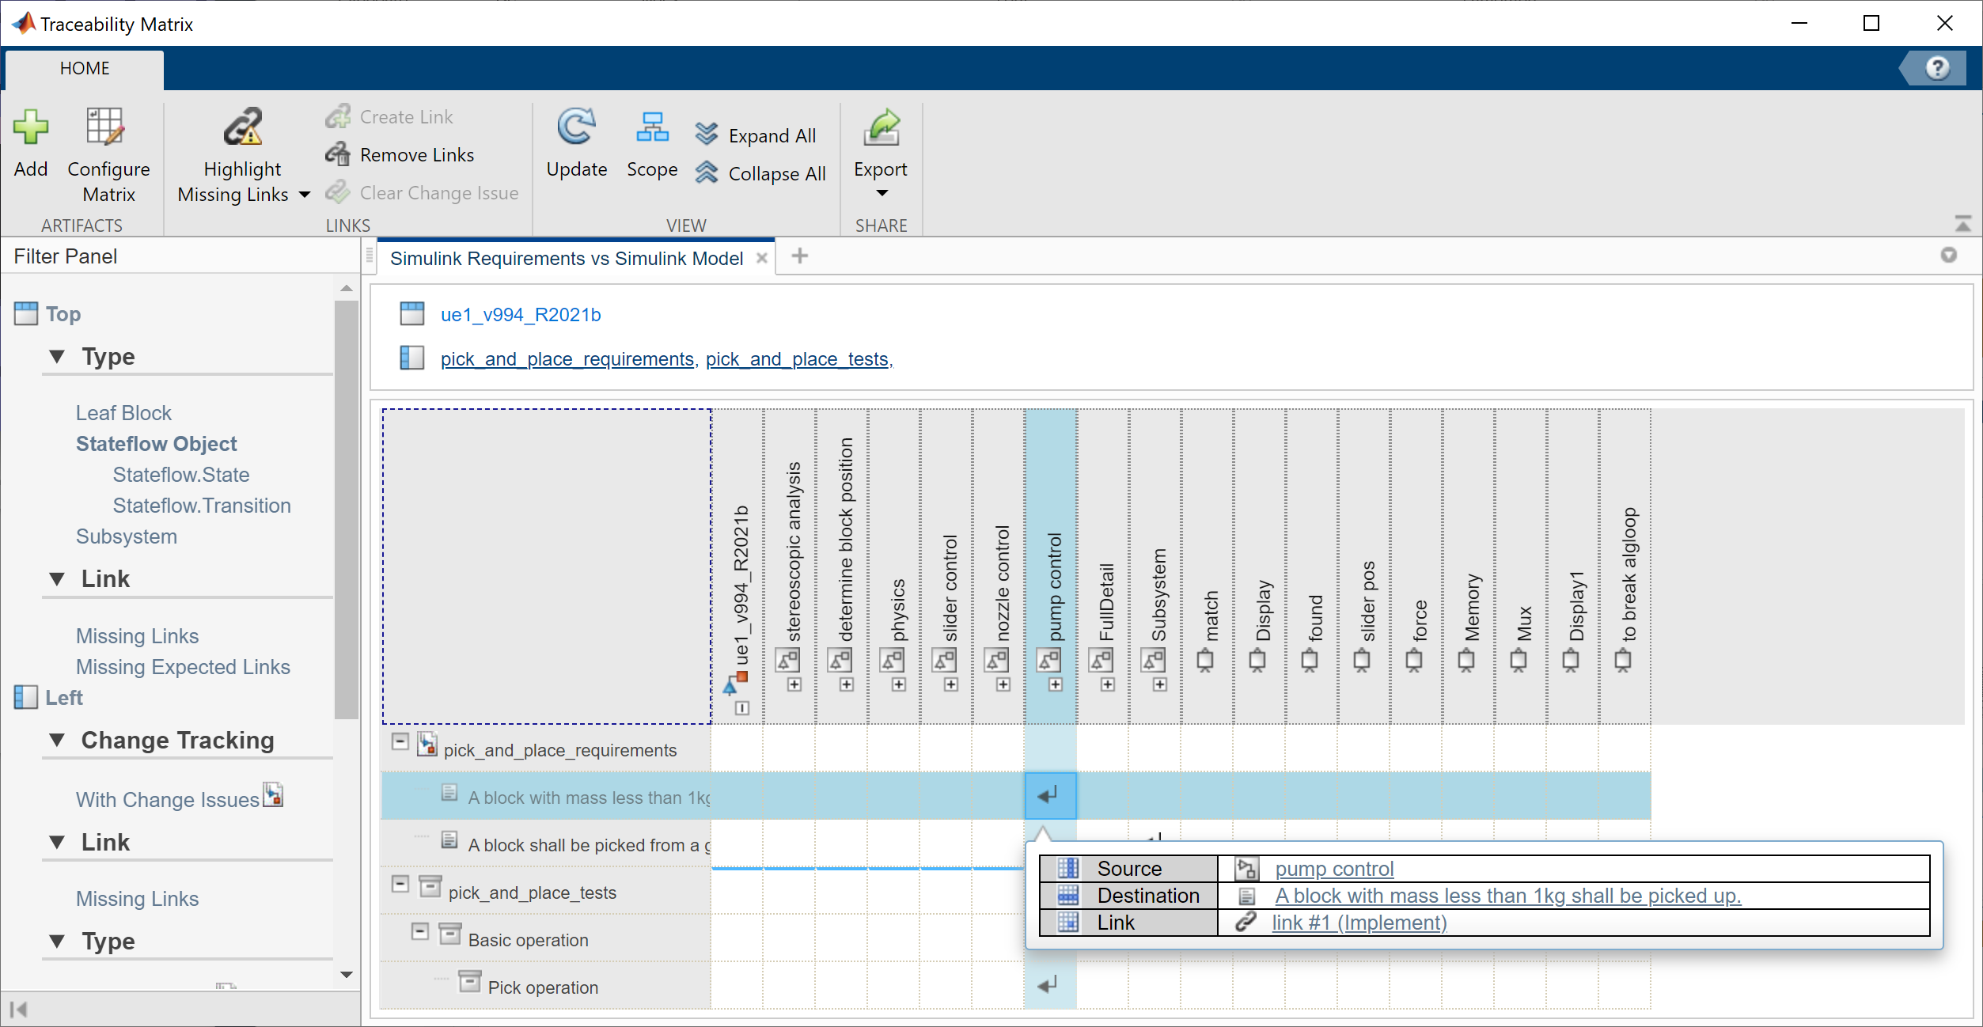
Structure
Inserting requirement and test links
Check
Formalize
ORGANIZE
Trace
O

Slide 39
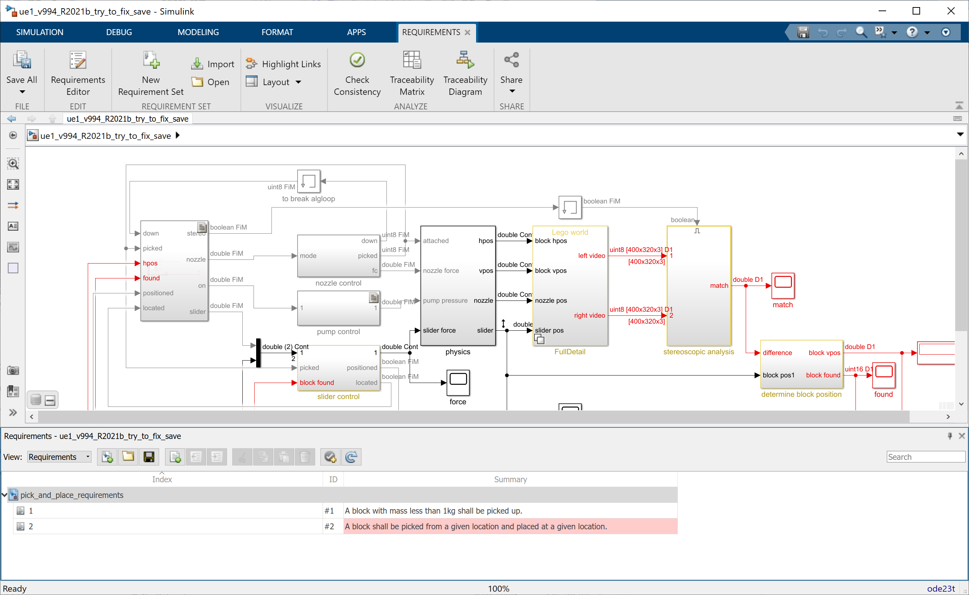
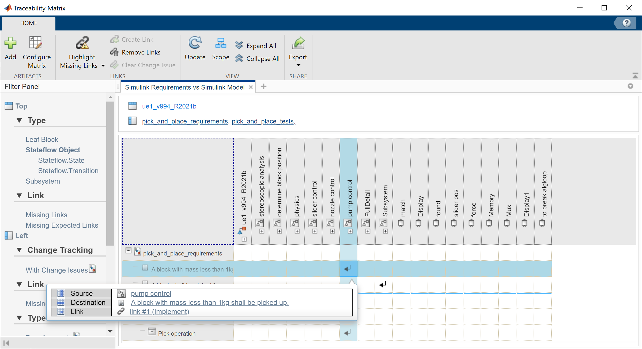
Structure
Inserting requirement and test links
Check
Formalize
ORGANIZE
Trace
O

Slide 40
Structure
Check
Formalize
ORGANIZE
Trace
O
Navigate

Slide 41
Structure
Creating a viewmark for oft visited views
Check
Formalize
ORGANIZE
Trace
O
Navigate

Slide 42
Structure
Check
Formalize
ORGANIZE
Trace
O
Navigate
Refactor

Slide 43
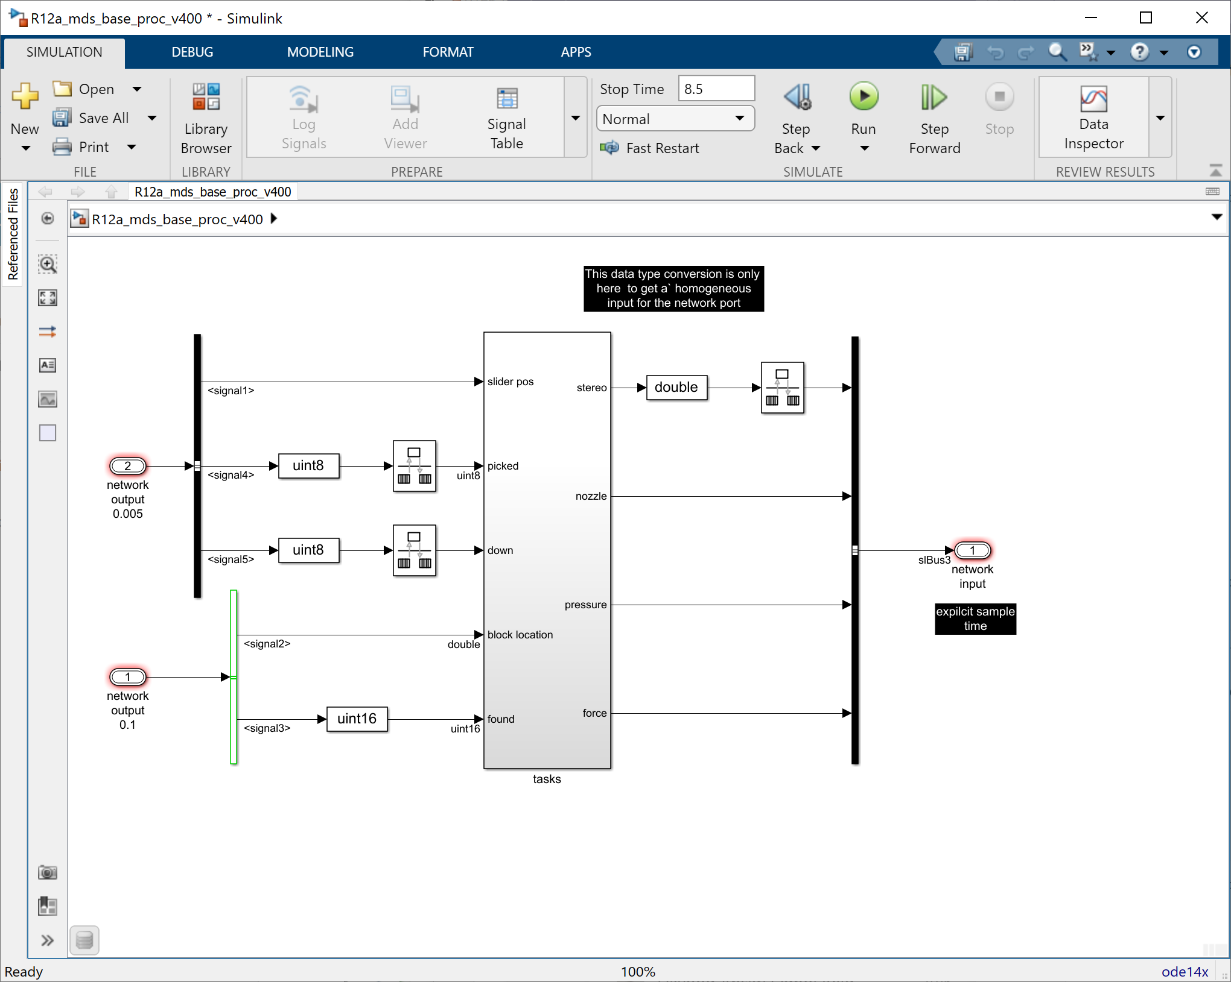
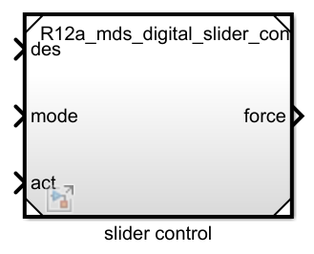
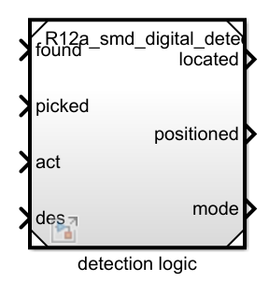
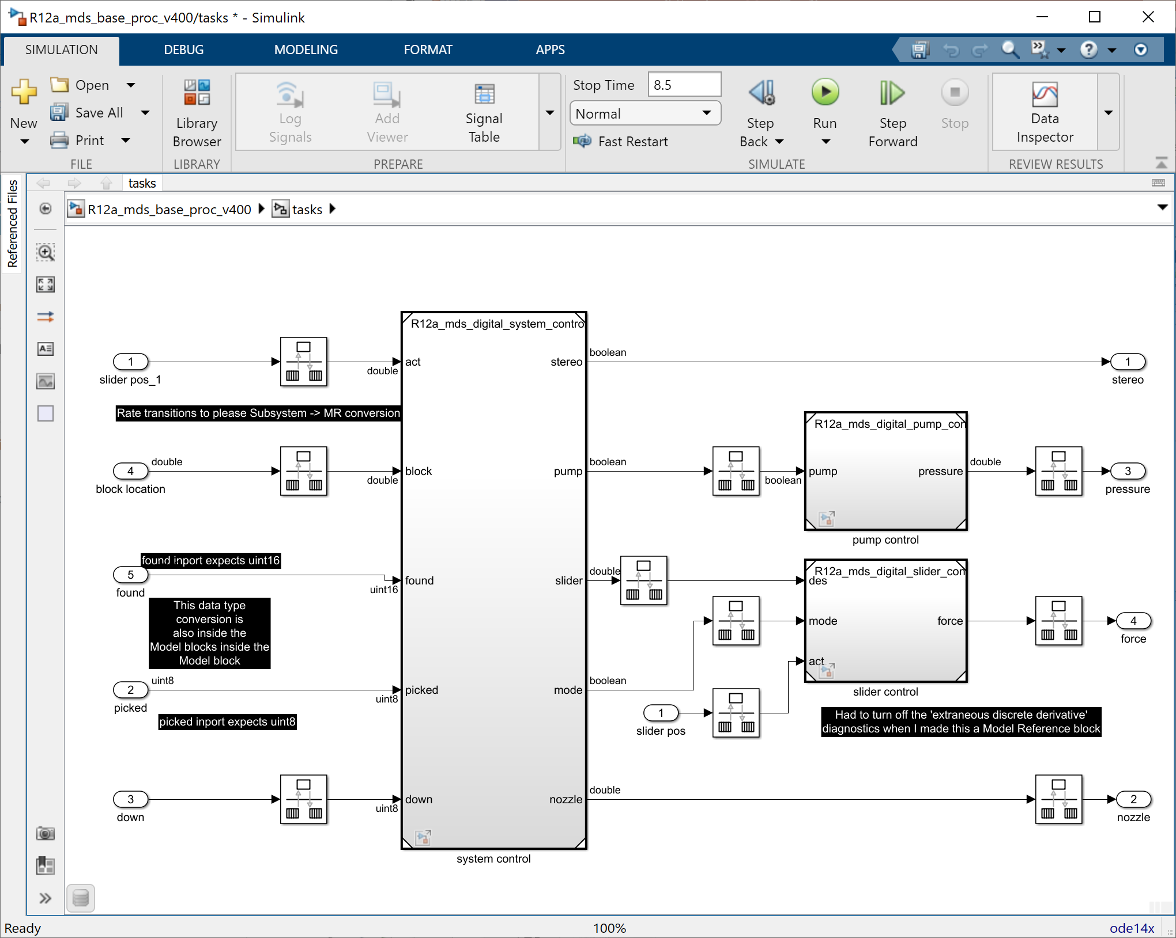
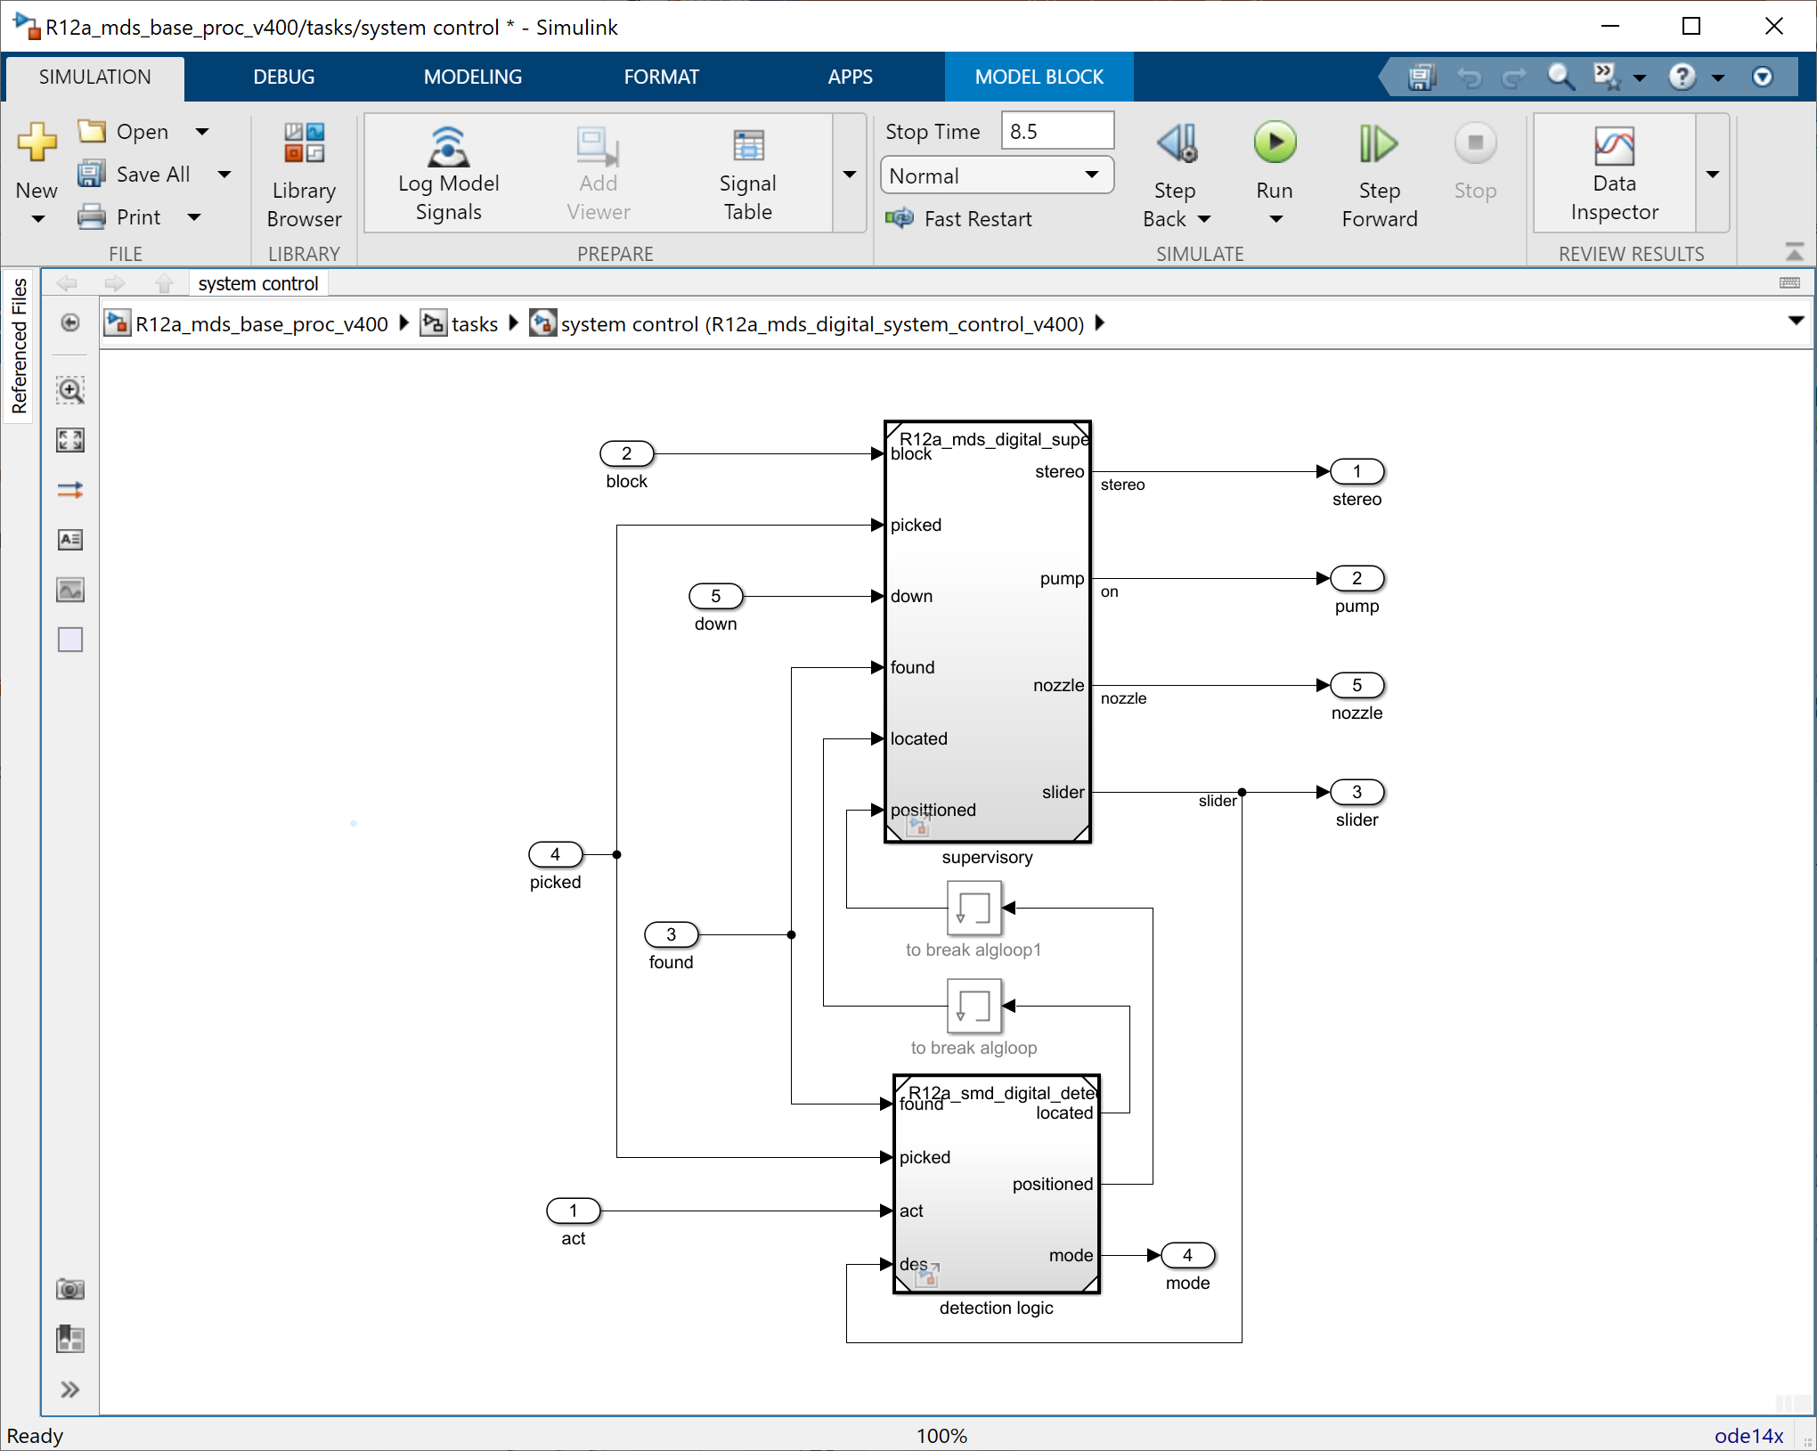
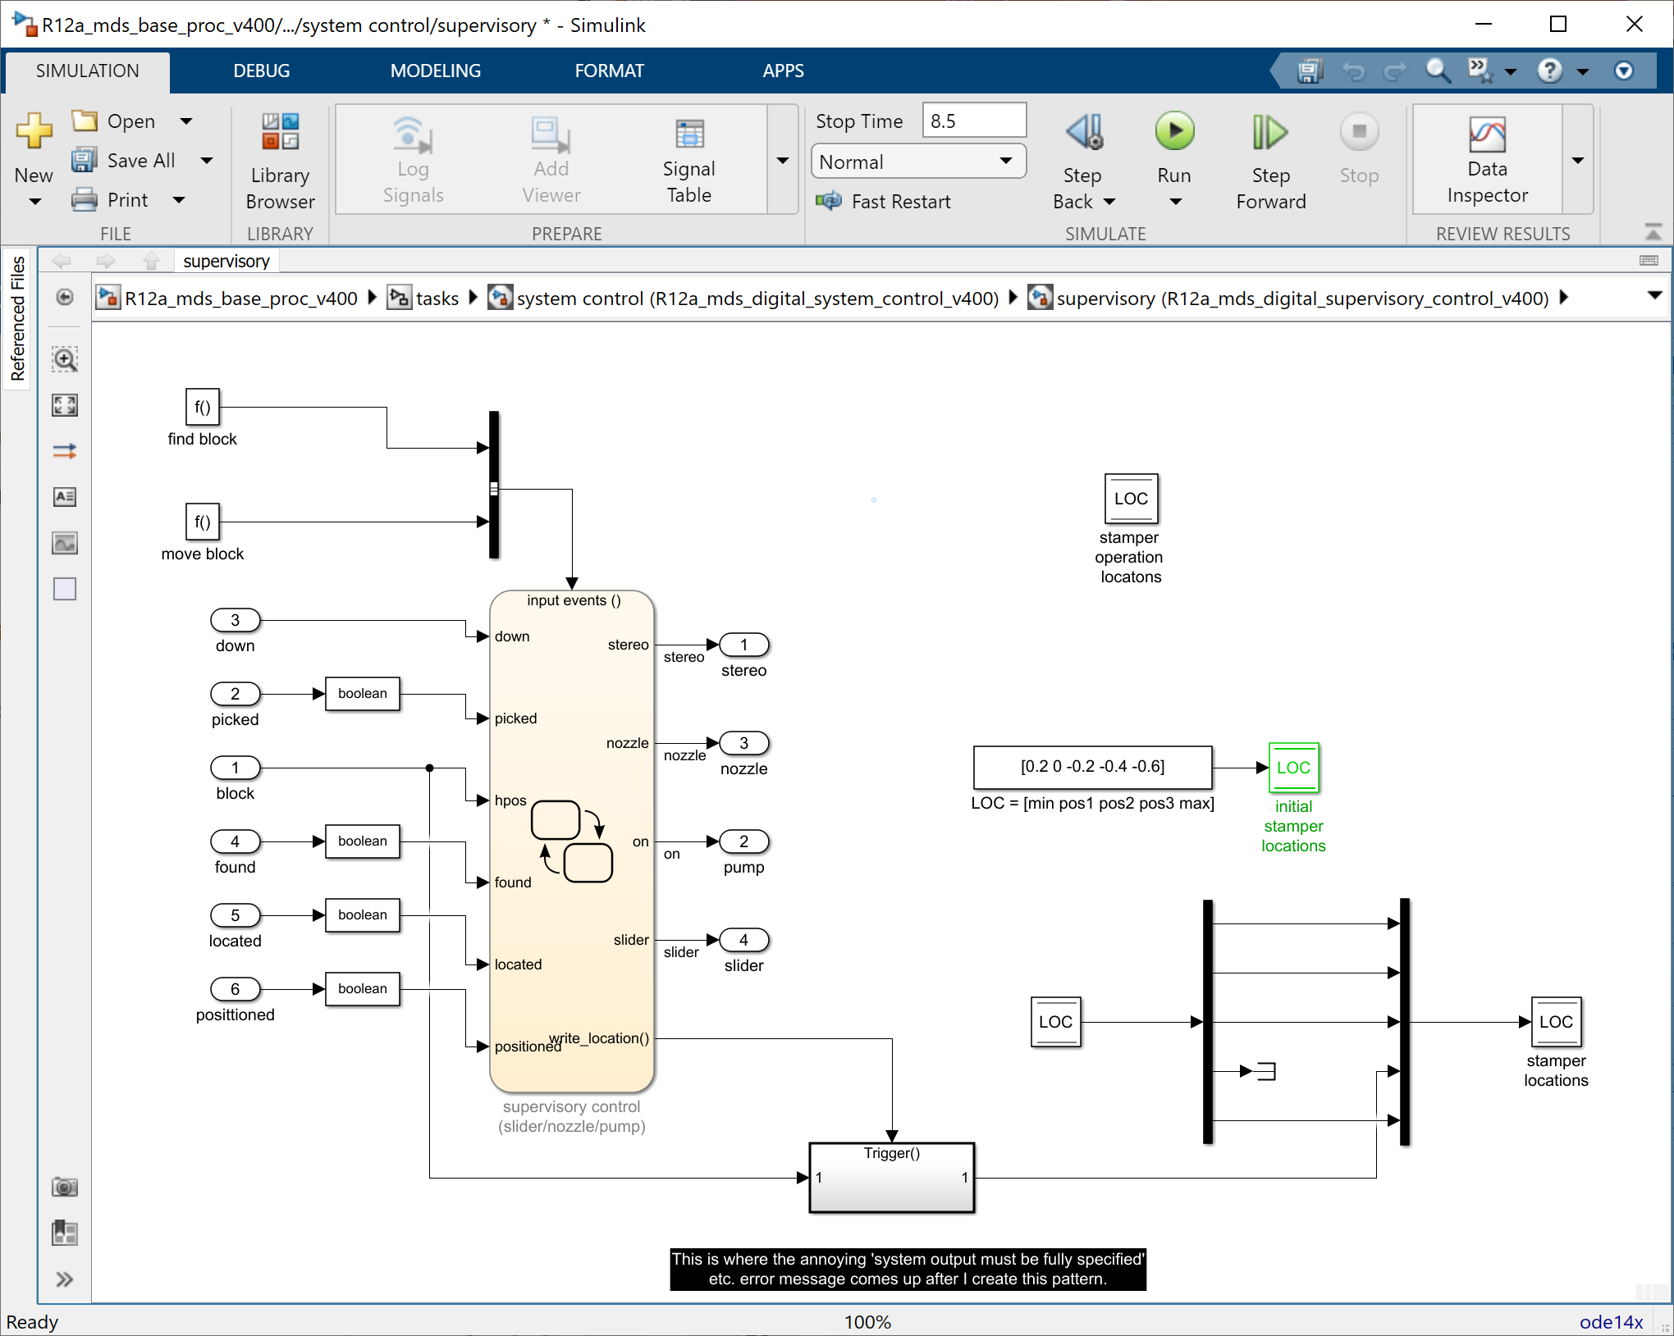
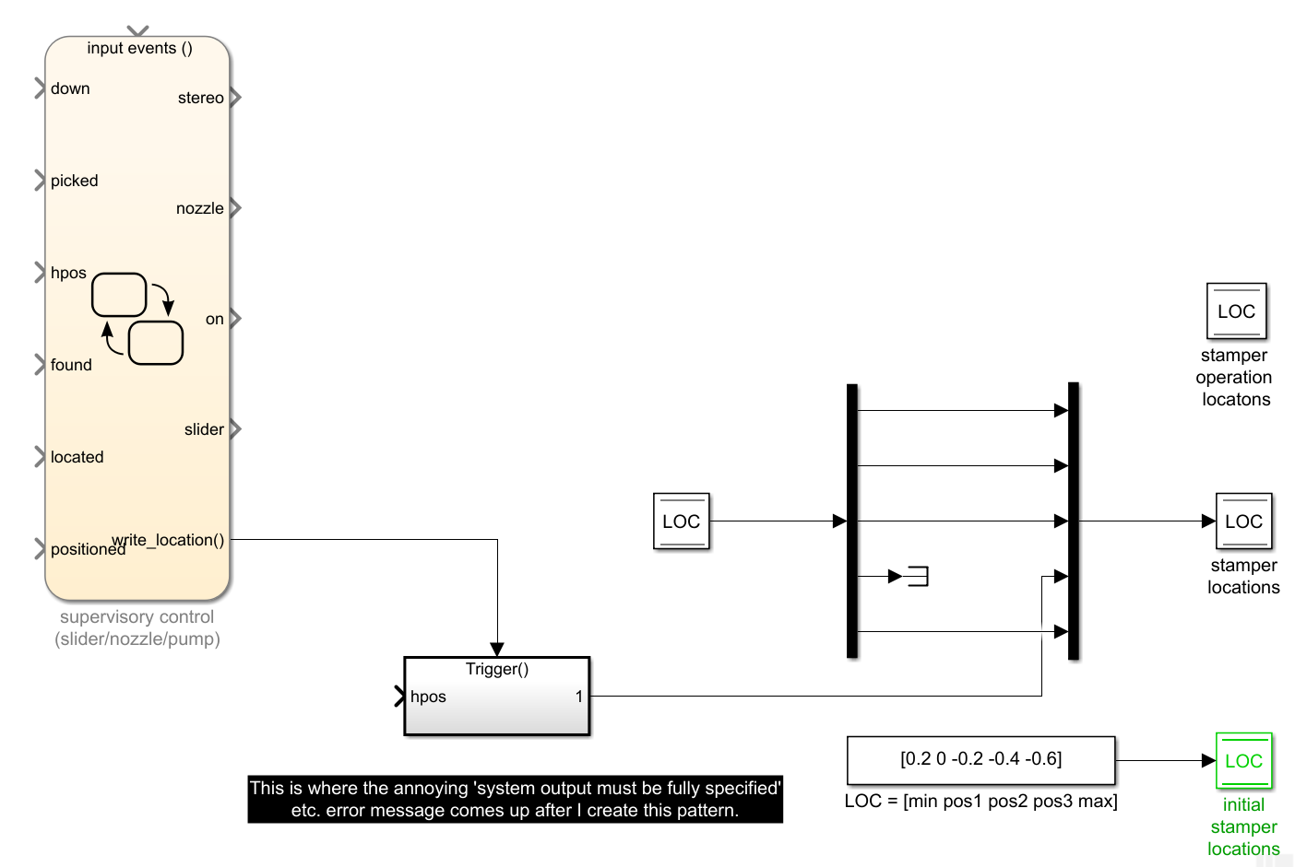
Structure
Moving tasks to execute under supervisory control
Check
Formalize
ORGANIZE
Trace
O
Navigate
Refactor

Slide 44
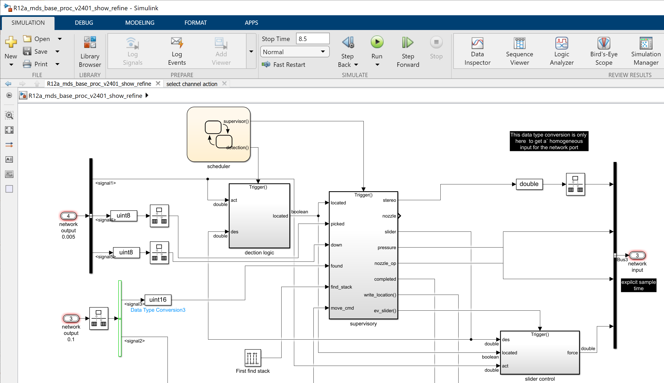
Structure
Moving tasks to execute under supervisory control
Check
Formalize
ORGANIZE
Trace
O
Navigate
Refactor

Slide 45
Design activities
CREATE
ORGANIZE
REFINE
EVALUATE
C
O
R
E

Slide 46
Transform
Describe increasing detail of a design
Capture how an implementation behaves
Allow approximations of designed behavior
Realizable
Lower cost
Better performance
Account for nonfunctional (not designed) behavior
Find actual physical realizations of principled solutions
Select components that meet (Pareto) optimal design objectives and constraints
Integrate
Profile
REFINE
Choose
R

Slide 47
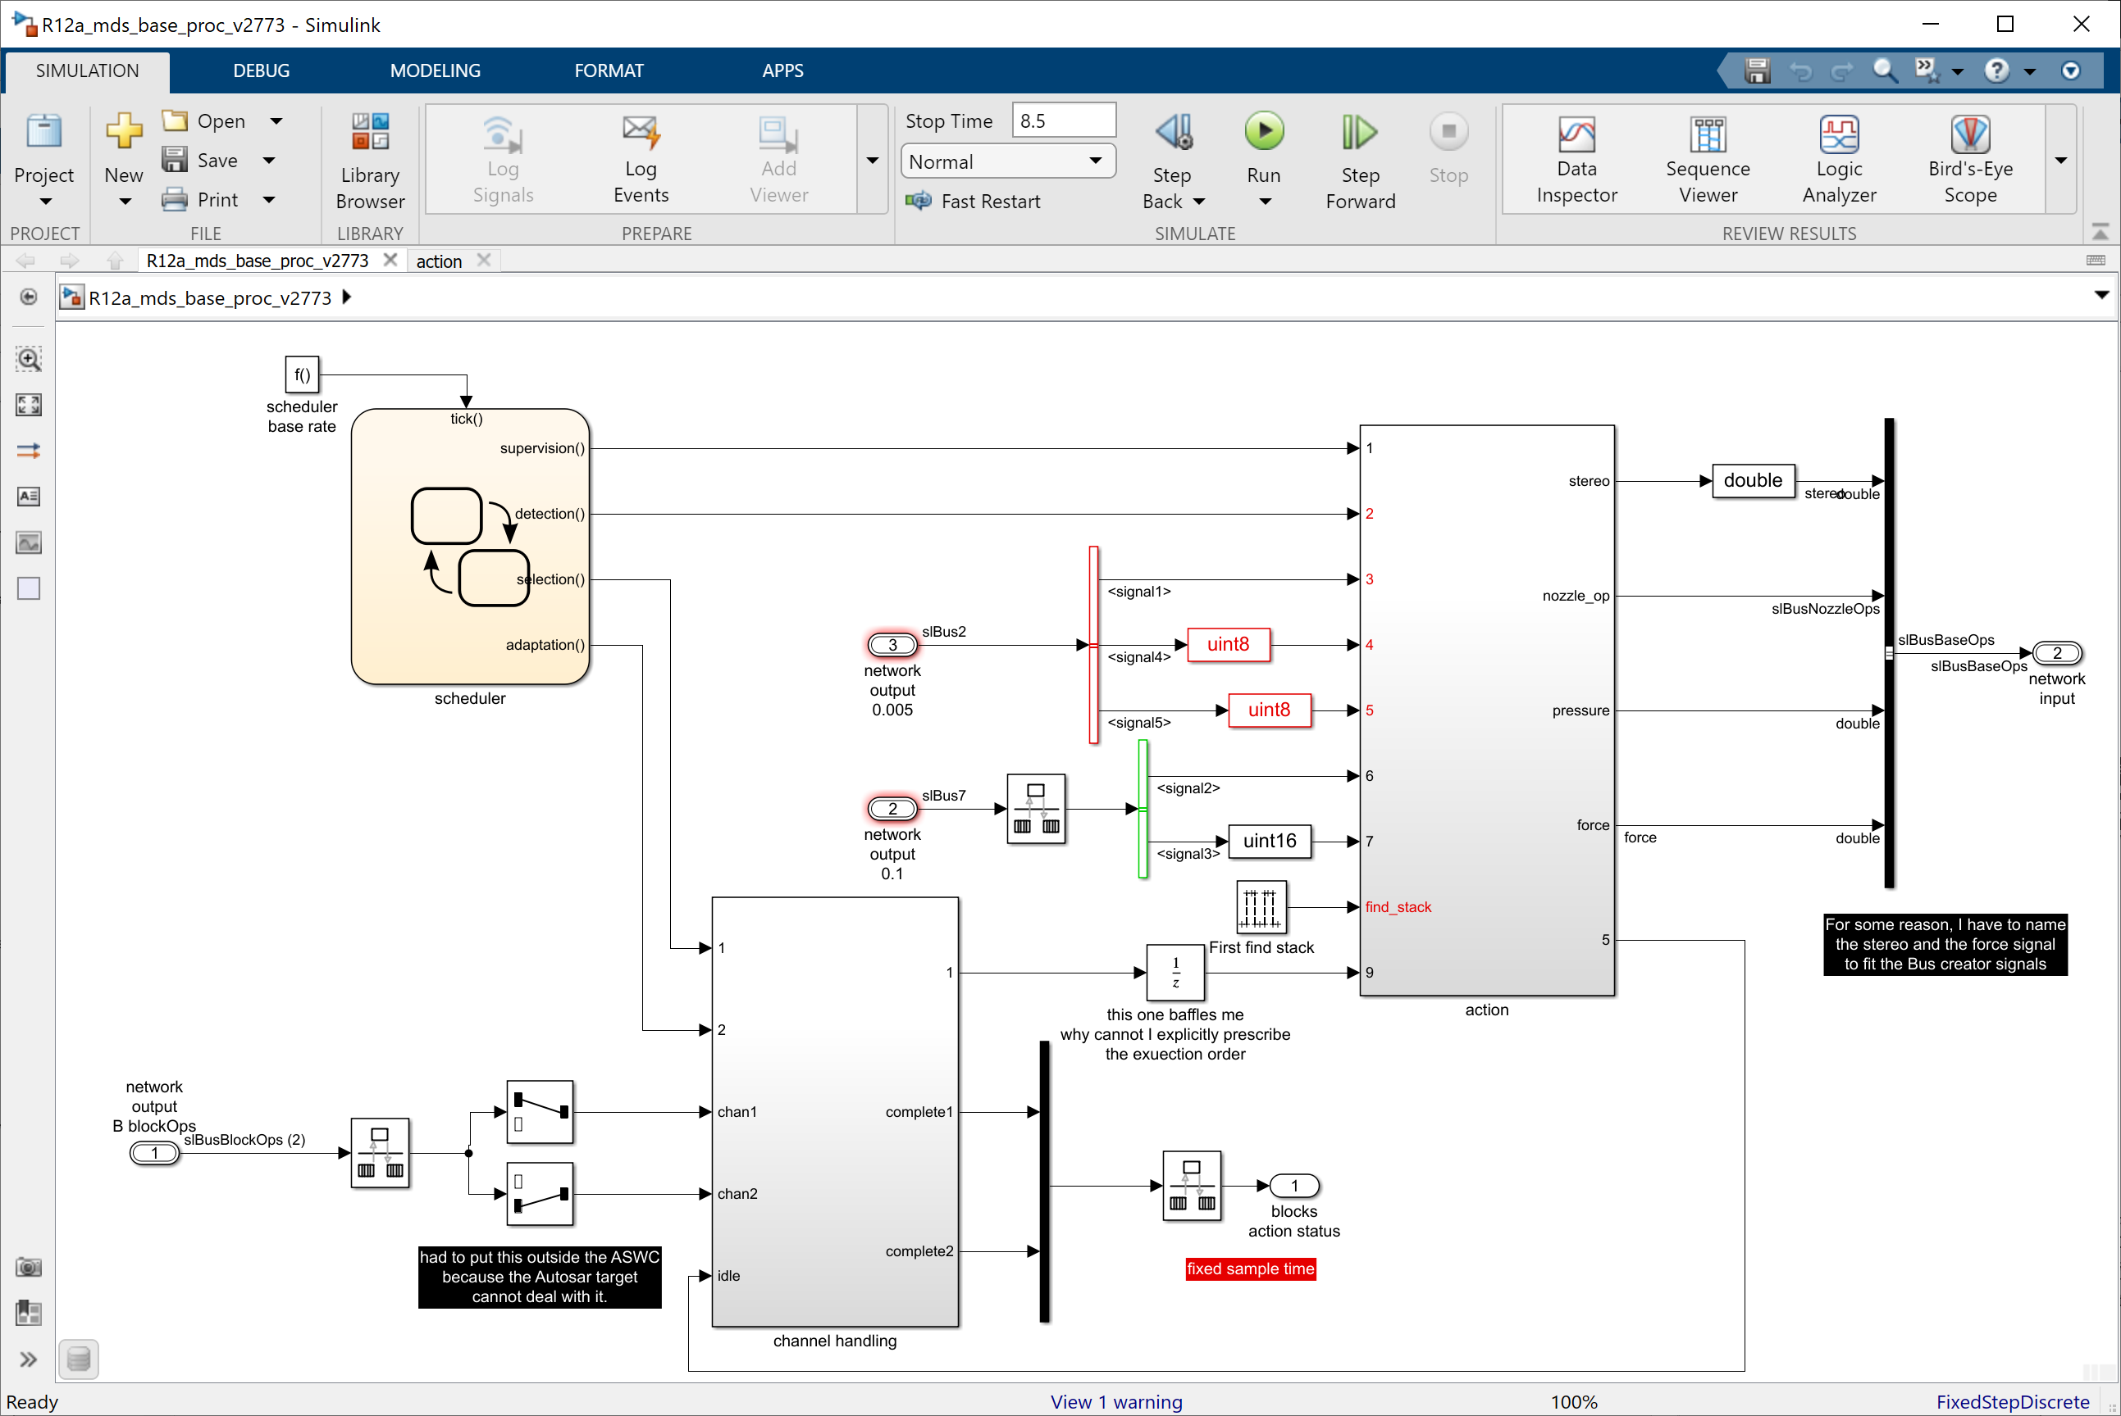
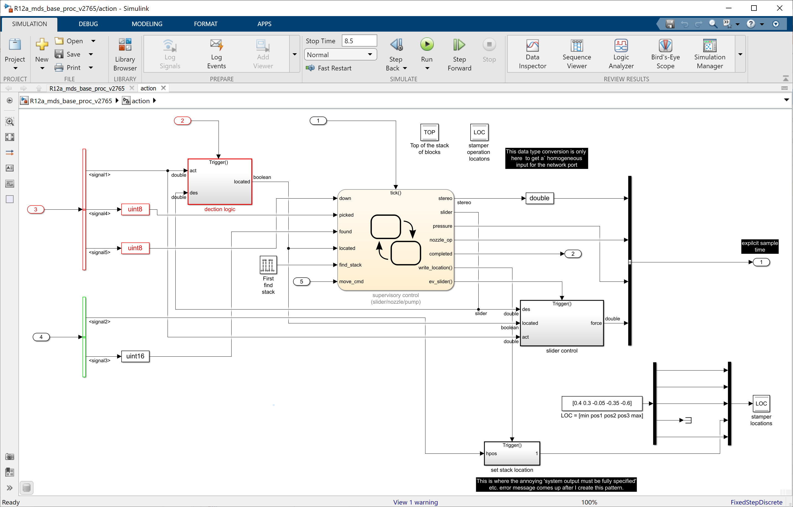
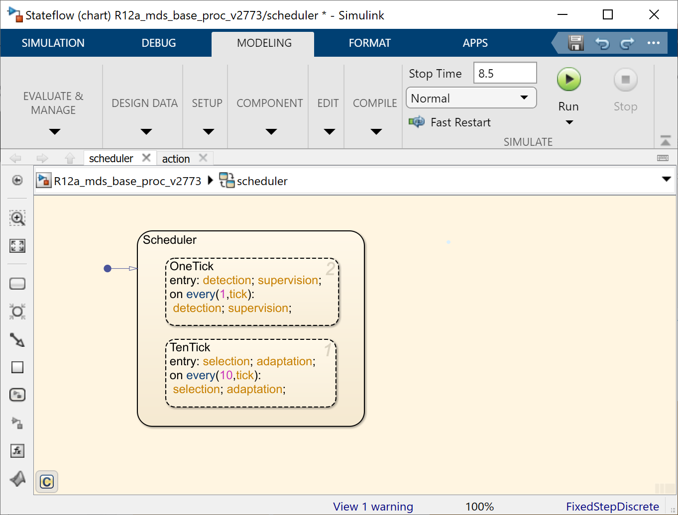
Transform
Adding an explicit execution scheduler
REFINE
R

Slide 48
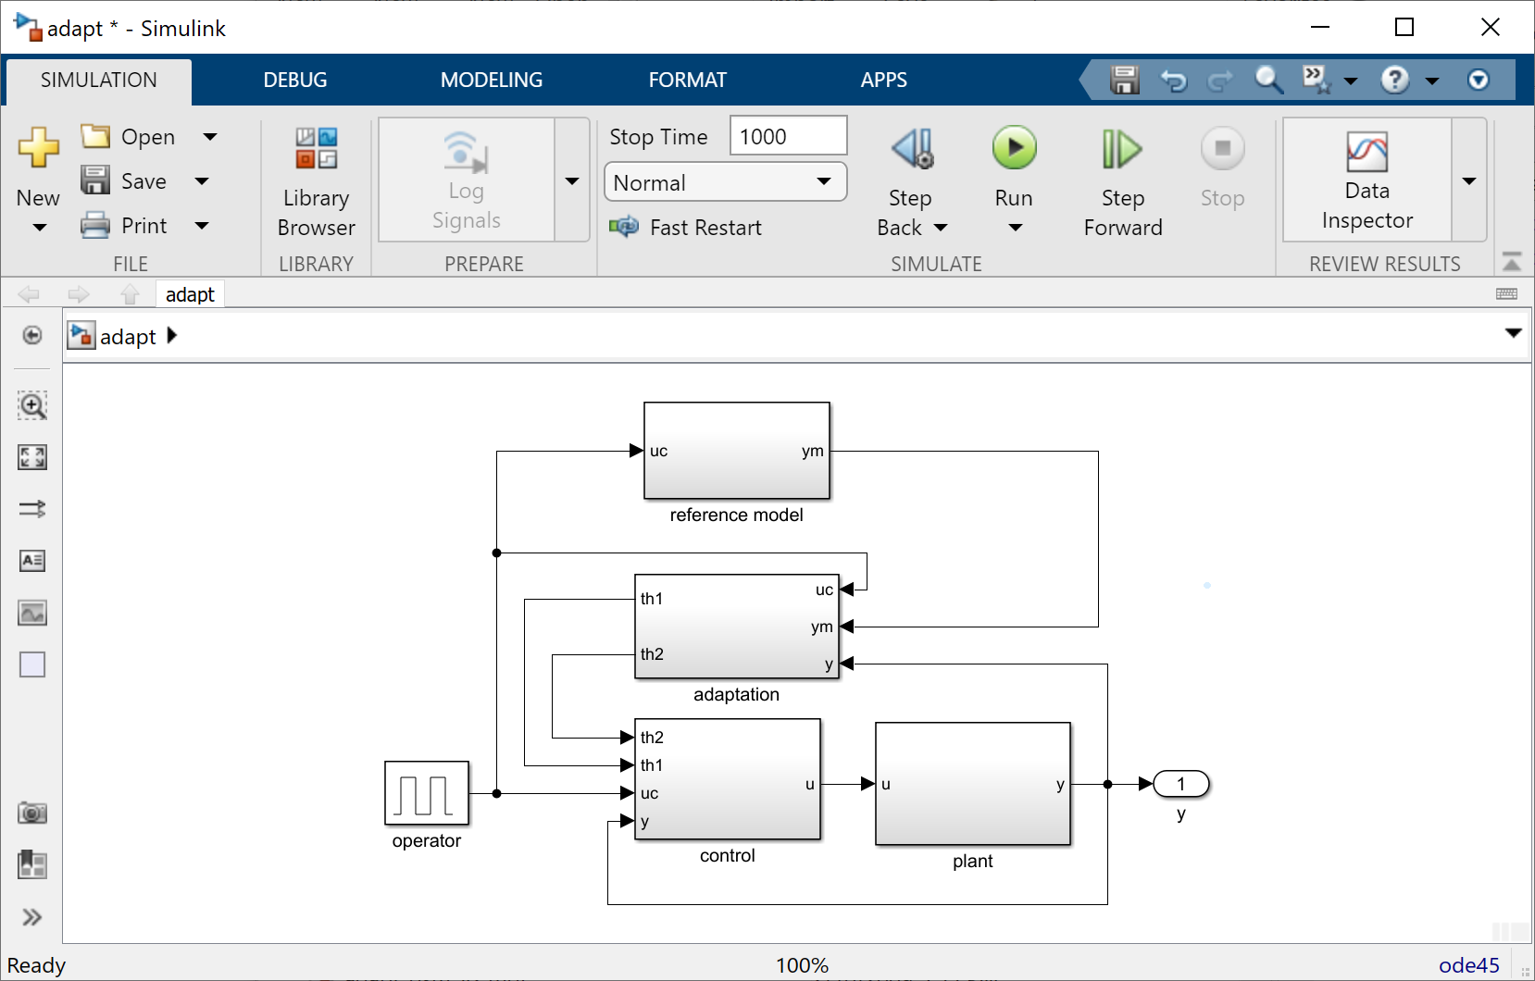
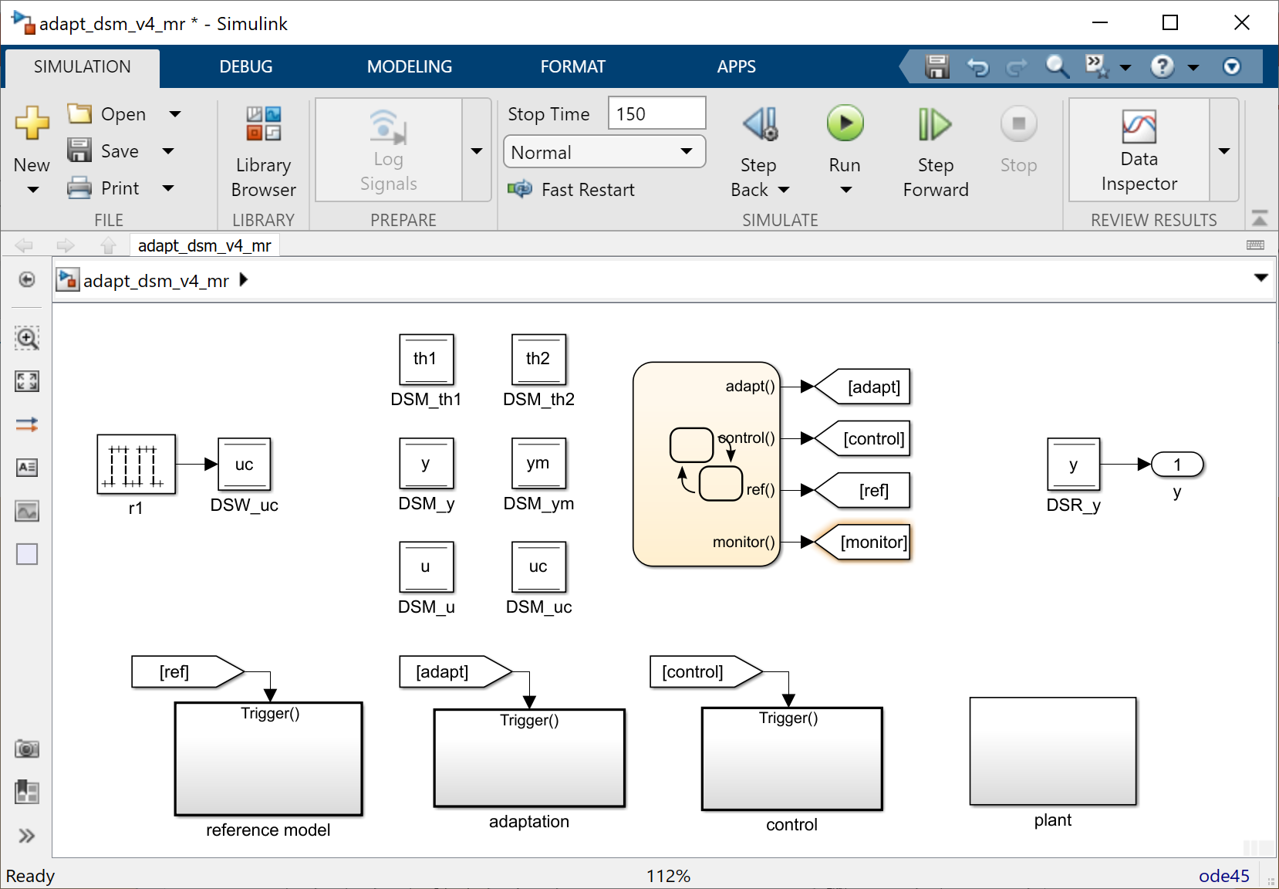
Transform
Inserting shared memory
REFINE
R

Slide 49
Transform
Integrate
REFINE
R

Slide 50
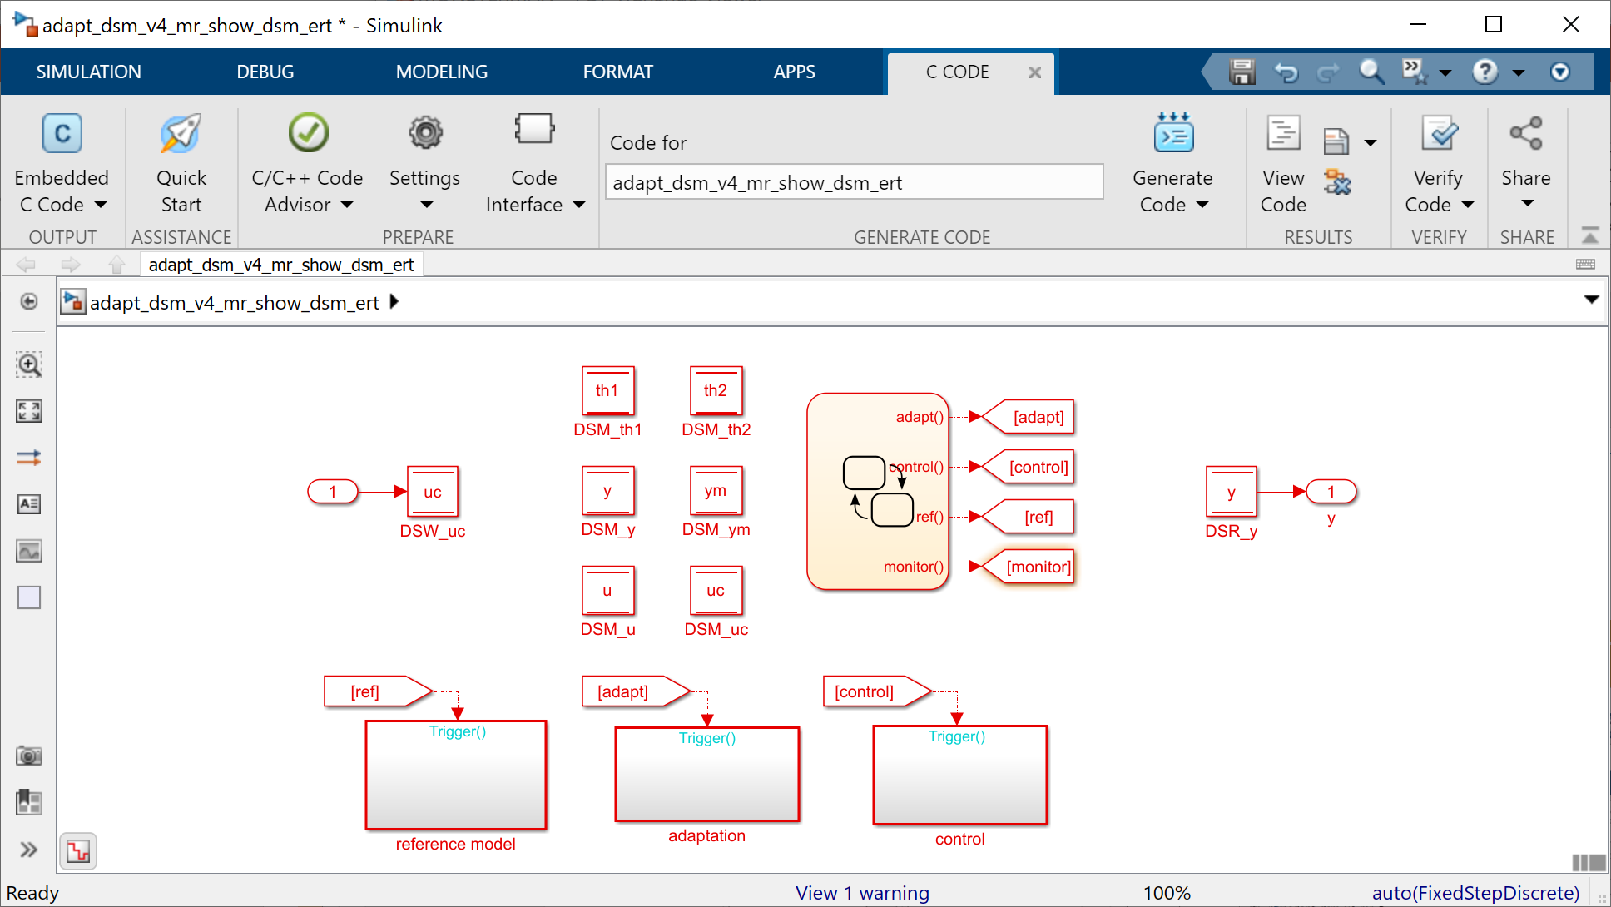
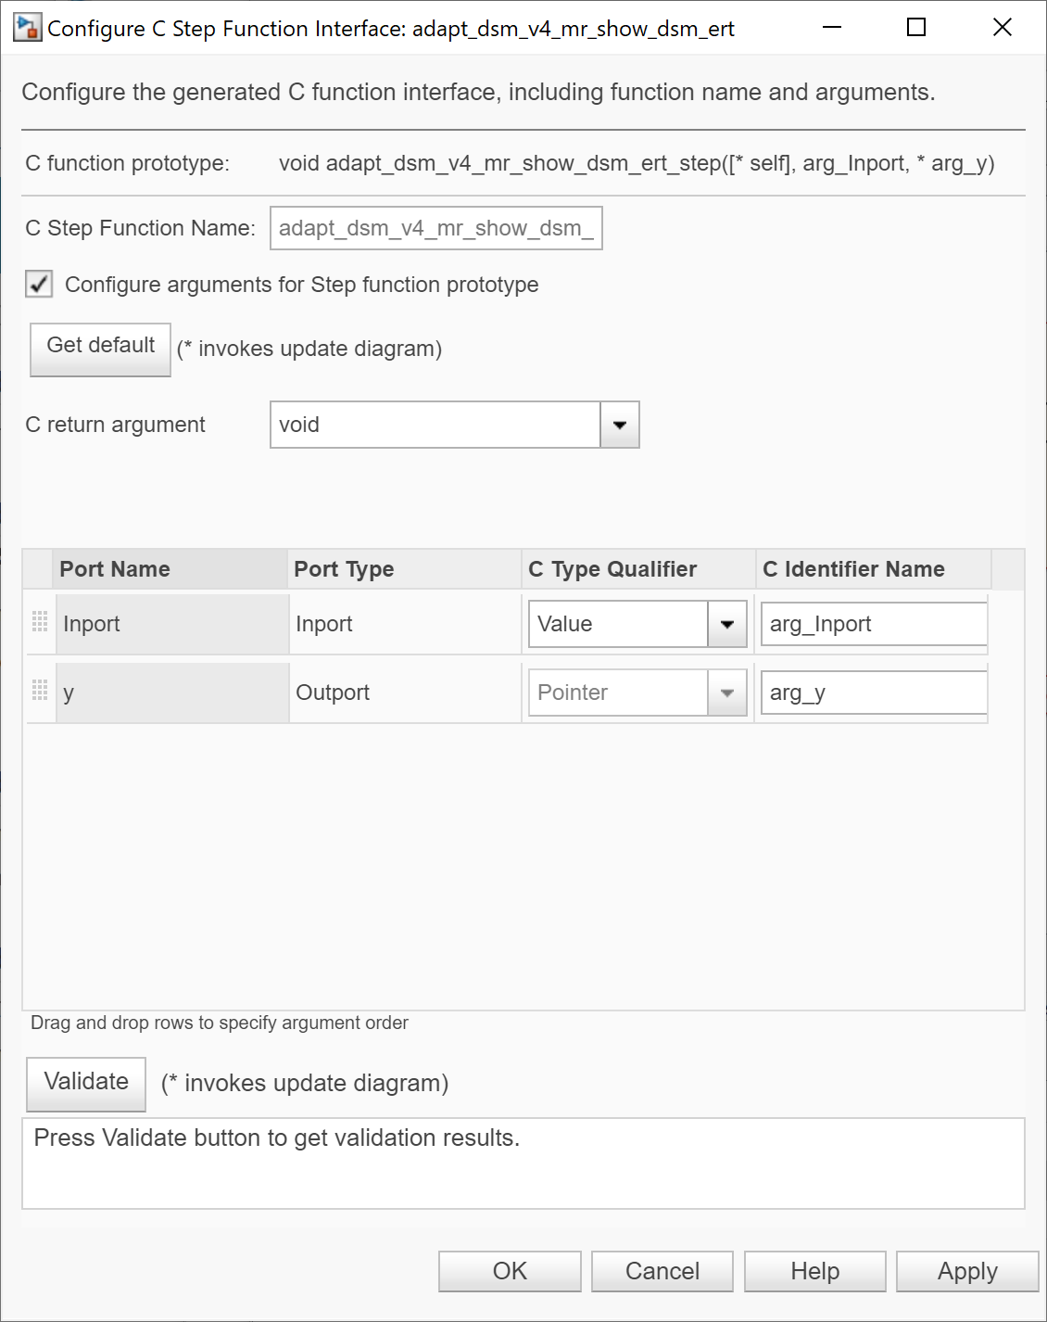
Transform
Integrating with code base
Integrate
REFINE
R

Slide 51
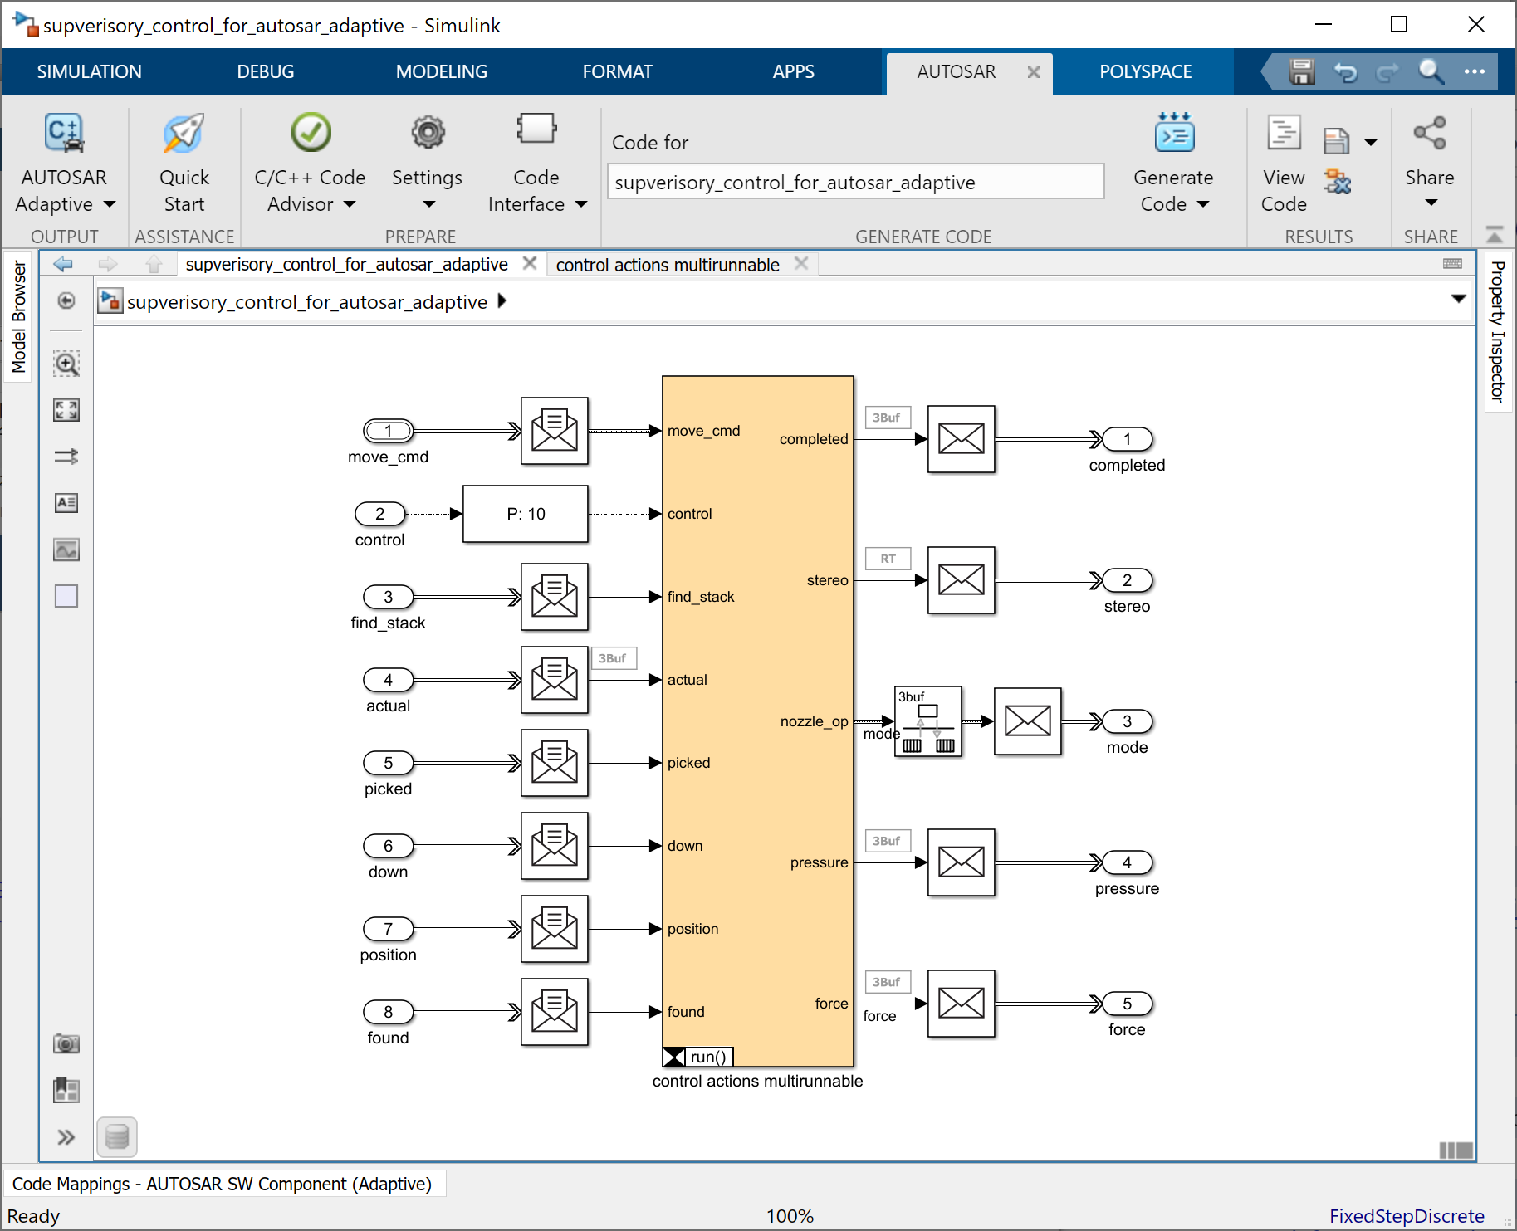
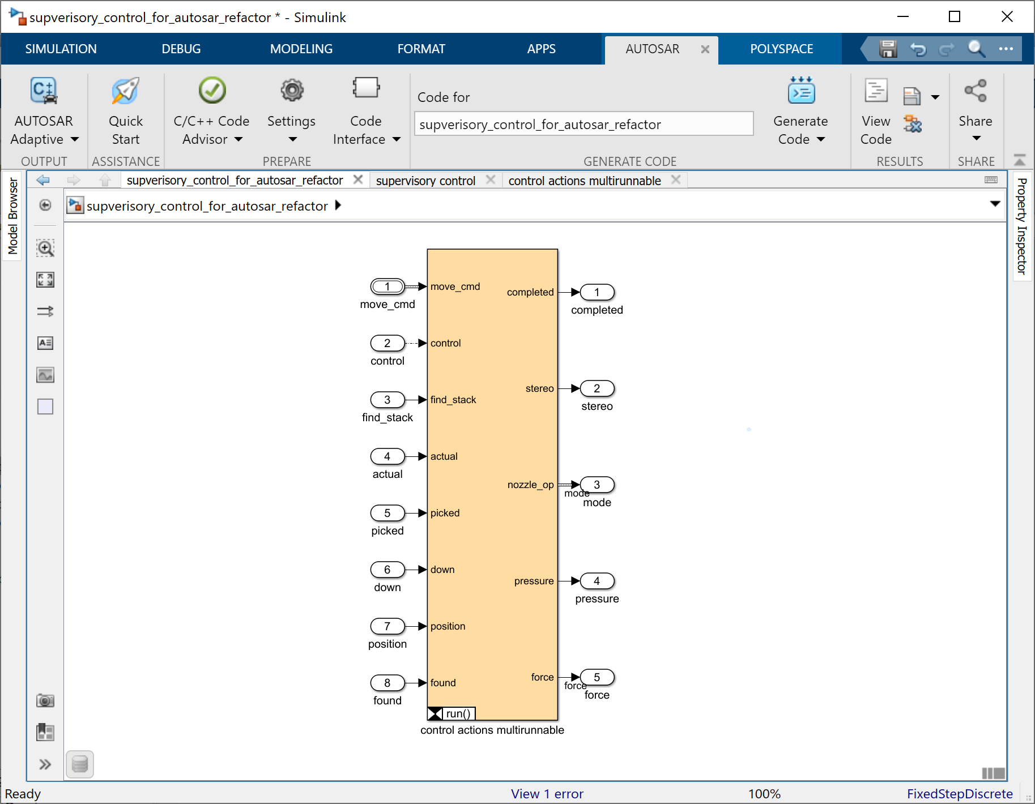
Transform
Integrating with middleware
Integrate
REFINE
R

Slide 52
Transform
Integrate
Profile
REFINE
R

Slide 53
Transform
Predicting hardware performance with AI
Integrate
Profile
REFINE
R
“HAQ: Hardware-Aware Automated Quantization with Mixed Precision,” Kuan Wang, Zhijian Liu, Yujun Lin, Ji Lin, and Song Han, 2019

Slide 54
Transform
Integrate
Profile
REFINE
Choose
R

Slide 55
Transform
Scaling component behavior
Integrate
Profile
REFINE
Choose
R

Slide 56
Transform
Parameterizing from electronic data sheets
Integrate
Profile
REFINE
Choose
R

Slide 57
Transform
Generating fidelity automatically
Integrate
Profile
REFINE
Choose
R

Slide 58
Design activities
CREATE
ORGANIZE
REFINE
EVALUATE
C
O
R
E

Slide 59
Review
Confirm formal processes to ensure solid engineering product
Documentation
Tracking changes
Contingency handling (safety, security, degradation)
Account for all design elements present
Trace to requirements and tests
Trace between design and implementation
Analyze correctness of design
Use qualified tools
Cover
Assess
EVALUATE
Verify
E
Assure
Qualify

Slide 60
Review
Generating understandable tests
EVALUATE
E

Slide 61
Review
Cover
EVALUATE
E

Slide 62
Review
Analyzing test coverage
Cover
EVALUATE
E

Slide 63
Review
Cover
Assess
EVALUATE
E

Slide 64
Review
Justifying missing coverage
Cover
Assess
EVALUATE
E

Slide 65
Review
Inspecting correspondence of model and code
Cover
Assess
EVALUATE
E

Slide 66
Review
Inspecting correspondence of model and code
Cover
Assess
EVALUATE
E

Slide 67
Review
Cover
Assess
EVALUATE
Verify
E

Slide 68
Review
Formally proving properties with abstract interpretation
Cover
Assess
EVALUATE
Verify
E

Slide 69
Review
Cover
Assess
EVALUATE
Verify
E
Assure

Slide 70
Review
Generating assurance cases
Cover
Assess
EVALUATE
Verify
E
Assure
“A Methodology for Automating Assurance Case Generation,” Shreyas Ramakrishna, Charles Hartsell, Abhishek Dubey, Partha Pal, and Gabor Karsai, 2020

Slide 71
Review
Cover
Assess
EVALUATE
Verify
E
Assure
Qualify

Slide 72
Review
Qualifying tools
Cover
Assess
EVALUATE
Verify
E
Assure
Qualify
“DeepFuzzSL: Generating Simulink Models with Deep Learning to Find Bugs in the Simulink Toolchain,” Sohil Lal Shrestha, Shafiul Azam Chowdhury, and Christoph Csallner, 2020

Slide 73
Design activities
CREATE
ORGANIZE
REFINE
EVALUATE
C
O
R
E

Slide 74
Agenda
Introduction of a running example
Pick and place machine
Illustrations of design activities in the CORE framework
Create
Organize
Refine
Evaluate
Discussion of opportunities for computational support
Automation
AI performed
AI assisted

Slide 75
CREATE
ORGANIZE
REFINE
EVALUATE
Construct
Structure
Transform
Review
Inspire
Check
Integrate
Cover
Extract
Formalize
Profile
Assess
Solve
Trace
Choose
Verify
Experiment
Navigate
Assure
Refactor
Qualify

Slide 76
CREATE
ORGANIZE
REFINE
EVALUATE
Construct
Structure
Transform
Review
Automatable tasks
Inspire
Check
Integrate
Cover
Extract
Formalize
Profile
Assess
Solve
Trace
Choose
Verify
Experiment
Navigate
Assure
Refactor
Qualify

Slide 77
CREATE
ORGANIZE
REFINE
EVALUATE
Creating the adaptation between interfaces should be perfect for AI?
Generating human interpretable tests is something AI should be good at?
Construct
Structure
Transform
Review
Automatable tasks
We have seen examples in this program
Inspire
Check
Integrate
Cover
AI performed tasks
Extract
Formalize
Profile
Assess
Styles should be learnable Some of it could be based on a corpus of examples
AI has shown to be able to predict hardware effects.
Solve
Trace
Choose
Verify
Design elements inserted by AI could be traced to specific requirements?
Given that nature of choice (a list of options), this should be amenable to AI.
Experiment
Navigate
Assure
Refactor
Qualify

Slide 78
Anticipate actions, choices
Detect patterns
Allow easy correcting
CREATE
ORGANIZE
REFINE
EVALUATE
High level human direction implemented by AI
Identify where deviations from nominal language patterns occur
Construct
Structure
Transform
Review
Automatable tasks
Inspire
Check
Integrate
Cover
AI performed tasks
Humans/AI symbiotic value
Extract
Formalize
Profile
Assess
Formulate problem where standard methodology applies
Solve
Trace
Choose
Verify
Human provides direction
Which behavior to study
Which technology to try
Experiment
Navigate
Assure
Anticipate user navigation destination
Human intuition to figure corner cases
Refactor
Qualify
Human specified objective with AI designed and implemented refactoring

Slide 79
CREATE
ORGANIZE
REFINE
EVALUATE
Human makes trade off (e.g., whether to redesign) with AI assistance
Construct
Structure
Transform
Review
Automatable tasks
Inspire
Check
Integrate
Cover
AI performed tasks
Humans/AI symbiotic value
Extract
Formalize
Profile
Assess
Human insight into design, architecture, implementation, hardware, for justification
Solve
Trace
Choose
Verify
Experiment
Navigate
Assure
Refactor
Qualify
AI identifies suspect elements to aid human decision

Slide 80
®

