Slide 1
An Introduction to Statecharts Modelling and Simulation
Simon Van Mierlo
simon.vanmierlo@uantwerpen.be
Hans Vangheluwe
hans.vangheluwe@uantwerpen.be

Slide 2
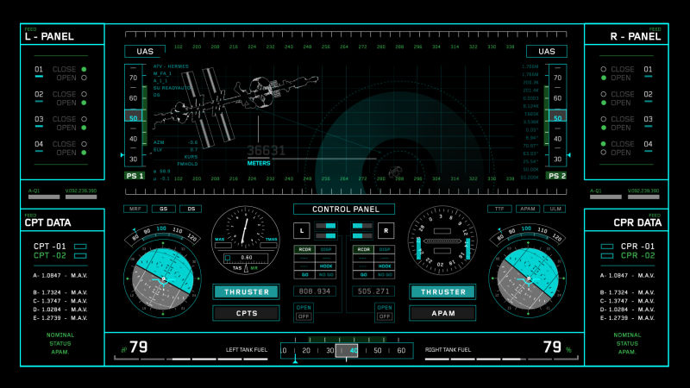
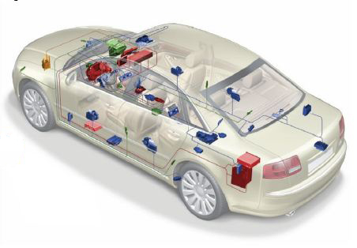
Complex Systems
Complexity: timed, autonomous, reactive (to events) behaviour
In contrast to transformational systems, which take input and, eventually, produce output
Notes:
What kind of complexity?

Slide 3
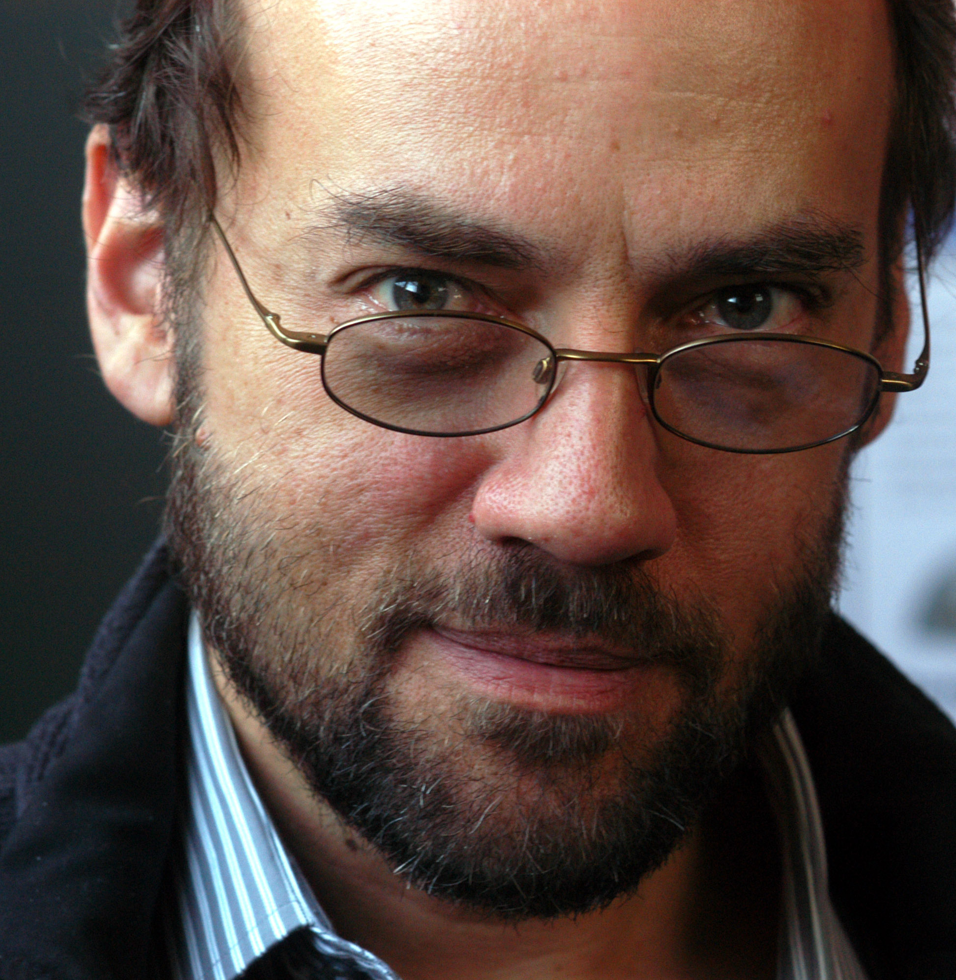
Modelling Reactive Systems
Interaction with the environment: reactive to events
Autonomous behaviour: timeouts
Partition system behaviour in modes (hierarchical) and concurrent units
Use programming language + threads and timeouts (OS)?
Programming language (and OS) is too low-level
-> most appropriate formalism: “what” vs. “how”
“Nontrivial software written with threads, semaphores, and mutexes are incomprehensible to humans”¹
¹E. A. Lee, "The problem with threads," in Computer, vol. 39, no. 5, pp. 33-42, May 2006.
Notes:
Programming language is good for transformational systems!
It was designed historically for implementing algorithms.
Abstractions were added later for concurrency and timeouts (through OS), but the fundamental building blocks and sequential execution style never changed.
We’re too close to “how” it is implemented, not “what” we want to implement.

Slide 4
Discrete-Event Abstraction
Notes:
Let’s look at one of the examples of before (Tank Wars): simplified.
Abstraction: most of the time “null” event (nothing pertinent happens).

Slide 5
Statecharts
Visual (topological, not geometric) formalism
Precisely defined syntax and semantics
Many uses:
Documentation (for human communication)
Analysis (of behavioural properties)
Simulation
Code synthesis
… and derived, such as testing, optimization, …
Notes:
Code synthesis: difference with DEVS for example, which is used exclusively for simulation, analysis of properties, not for code generation.

Slide 6
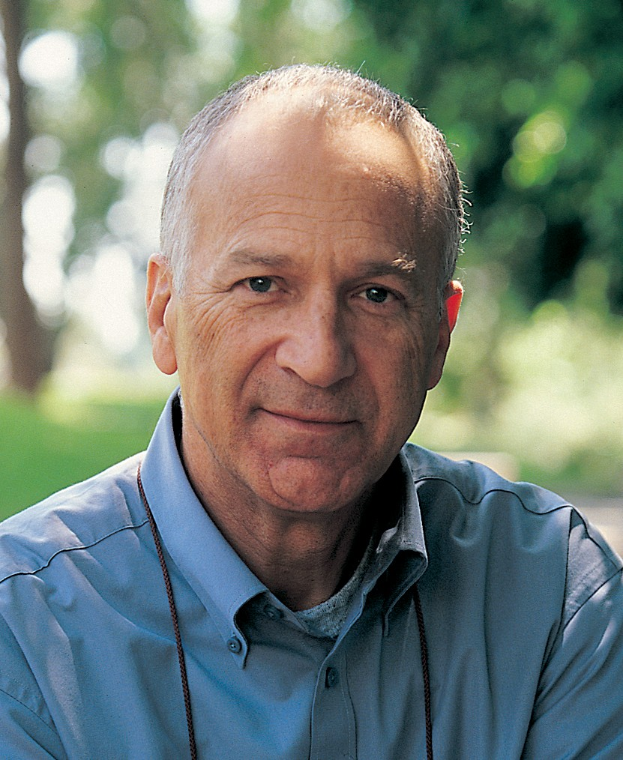
Statecharts History
Introduced by David Harel in 1987²
Notation based on higraphs = hypergraphs + Venn diagrams
Semantics extend deterministic finite state automata with:
Depth (Hierarchy)
Orthogonality
Broadcast Communication
Time
History
Syntactic sugar, such as enter/exit actions
²David Harel, Statecharts: a visual formalism for complex systems, Science of Computer Programming, Volume 8, Issue 3, 1987, Pages 231-274
Notes:
Notion of nodes, edges, but also regions that can overlap, be nested and composed.

Slide 7
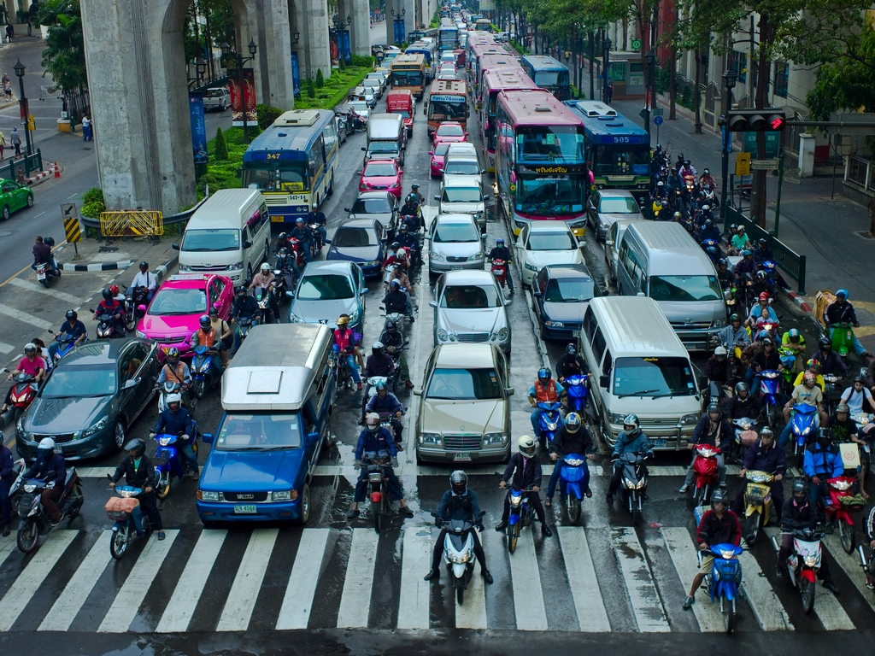
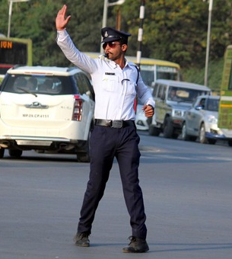
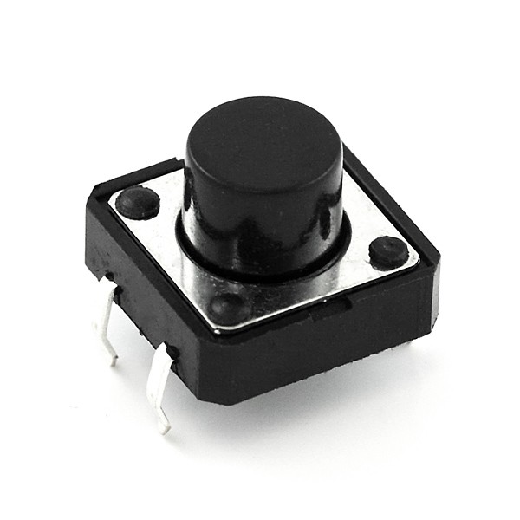
Running Example
Environment
Controller
input
(Physical) Plant
<<observe>>
output
<<observe>>
<<act>>

Slide 8
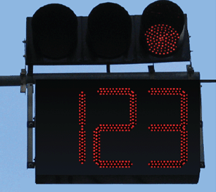
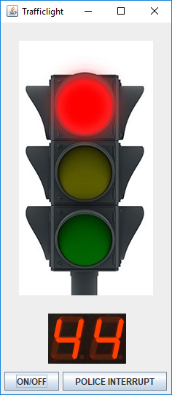
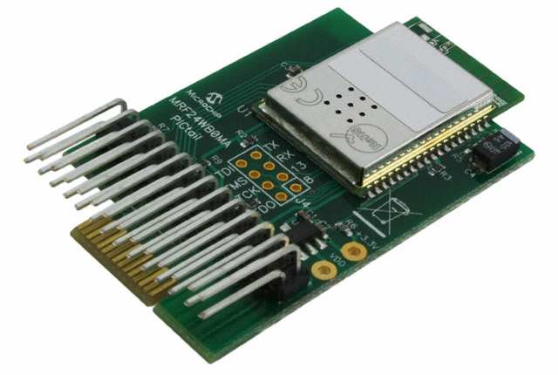
Deployment
Environment
(Simulated) Plant
Controller
(Physical) Plant
Environment
system
input
<<observe>>
<<observe>>
system
output
<<act>>
1
2
Notes:
Specification of controller -> we know that this will be a Statechart model, but for now we don’t really care: it can be programming code, or whatever.
We don’t have a real traffic light, nor a policeman: so we will build a simulated environment from the same specification.
So now in the remaining slide: build the controller (using Statecharts).

Slide 9
Workflow
³ Hans Vangheluwe and Ghislain C. Vansteenkiste. A multi-paradigm modeling and simulation methodology: Formalisms and languages. In European Simulation Symposium (ESS), pages 168-172. Society for Computer Simulation International (SCS), October 1996. Genoa, Italy.
⁴ FTG+PM: An Integrated Framework for Investigating Model Transformation Chains, Levi Lúcio, Sadaf Mustafiz, Joachim Denil, Hans Vangheluwe, Maris Jukss. System Design Languages Forum (SDL) 2013, Montreal, Quebec. LNCS Volume 7916, pp 182-202, 2013.

Slide 10
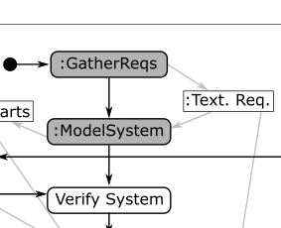
Requirements
R1: three differently coloured lights: red, green, yellow
R2: at most one light is on at any point in time
R3: at system start-up, the red light is on
R4: cycles through red on, green on, and yellow on
R5: red is on for 60s, green is on for 55s, yellow is on for 5s
R6: police can interrupt autonomous operation
Result = blinking yellow light (on -> 1s, off -> 1s)
R7: police can resume an interrupted traffic light
Result = light which was on at time of interrupt is turned on again
R8: a timer displays the remaining time while the light is red or green; this timer decreases and displays its value every second. The colour of the timer reflects the colour of the traffic light.
Notes:
Don’t forget: we’re modelling the controller software of the traffic light, not the traffic light itself.

Slide 11
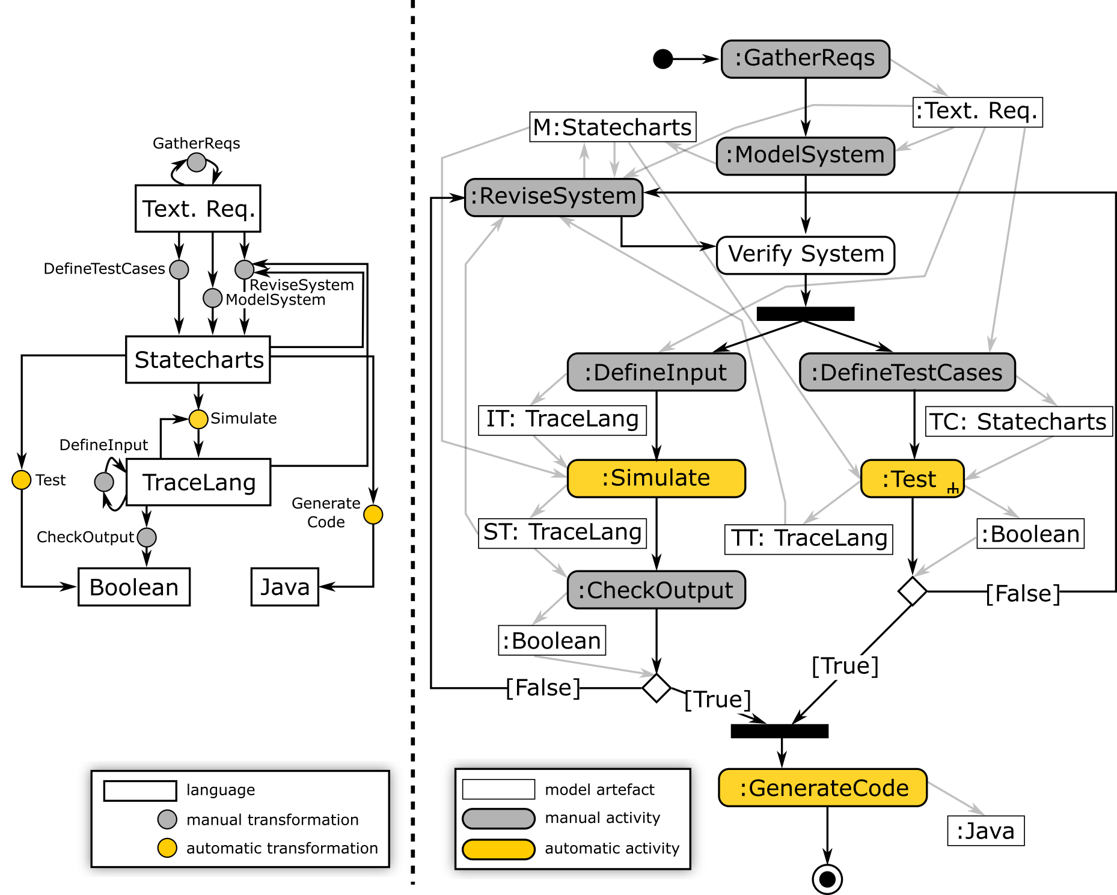
Workflow

Slide 12
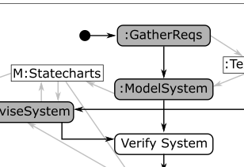
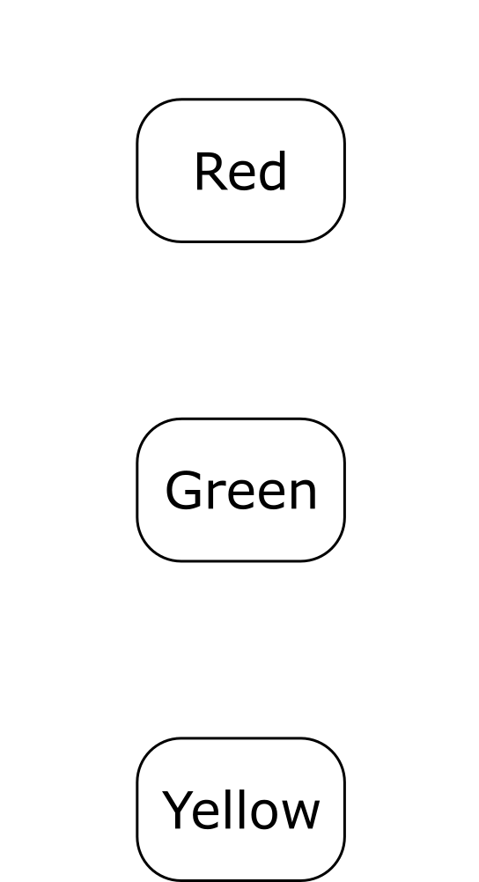
States
R1: three differently coloured lights: red (R), green (G), yellow (Y)
R2: at most one light is on at any point in time
{R: on, Y: off, G: off}
{R: off, Y: off, G: on}
(Simulated) Plant
Environment
<<observe>>
{R: off, Y: on, G: off}

Slide 13
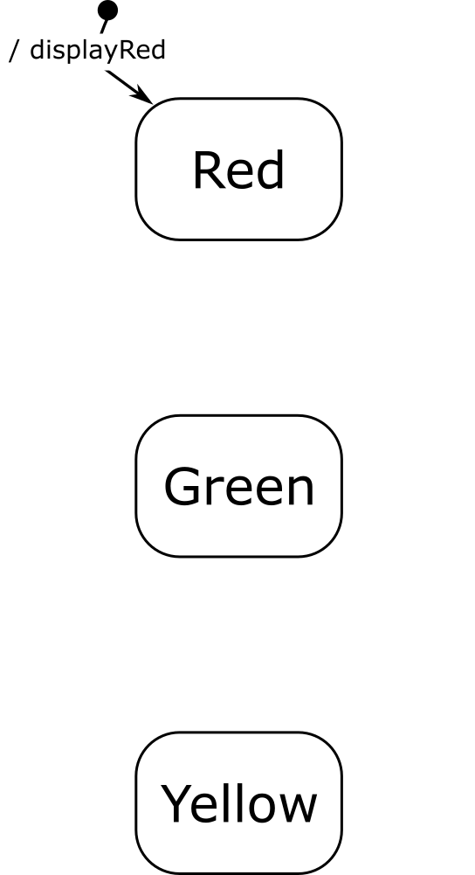
Default State
R1: three differently coloured lights: red (R), green (G), yellow (Y)
R2: at most one light is on at any point in time
R3: at system start-up, the red light is on
{R: on, Y: off, G: off}
{R: off, Y: off, G: on}
(Simulated) Plant
Environment
<<observe>>
{R: off, Y: on, G: off}

Slide 14
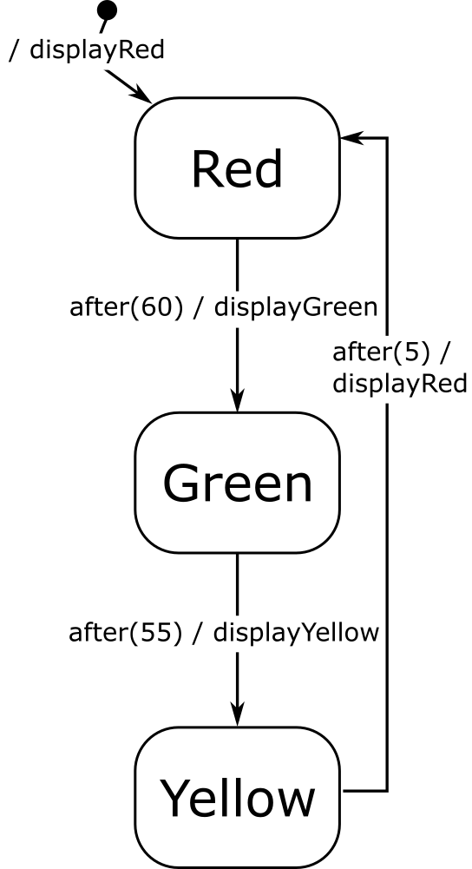
Transitions
R1: three differently coloured lights: red (R), green (G), yellow (Y)
R2: at most one light is on at any point in time
R3: at system start-up, the red light is on
R4: cycles through red on, green on, and yellow on
R5: red is on for 60s, green is on for 55s, yellow is on for 5s
{R: on, Y: off, G: off}
event(params) [guard] / output_action(params)
{R: off, Y: off, G: on}
(Simulated) Plant
Environment
<<observe>>
{R: off, Y: on, G: off}

Slide 15
Yakindu⁵: Modelling
(introducing syntactic sugar: enter actions)
⁵ https://www.itemis.com/en/yakindu/state-machine/

Slide 16
Workflow

Slide 17
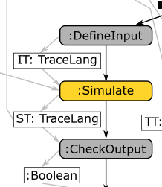
Yakindu: Simulation (Scaled Real-Time)

Slide 18
Workflow

Slide 19
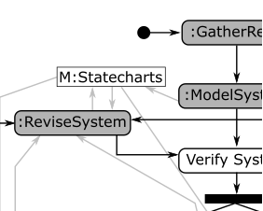
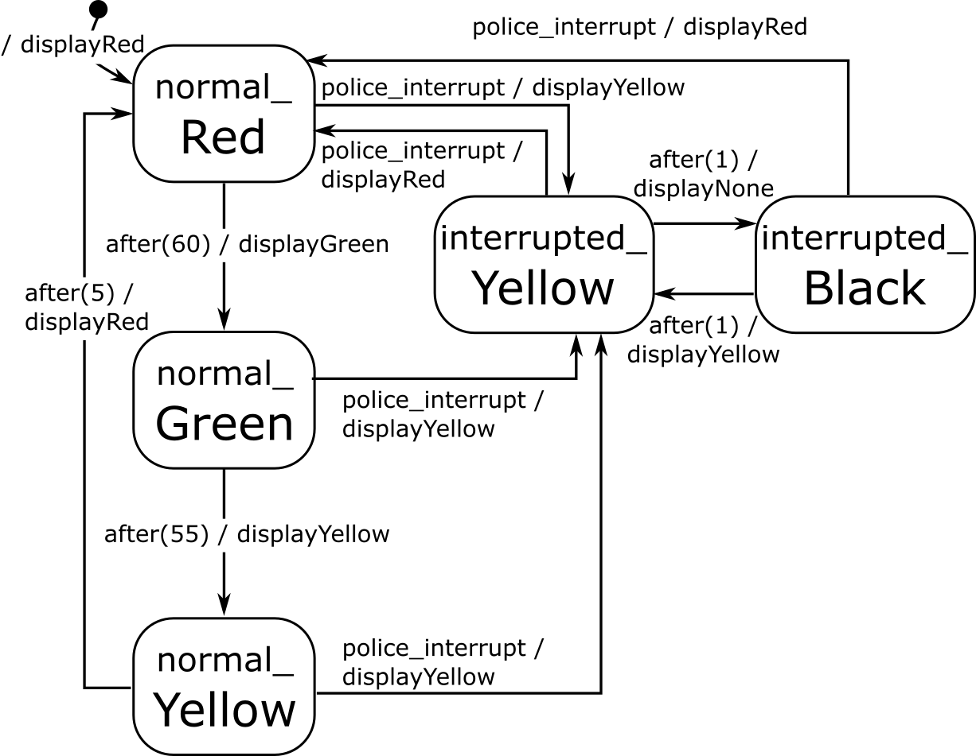
Hierarchy
R6: police can interrupt autonomous operation
Result = blinking yellow light (on -> 1s, off -> 1s)
R7: police can resume an interrupted traffic light
Semantics/Meaning?
FLATTEN

Slide 20
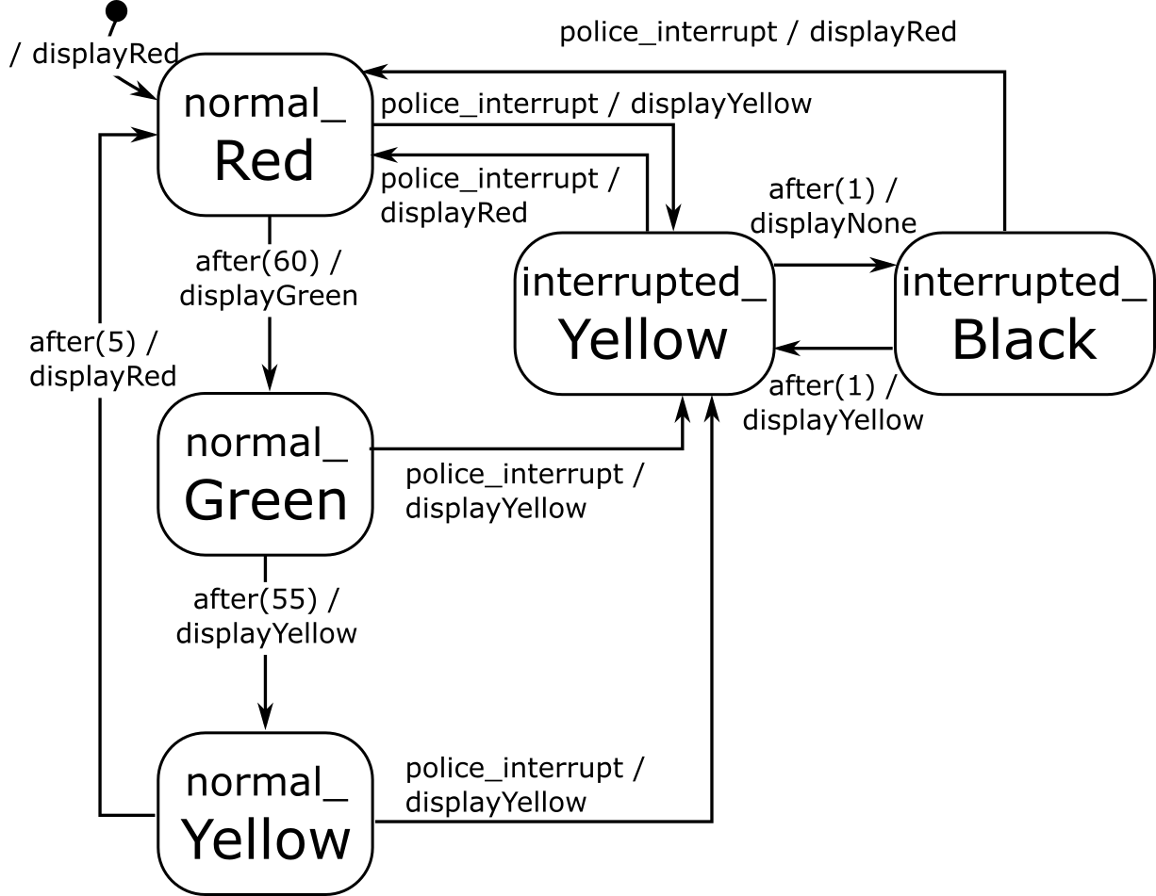
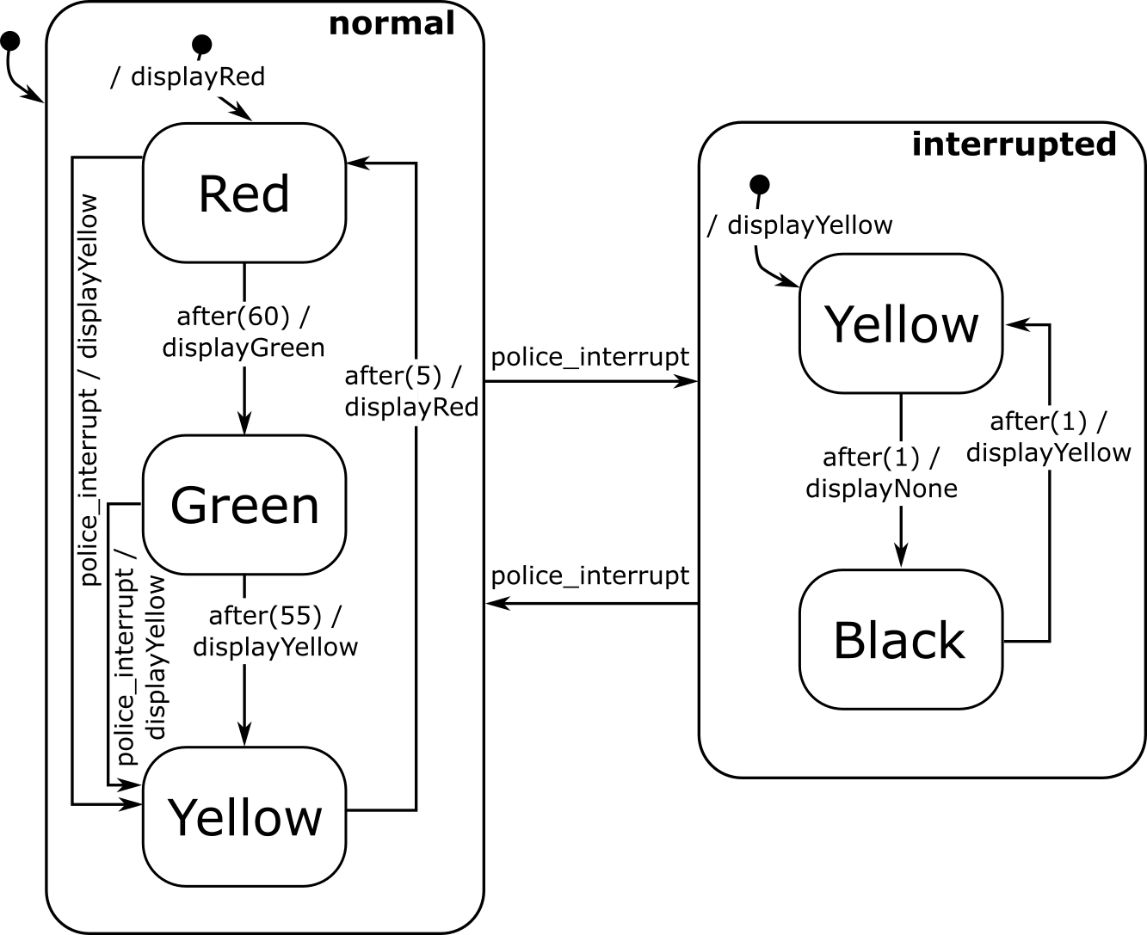
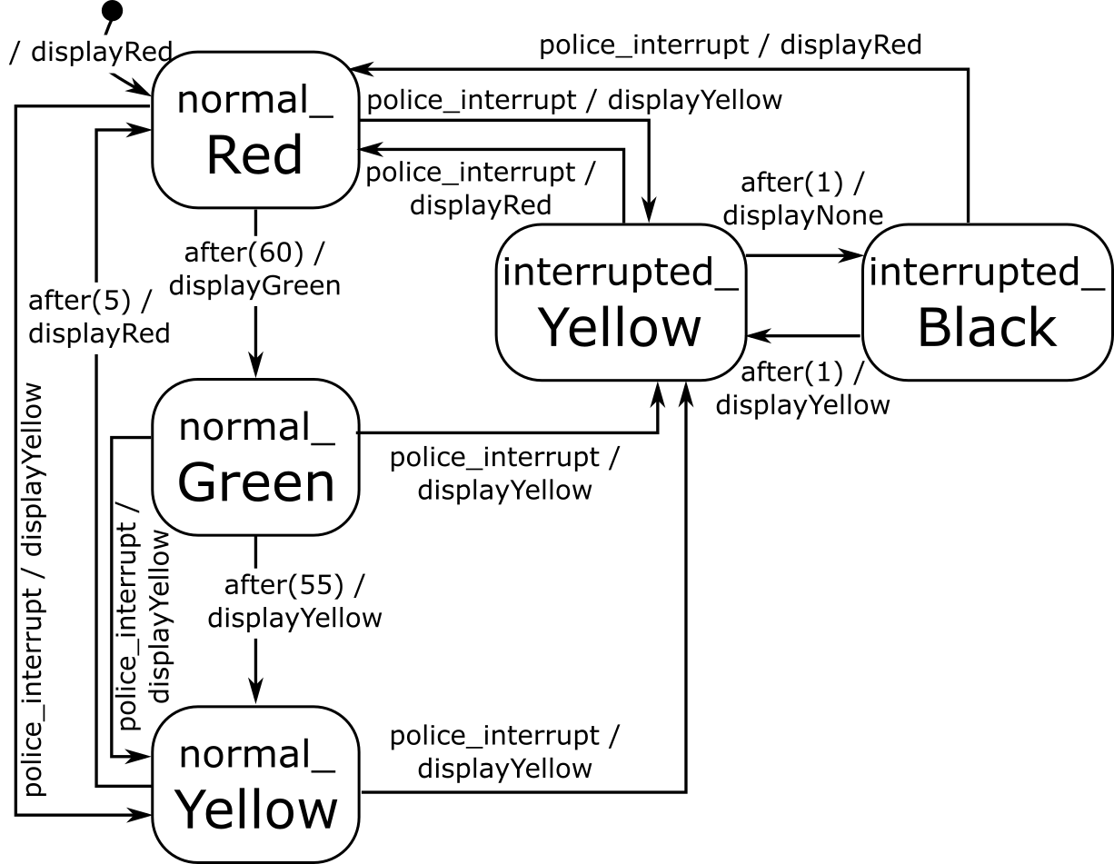
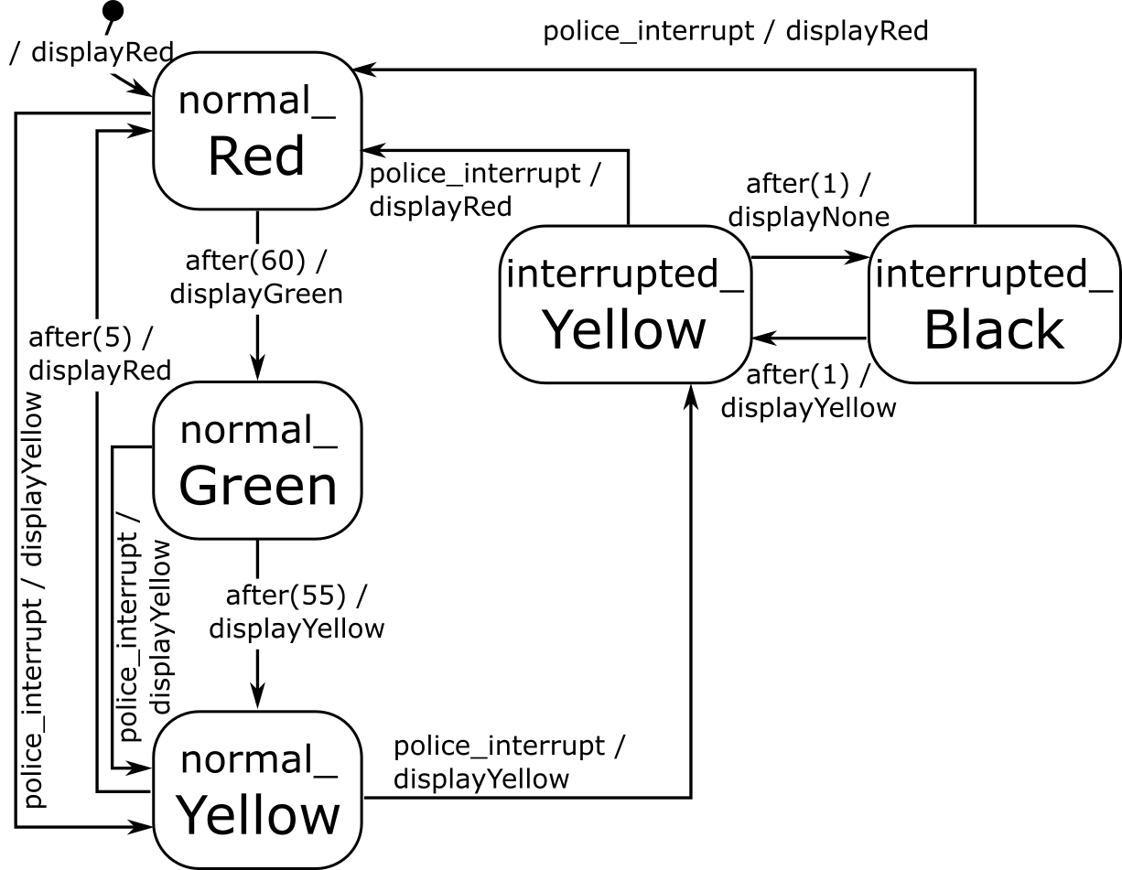
Hierarchy: Modified Example
Statemate, Yakindu, …
Semantics/Meaning?
(unwanted) non-determinism!
FLATTEN
Rhapsody, …
determinism!
Notes:
Motivation for choices: Statemate because we can see composite states as black boxes, Rhapsody for ‘specialization’

Slide 21
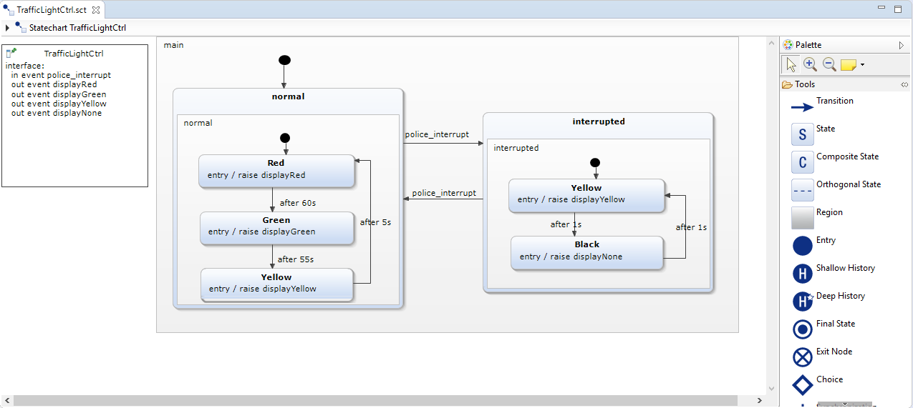
Yakindu: Hierarchy

Slide 22
History
R7: police can resume an interrupted traffic light
Result = light which was on at time of interrupt is turned on again
H
shallow history
H*
deep history

Slide 23
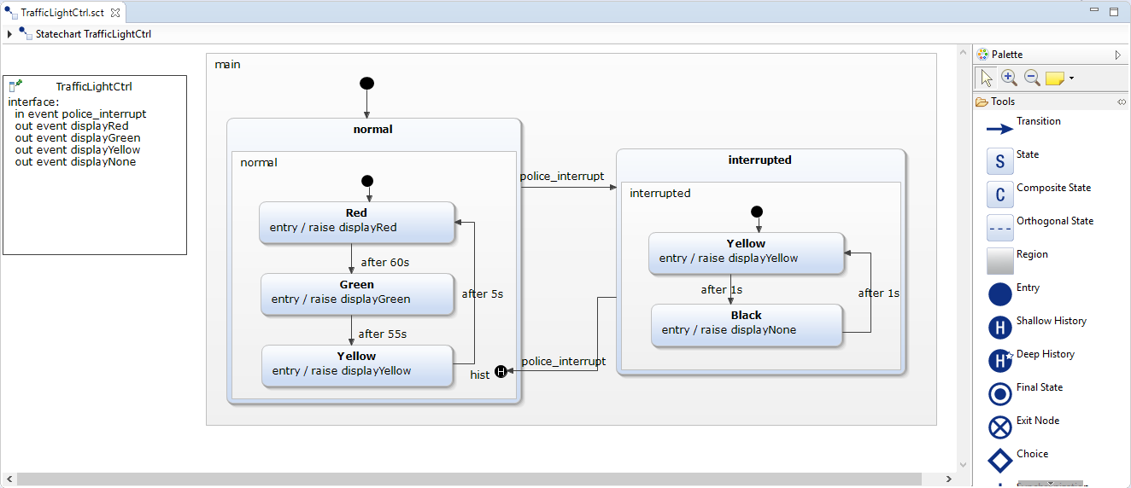
Yakindu: History

Slide 24
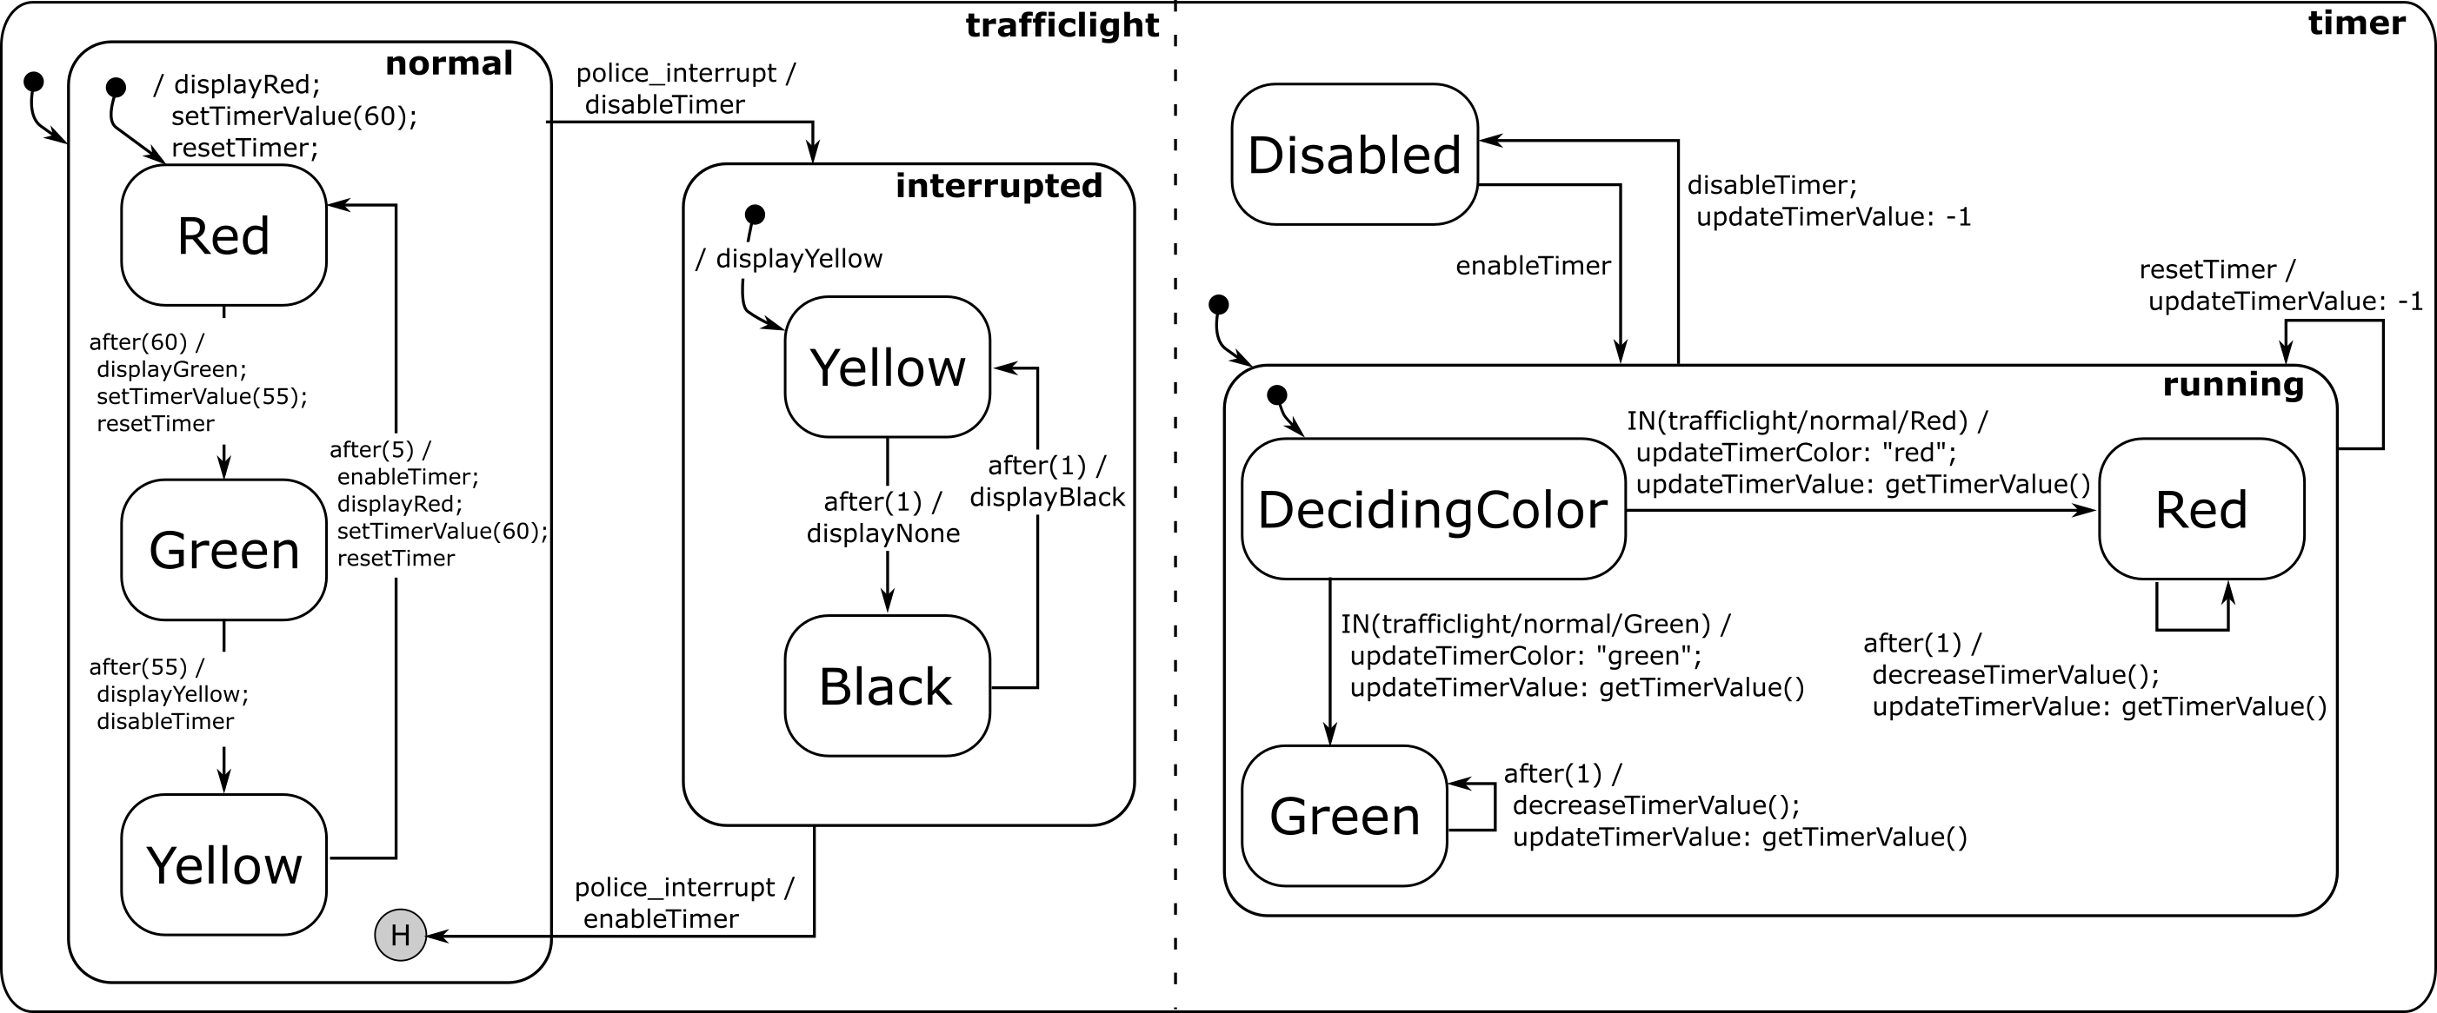
Concurrency
TrafficLight
- timer: int
R8: a timer displays the remaining time while the light is red or green; this timer decreases and displays its value every second. The colour of the timer reflects the colour of the traffic light.
Notes:
Diamond property
Parallel independence

Slide 25
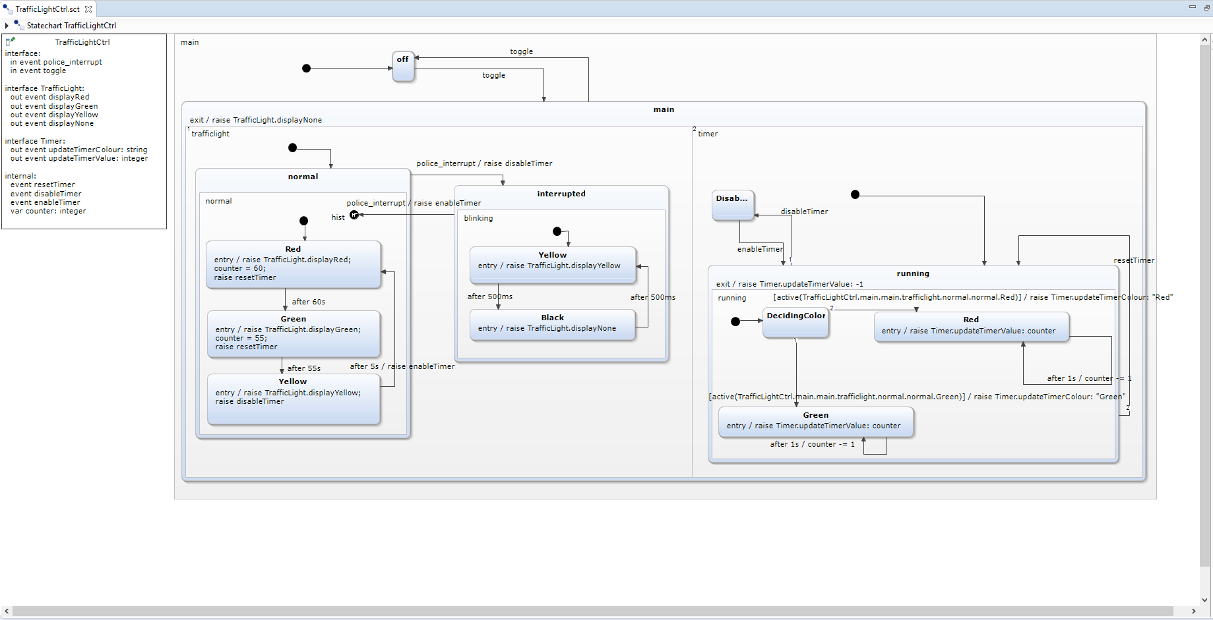
Yakindu: Concurrency

Slide 26
Workflow

Slide 27
Yakindu: Simulation (Scaled Real-Time)

Slide 28
Workflow

Slide 29
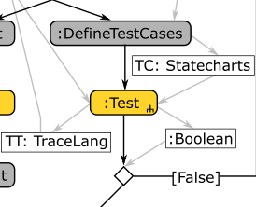
Statecharts Testing
Generator
System Under Study
Acceptor
⁶ Zeigler BP. Theory of modelling and simulation. New York: Wiley-Interscience, 1976.
⁷ Mamadou K. Traoré, Alexandre Muzy, Capturing the dual relationship between simulation models and their context,
Simulation Modelling Practice and Theory, Volume 14, Issue 2, February 2006, Pages 126-142

Slide 30
Orthogonal Components (White-Box)

Slide 31
Workflow

Slide 32
Yakindu: Testing

Slide 33
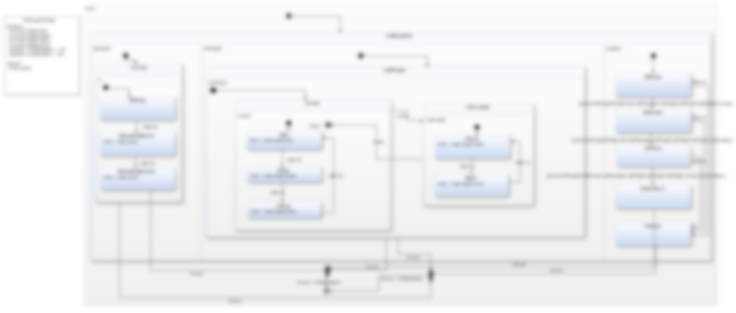
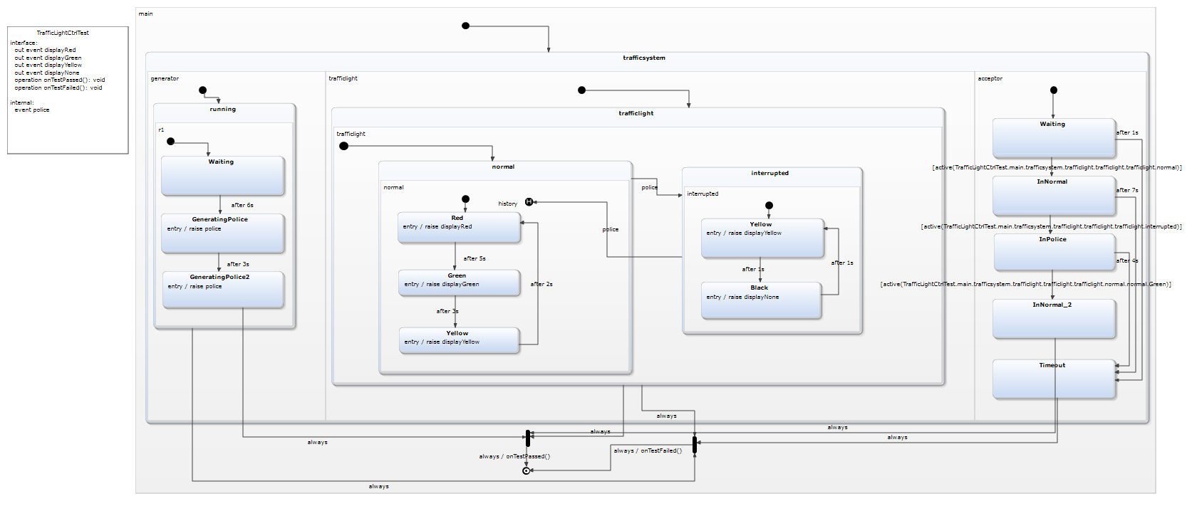
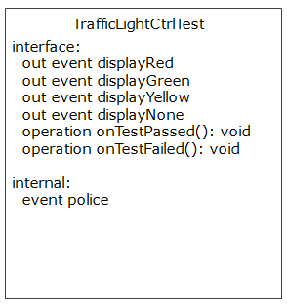
Yakindu: Testing
Interface
Callback
Synchronization

Slide 34
Yakindu: Testing

Slide 35
Workflow

Slide 36
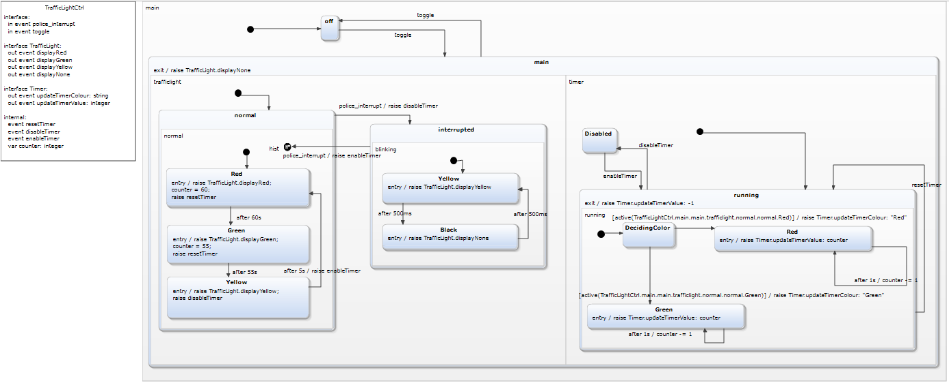
Code Generation
interrupts
events
Interface:
setRed(boolean)
setGreen(boolean)
setYellow(boolean)
setTimerValue(int)
setTimerColour(string)
Interface:
in event police_interrupt
in event toggle
out event updateTimerColour: string
out event updateTimerValue: int
out event displayRed, displayYellow, displayGreen, displayNone

Slide 37
Generated Code
Sample
Files
8 files
1311 lines of code
302 manual (UI) code
Notes:
Kan code genereren voor meerdere platformen - talen: VHDL, Java, C++, Python, ... (maar heb dan wel een neutrale Action Language nodig) - discrete-time (hardware platform), discrete-event (general purpose OS)

Slide 38
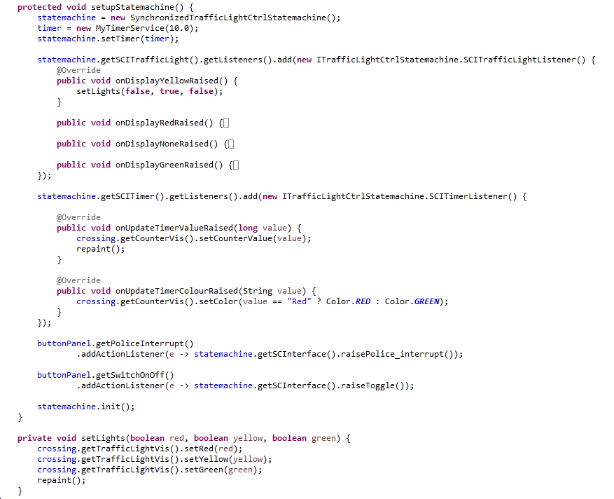
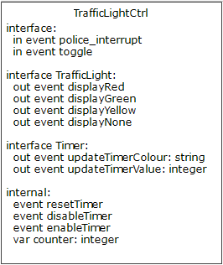
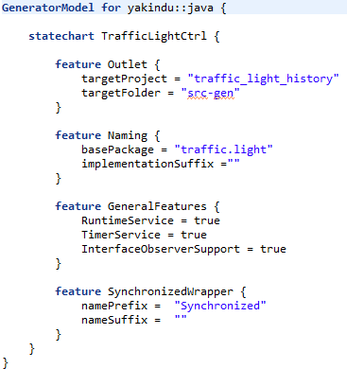
Interface
Setup Code
(Excerpt)
Generator
Runner
Notes:
Customizable Code Generator Framework
Kan code genereren voor meerdere platformen - talen: VHDL, Java, C++, Python, ... (maar heb dan wel een neutrale Action Language nodig) - discrete-time (hardware platform), discrete-event (general purpose OS)

Slide 39
Deployed Application (Scaled Real-Time)
Notes:
Add discussion on simulated time?
Slide on “how does this behave?” Deployment on resources-constrained platform?

Slide 40
Recap
Model the behaviour of complex, timed, reactive, autonomous systems
“What” instead of “How” (= implemented by Statecharts compiler)
Abstractions:
States (composite, orthogonal)
Transitions
Timeouts
Events
Tool support:
Yakindu
SCCD⁸
⁸ Simon Van Mierlo, Yentl Van Tendeloo, Bart Meyers, Joeri Exelmans, and Hans Vangheluwe. SCCD: SCXML extended with class diagrams. In 3rd Workshop on Engineering Interactive Systems with SCXML, part of EICS 2016, 2016.
Notes:
Kan code genereren voor meerdere platformen - talen: VHDL, Java, C++, Python, ... (maar heb dan wel een neutrale Action Language nodig) - discrete-time (hardware platform), discrete-event (general purpose OS)

