Slide 1
The Current State of
Agent-Based Modeling
Tim Leys

Slide 2
Purpose

Slide 3
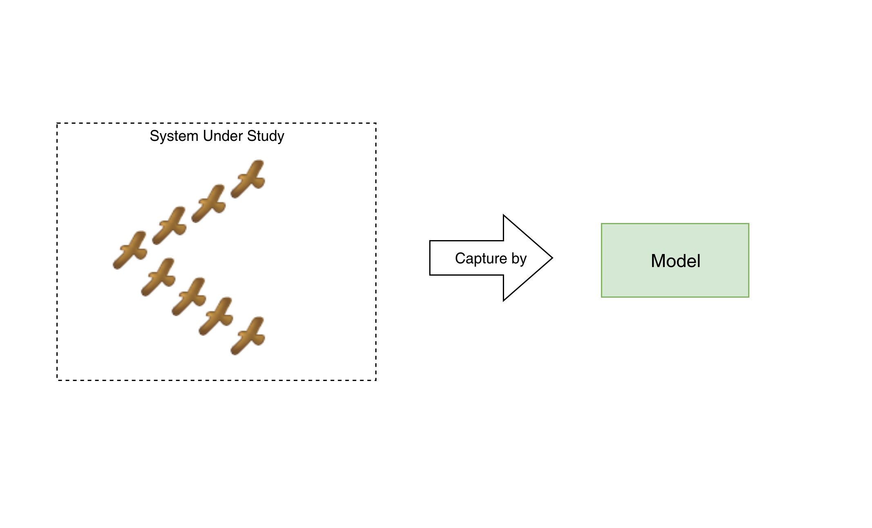
Agent-Based Modeling

Slide 4
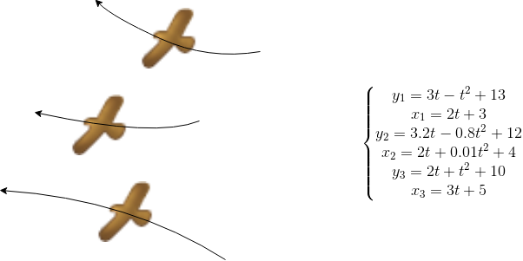
Equation Based Model

Slide 5
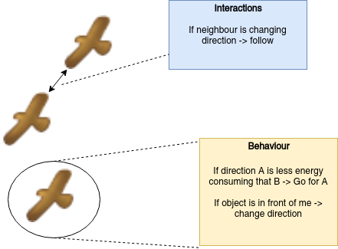
Stochastic Model

Slide 6
Agent-Based Model

Slide 7
Agent-Based Model

Slide 8
Agent-Based Modeling
Agent Based Modeling (ABM) is used in a wide variety of fields
Economics,
Biology,
Social Sciences,
Computer Science, etc.

Slide 9
Multi-Agent System
Control Unit

Slide 10
Multi-Agent System
Collaborate
Perceive Environment

Slide 11
Multi-Agent Systems
Multi-Agent Systems have numerous applications
DAI
Robotics
Distributed Systems
Security

Slide 12
Research Questions
RQ1: Is there a universally agreed upon meaning for the concepts: agent, multi-agent system, and agent-based modeling?
RQ2: Do agent-based modeling and multi-agent systems agree on the meaning of some concepts.
RQ3: How does Agent-Based modeling relate to Multi-Agent Systems?
RQ4: How well do contemporary agent-based tools reflect the paradigm?
Notes:
Why do we want to

Slide 13
Current Definitions

Slide 14
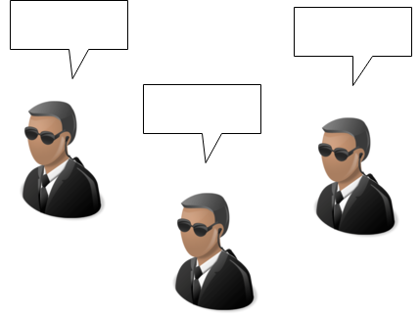
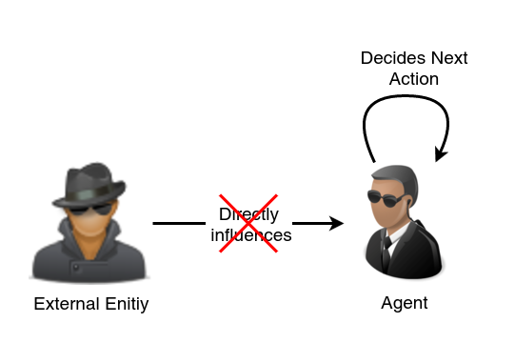
What is an Agent
Key hallmarks of agent-hood:
Autonomy
Social Ability
Responsiveness
Proactiveness
Nick Jennings and Michael Woolridge. Software agents. IEE Review,pages 1720, 1996.
Notes:
Proactiveness: opportunistic goal oriented behaviour, initiative

Slide 15
What is an Agent
A more recent survey denote following essential features:
An agent is a self-contained, modular, and uniquely identifiable individual
An agent is autonomous and self-directed
An agent has a state that varies over time
An agent is social having dynamic interactions with other agents that influence its behaviour.
Charles M Macal and Michael J North. Tutorial on agent-based modelling and simulation. Journal of simulation, 4(3):151162, 2010.

Slide 16
What is an Agent
An agent is a software or hardware entity (a process) situated in a virtual or a real environment:
Which is capable of acting in an environments
Which is driven by a set of tendencies
Which possesses resources of its own
Which has only a partial representation of this environment
Which can directly or indirectly communicate with other agents
Which may be able to reproduce itself
Whose autonomous behavior is the consequence of its perceptions, representations and interactions with the world and other agents
Fabien Michel, Jacques Ferber, and Alexis Drogoul. Multi-agent systems and simulation: A survey from the agent community’s perspective. In Multi-Agent Systems, pages 17–66. CRC Press, 2018.

Slide 17
What is an Agent
An entity which is placed in an environment and senses different parameters that are used to make a decision based on the goal of the entity. The entity performs the necessary action on the environment based on this decision.
A. Dorri, S. S. Kanhere, and R. Jurdak. Multi-agent systems: A survey. IEEE Access, 6:2857328593, 2018.

Slide 18
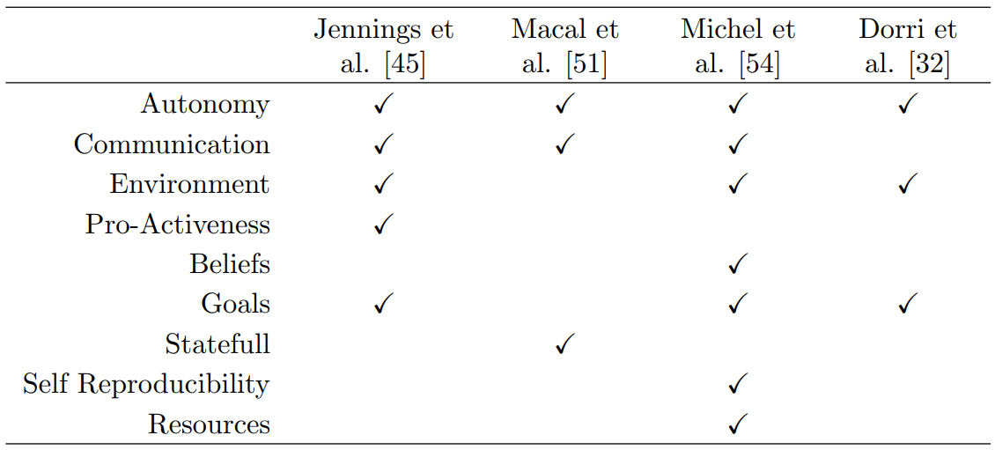
What is an Agent

Slide 19
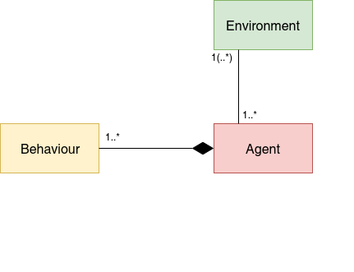
What is an Agent

Slide 20
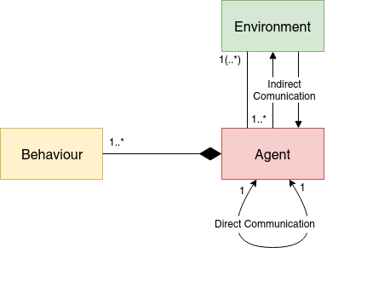
What is an Agent

Slide 21
Agent Behaviour
Reactive Agent vs. Goal Directed Agent
Reactive Agents: If-then behaviour
Goal Directed Agents: Complex proactive behaviour
Belief-Desire-Intention Model
Jose M Vidal, Paul A Buhler, and Michael N Huhns. Inside an agent. IEEE Internet Computing , 5(1):82–86, 2001.
Stuart J Russell and Peter Norvig.Artificial intelligence: a modern approach. Malaysia; Pearson Education Limited,, 2016.
Michael Georgeff et all. The belief-desire-intention model of agency. In J ̈org P. Muller, Anand S. Rao, and Munindar P. Singh, editors,Intelligent Agents V: Agents Theories, Architectures, and Languages, pages 1–10, Berlin, Heidelberg,1999. Springer Berlin Heidelberg.

Slide 22
Agent’s Environment
Agents are not completely free of external dependencies. Agents are situated in an environment that provides the conditions under which an entity (agent or object) exists.
An environment has following properties
Accessibility
Determinism
Dynamism
Continuity
James J Odell, H Van Dyke Parunak, Mitch Fleischer, and Sven Brueckner. Modeling agents and their environment. In International Workshop on Agent-Oriented Software Engineering, pages 16–31. Springer, 2002
A. Dorri, S. S. Kanhere, and R. Jurdak. Multi-agent systems: A survey.IEEE Access, 6:2857328593, 2018.

Slide 23
What is a Multi-Agent System
A multi-agent system is a loosely coupled network of problem-solving entities (agents) that work together to find answers to problems that are beyond the individual capabilities or knowledge of each entity (agent).
Peter Stone and Manuela Veloso. Multiagent systems: A survey from a machine learning perspective.Autonomous Robots, 8(3):345–383, 2000.

Slide 24
What is a Multi-Agent System
A Multi-Agent System (MAS) is an extension of the agent technology where a group of loosely connected autonomous agents act in an environment to achieve a common goal. This is done either by cooperating or competing, sharing or not sharing knowledge with each other.
Jacques Ferber and Gerhard Weiss. Multiagent systems: an introduction to distributed artificial intelligence, volume 1. Addison-Wesley Reading,1999.

Slide 25
What is a Multi-Agent System
The major characteristics of a multi-agent system are:
Each agent has just incomplete information and is restricted in its capabilities
System control is distributed
Data is decentralized
Computation is asynchronous
Gerhard Weiss.Multiagent systems: a modern approach to distributed artificial intelligence. MIT press, 1999.

Slide 26
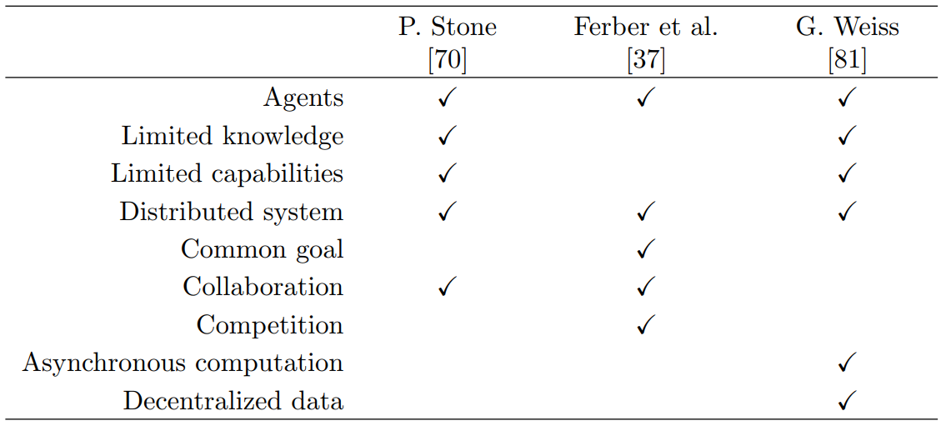
What is a Multi-Agent System

Slide 27
What is Agent-Based Modeling
An agent-based model contains:
A set of agents
A set of relations and methods of interaction
The agents’ environment
Charles M Macal and Michael J North.Tutorial on agent-based modelling and simulation.Journal of simulation, 4(3):151–162, 2010

Slide 28
What is Agent-Based Modeling
Four categories of agent-based models:
Individual ABMs
Autonomous ABMs
Interactive ABMs
Adaptive ABMs
Charles M Macal. Everything you need to know about agent-basedmodelling and simulation.Journal of Simulation, 10(2):144–156,2016

Slide 29
What is Agent-Based Modeling
Another categorization:
Flow models
Market models
Organization models
Diffusion models
Eric Bonabeau. Agent-based modeling: Methods and techniques for sim-
ulating human systems. Proceedings of the National Academy of Sciences,
99(suppl 3):7280–7287, 2002.

Slide 30
What is Agent-Based Modeling
An agent based model is a model in which:
Each individual of a system and its behaviour is modeled (bottom-up), rather than the global behaviour of the system (top-down)
Each of the entities is modeled as an agent, where the interactions between agents and actions on the environment are modeled explicitly.
The environment in which the agents are situated is modeled explicitly
Fabien Michel, Jacques Ferber, and Alexis Drogoul. Multi-agent systems and simulation: A survey from the agent community’s perspective. In Multi-Agent Systems, pages 17–66. CRC Press, 2018.

Slide 31
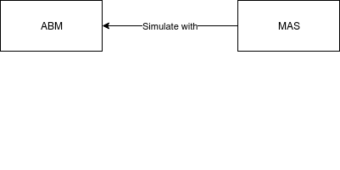
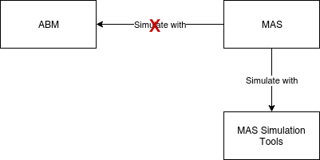
Relation ABM and MAS
MAS are complex systems → Benefit greatly from MDE
MAS has influenced ABM

Slide 32
Current Tools

Slide 33
Case Study
Parameters:
IAT range
preferred velocity range
road length
number of segments
maximum speed
observe delay

Slide 34
Tools Under Study
DEVS (Resource Centric & Entity Centric)
NetLogo
Repast
SARL
Steven F Railsback, Steven L Lytinen, and Stephen K Jackson. Agent-based simulation platforms: Review and development recommendations.Simulation, 82(9):609–623, 2006. Amount of References: 793.

Slide 35
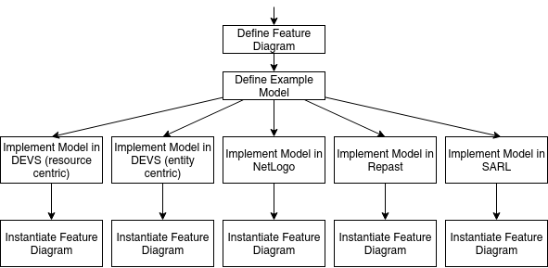
Feature Analysis: Methodology

Slide 36
Repeatability: Methodology

Slide 37
Resource Centric DEVS
In resource centric DEVS the behaviour of the resources is modeled, rather than the entities.
In the traffic model, this means that the road segments are modeled explicitly and cars are passed as passive objects.

Slide 38
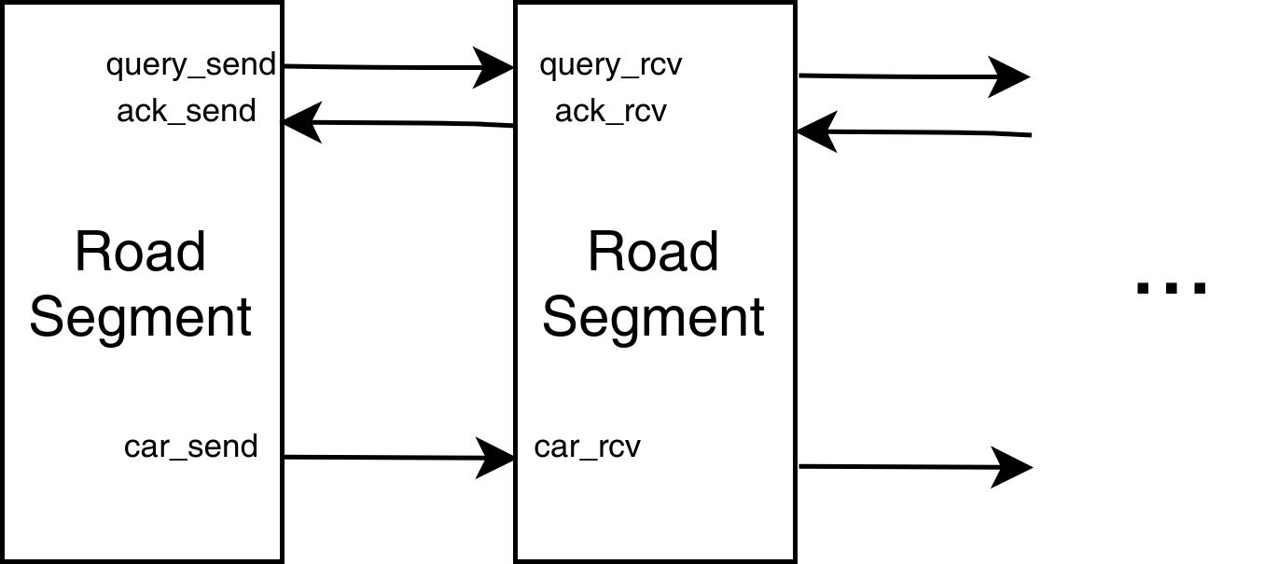
Resource Centric DEVS

Slide 39
Resource Centric DEVS: Features
No agent behaviour
No communication between agents
No static environments
No spatial environments

Slide 40
Resource Centric DEVS: Repeatability
DEVS is a deterministic formalism
Python PDEVS is a python library →Non-Determinism through parallelization or random number generator
In the scenarios, we achieved repeatability on trace level

Slide 41
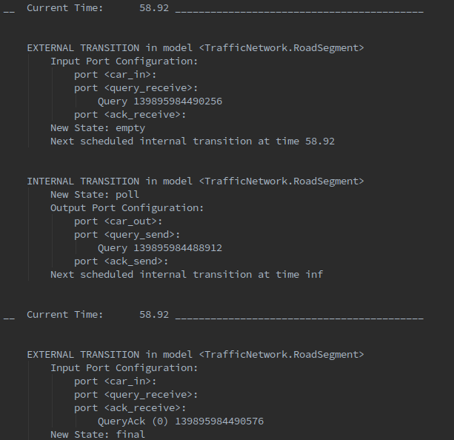
Resource Centric DEVS: Repeatability

Slide 42
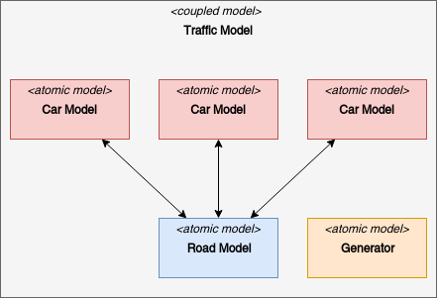
Entity Centric DEVS

Slide 43
Entity Centric DEVS: Features
Good support for reactive and proactive behaviour
Agents are autonomous
No spatial environment

Slide 44
Entity Centric DEVS: Repeatability
Similar to Resource Centric DEVS
In the scenarios, we achieved repeatability on trace level, after updating the select function

Slide 45
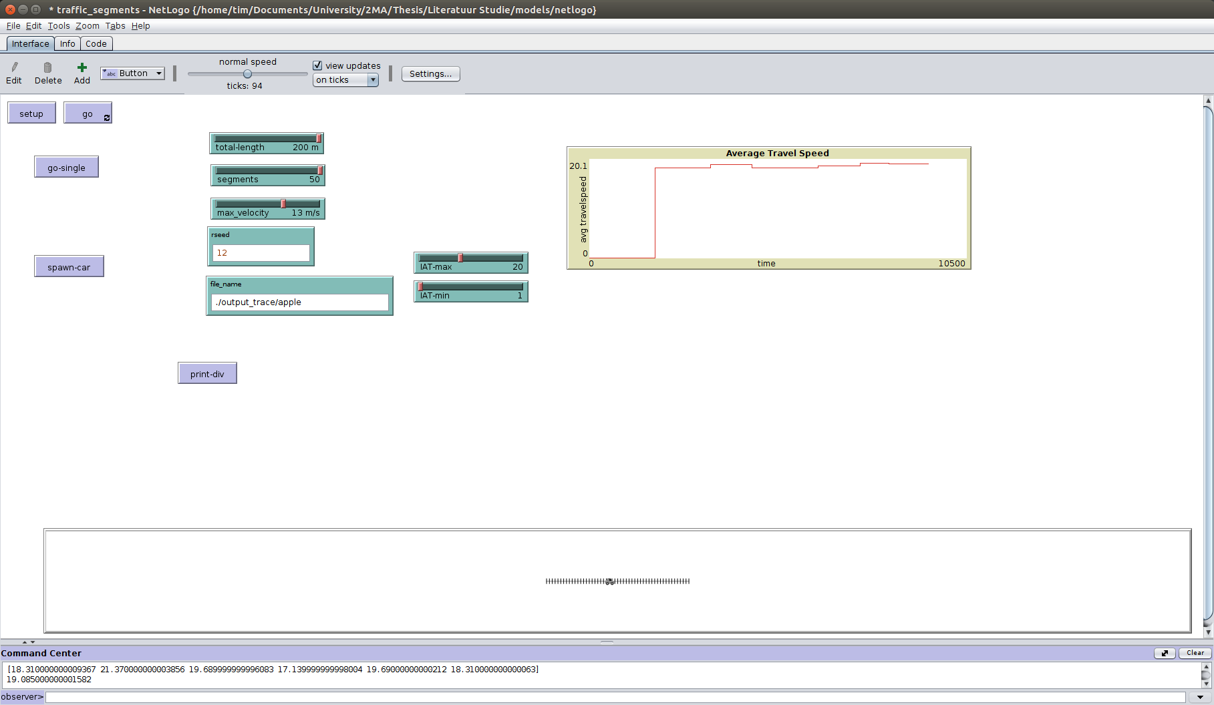
NetLogo

Slide 46
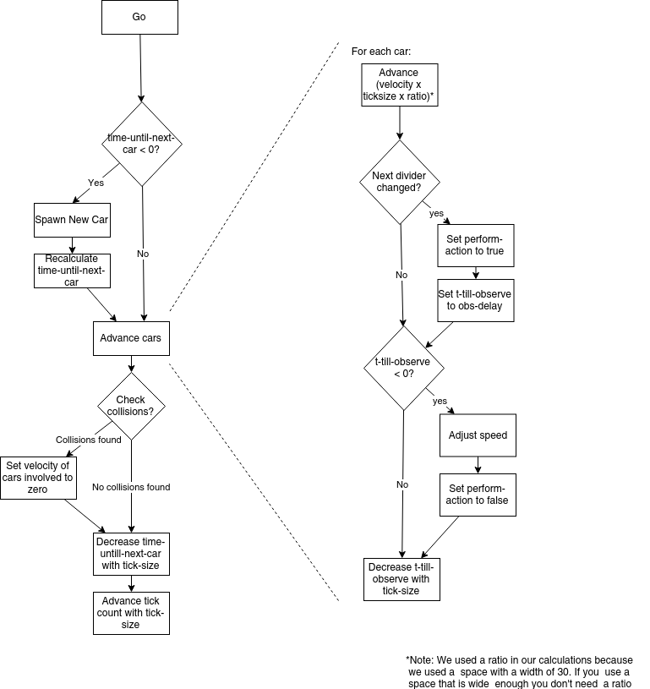

Slide 47
NetLogo: Features
Agents are controlled by a central observer
Every function is global
No scheduling
Good support for spatial environments

Slide 48
NetLogo: Repeatability
NetLogo claims to be repeatable with some exceptions:
every and wait
Different versions of NetLogo
Errors in NetLogo or Model
Scenarios were repeatable on trace level

Slide 49
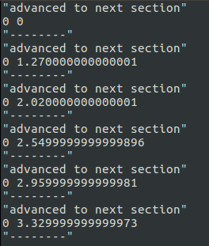
NetLogo

Slide 50
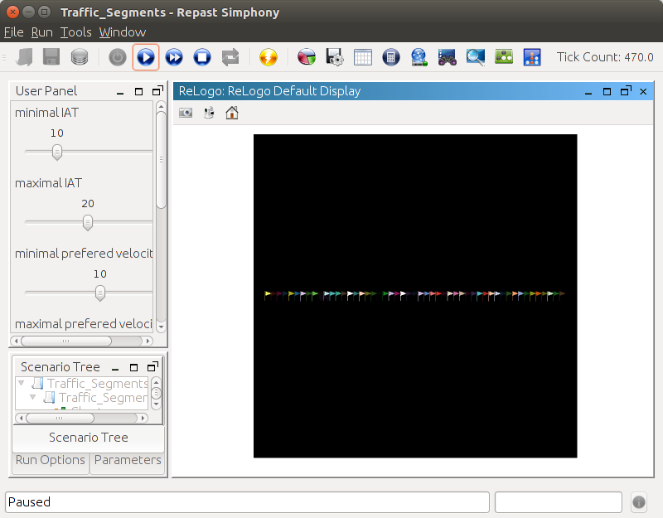
Repast

Slide 51
Observer
Car

Slide 52
Repast: Features
Agents are controlled by a central observer
Agent specific functions
No scheduling
Good support for spatial environments

Slide 53
Repast: Repeatability
Repast provides a repeatable random number generator
Repast models systems as a single process
Output traces like in NetLogo
Scenarios are repeatable on trace level

Slide 54
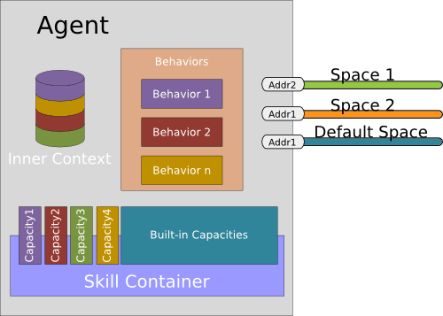
SARL
Primitives:
Events
Capacity & Skills
Agent
Behaviour
Spaces and Contexts

Slide 55
SARL

Slide 56
SARL

Slide 57
SARL: Features
Agent specific concepts are first class abstractions
Poor support for environments
No virtual clock

Slide 58
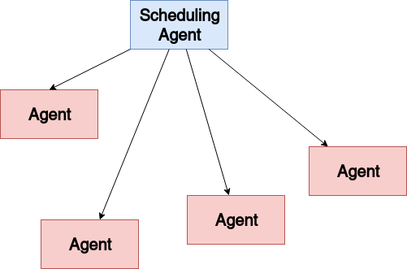
SARL for Modeling and Simulation

Slide 59
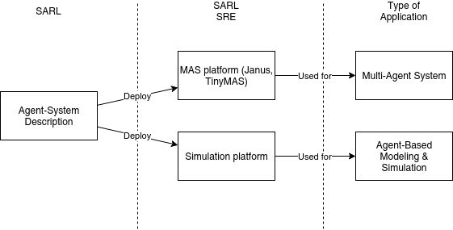
SARL for Modeling and Simulation

Slide 60
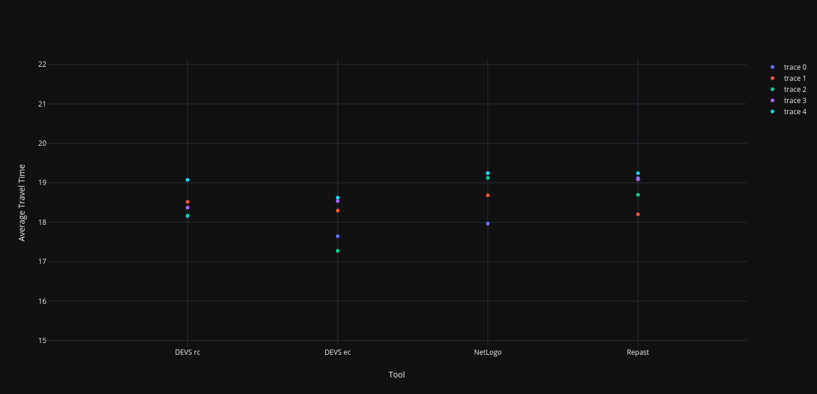
Reproducibility

Slide 61
Thesis Proposal

Slide 62
Proposal 1

Slide 63
Formal Semantics For ABM
None of the above mentioned tools or languages have formal semantics specifically for ABM
Formal semantics will improve the uniformity of agent-based models
Formally determine whether a model is ABM or not

Slide 64
Uniformal Formalism for ABM
A formalism that represents the formal semantics
Translating models in existing formalisms to the uniformal language
Formally comparing different models

Slide 65
Plan
Investigate SARL
Extract agent specific part from the GPL part
Fill in gaps (simulation, scheduling)
Investigate their semantics
Propose formal semantics
Check formal semantics with ABM tools
Re-evaluate

Slide 66
Proposal 2

Slide 67
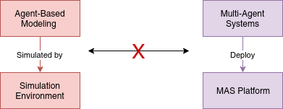
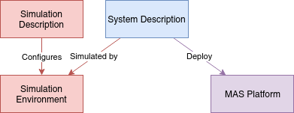
Simulation Environment for SARL

Slide 68
Starting Point
Analyze the Janus platform
Analyze SARL meta-model
Define missing parts for M&S (Scheduling, Simulated Time)
Implement a SRE that simulates the SARL program as an ABM

Slide 69
Conclusion

Slide 70
Conclusion
ABM is a divided field, however, they agree upon general concepts
ABM modeling is a paradigm on its own
CT ABM, DT ABM, and DE ABM
Refinement of SD
Many tools exist, but no formal semantics are defined

Slide 71
Thank You for Your Attention
Special thanks to:
Promotor: Prof. Dr. Hans Vangheluwe
Supervisors: Dr. Simon Van Mierlo, Dr. Romain Franceschini
Title Picture: https://www.yaleclimateconnections.org/2017/01/ climate-change-affecting-bird-migrations/

