Slide 1
Dynamic structure modelling for Causal Block Diagrams
Master Thesis by Yves Maris
Promotors: Fernando Barros, Hans Vangheluwe

Slide 2
Overview
Background: Causal Block Diagrams
  Syntax
  Semantics
Problem statement
Dynamic structure CBD
  Syntax
  Semantics
Implementation
Case study: elevator model

Slide 3
Overview
Background: Causal Block Diagrams (CBD)
  Syntax
  Semantics
Problem statement
Dynamic structure CBD
  Syntax
  Semantics
Implementation
Case study: elevator model

Slide 4
Causal Block Diagrams Abstract Syntax

Slide 5
Causal Block Diagrams Visual Syntax

Slide 6
Overview
Background: Causal Block Diagrams (CBD)
  Syntax
  Semantics
Problem statement
Dynamic structure CBD
  Syntax
  Semantics
Implementation
Case study: elevator model

Slide 7
Causal Block Diagrams semantics

Slide 8
Background: flattening
Purely syntactical
Needed for loop detection

Slide 9
Background: Evaluation Order
Dependenties beween blocks
Topological sort

Slide 10
Loop detection
Strong component algorithm
Use gausian solver for implicit solution

Slide 11
Overview
Background: Causal Block Diagrams (CBD)
  Syntax
  Semantics
Problem statement
Dynamic structure CBD
  Syntax
  Semantics
Implementation
Case study: elevator model

Slide 12
Problem Statement
Expressiveness limited by fixed structure
Changing model during simulation
Staying consistent with CBD constructs

Slide 13
Schedule
Background: Causal Block Diagrams
Problem statement
Dynamic structure CBD
  Syntax
  Semantics
Implementation
Case study: elevator model

Slide 14
Abstract Syntax

Slide 15
Visual syntax: implicit representation
Trigger received trough CBD input port
Added structures: green
Removed structures: red

Slide 16
Visual syntax: explicit representation
Reuse of existing graph transformation syntax
Left-hand side before
Right-hand side after
Trigger trough input port

Slide 17
Visual syntax: hybrid representation
Mix between implicit and explicit representation
Implicit representation separated by block
Simulated model isolated

Slide 18
Visual syntax: comparison
Implicit representation not expressive enough
Hybrid representation
  Same expressiveness as explicit representation
  More compact

Slide 19
Overview
Background: Causal Block Diagrams (CBD)
  Syntax
  Semantics
Problem statement
Dynamic structure CBD
  Visual syntax
  Semantics
Implementation
Case study: elevator model

Slide 20
Related work
Hybrid CBD
Mustafiz, Sadaf, et al. "Towards Modular Language Design Using Language Fragments: The Hybrid Systems Case Study." Information Technology: New Generations. Springer International Publishing, 2016. 785-797.
  Uses signal crossing
Dynamic structure DEVS (DSDEVS)
Barros, Fernando J. "Modeling formalisms for dynamic structure systems."ACM Transactions on Modeling and Computer Simulation (TOMACS) 7.4 (1997): 501-515.
Hetrogeneous flow systems
Barros, Fernando J. "Dynamic structure multiparadigm modeling and simulation." ACM Transactions on Modeling and Computer Simulation (TOMACS) 13.3 (2003): 259-275.
  Use of model executive

Slide 21
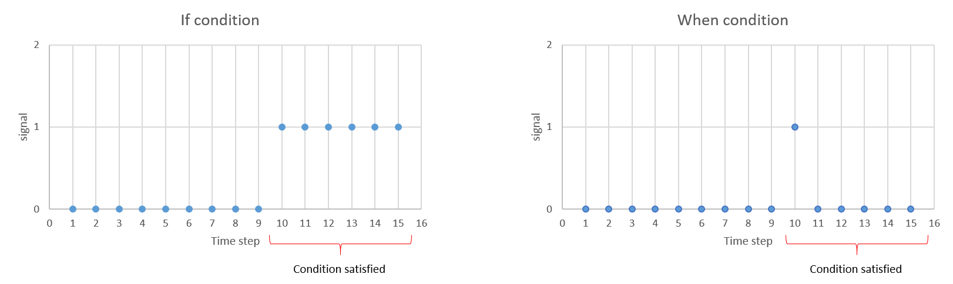
Triggering a change: zero crossing
Piecewise constant signal to “event”
Pre and post condition
Implemented using basic blocks

Slide 22
Triggering a change: zero crossing
Signal must cross zero from below
  Previous iteration: condition must be not satisfied
  Current iteration: condition must be satisfied

Slide 23
Triggering a change: timed event
Generating “event” after a fixed number of timesteps
Value determined when intialised

Slide 24
Modeling a change: structure block
Features of a dynamic structure formalism
  Identification of existing structures
  Creation of new structures
  Removal of existing structures
  Initialisation of values

Slide 25
Modeling a change: structure block
Structure block = adapted CBD specification
Structure function for modelling change
Multiple input/ no output ports
  Default 1: event that triggers a change
  Other input ports for initialisation of values
Changes apply only to one CBD! (hierarchical)

Slide 26
Modeling a change: examples

Slide 27
Modeling a change: examples

Slide 28
Adapted operational semantics

Slide 29
Overview
Background: Causal Block Diagrams (CBD)
  Syntax
  Semantics
Problem statement
Dynamic structure CBD
  Syntax
  Semantics
Implementation
Case study: elevator model

Slide 30
Implementation

Slide 31
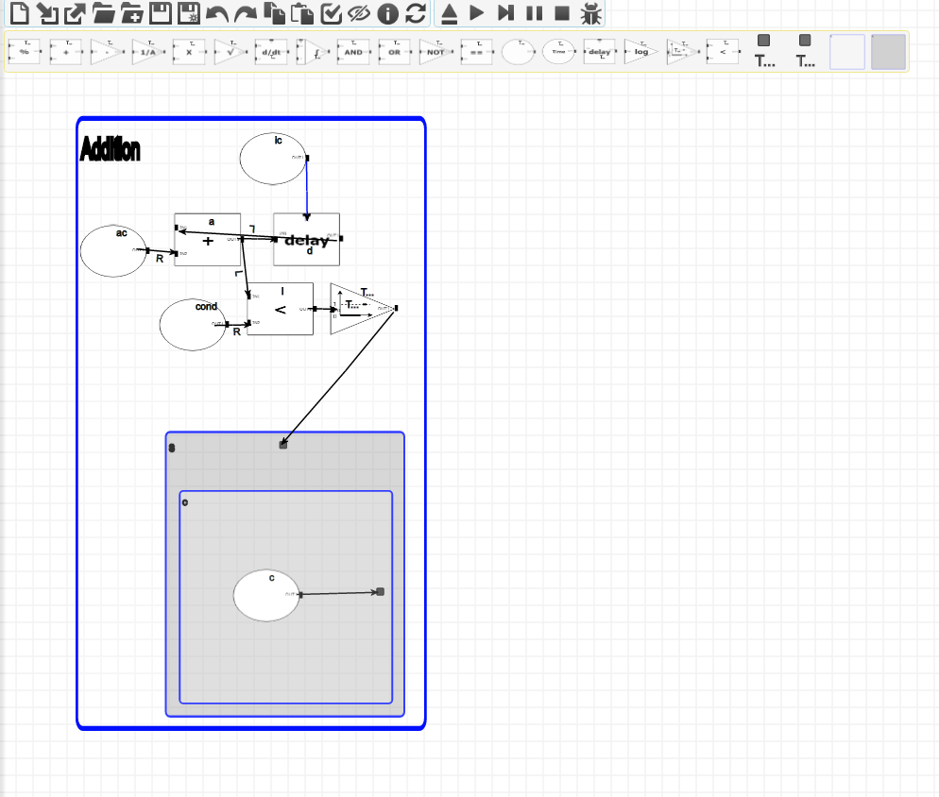
Implementation: AToMPM
Visual modeling enviroment

Slide 32
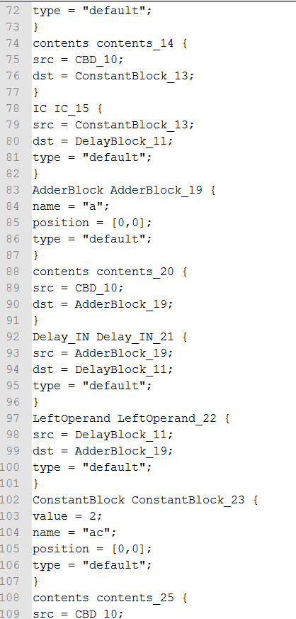
Metadepth
Exported AToMPM model using built in functionality
Supports EGL for code generation

Slide 33
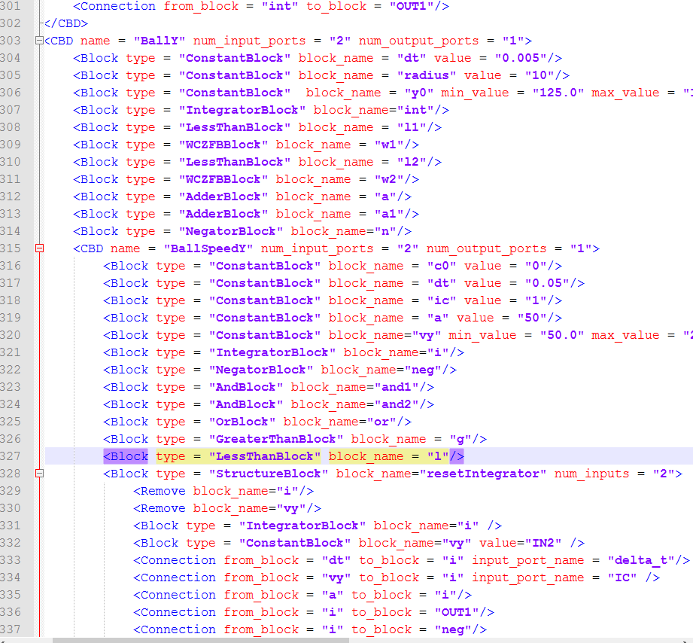
XML
Readable models
Consistent declarations
Remove tags

Slide 34
Python
Parser generates code including structure functions
Simulator implemented in python
  Extended CBD simulator from MOSIS course

Slide 35
Debugging
Test driven development
Traces

Slide 36
Overview
Background: Causal Block Diagrams (CBD)
  Syntax
  Semantics
Problem statement
Dynamic structure CBD
  Syntax
  Semantics
Implementation
Case study: elevator model

Slide 37
Case Study
Balls in elevator
Doors open when elevator reaches floor
Balls can enter and leave elevator trough door

Slide 38
Modeling a Ball

Slide 39
Position with constant velocity

Slide 40
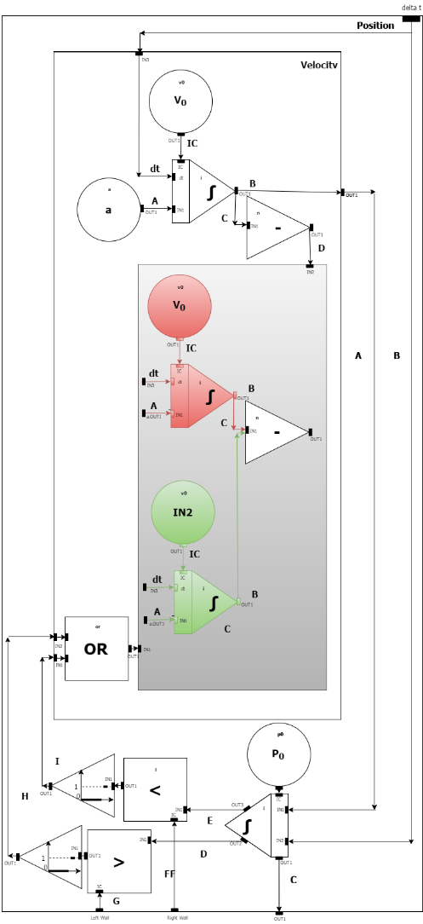
Position with constant acceleration

Slide 41
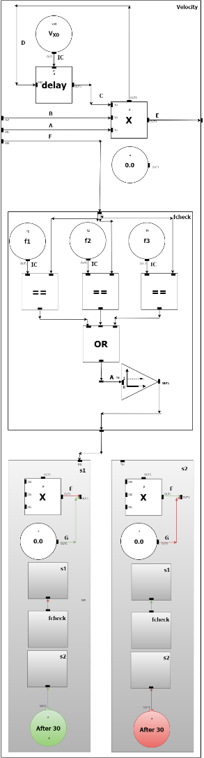
Velocity CBD for elevator wall

Slide 42
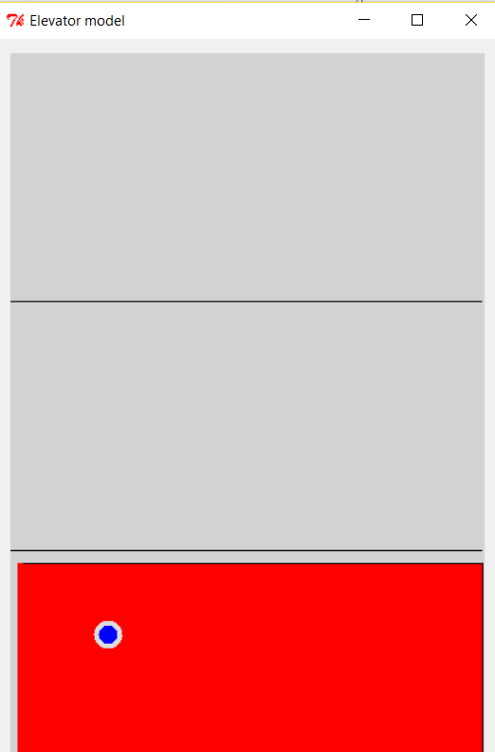
Demo

Slide 43
Future work
Advanced scheduling of structure blocks
Optimisation techniques
Comparison to other methods (hybrid systems)

Slide 44
Questions?

